Slide 1

Shaping Tomorrow’s Global
Built Environment Today
THIS IS
ASHRAE
Society Year 2024-2025
ashrae.org
August 2024
Notes:
Add tagline and HQ building

Slide 2


ASHRAE Overview
16 Regions
190+ Chapters
400+ Student Branches
Mission
To serve humanity by advancing the arts and sciences of heating, ventilation, air conditioning, refrigeration and their allied fields.
Vision
A healthy and sustainable built environment for all.
      53,000+ Members
      130+ Countries
Industry Classification
Consulting Engineers | Contractors | Manufacturers/Manufacturing Representatives
Government | Health & Education | Design Build | Architects
      200+ Standards
      and Guidelines

Slide 3
What We Do and How We Do It
33 Standing Committees
130+ Standards and
Guidelines Committees
100+ Technical Committees
300+ Publications
7 Certification Programs
200+ Educational Courses
Research
Scholarships
1.
  Serve as pipeline for providing technical information to members, chapters, companies and government officials
  Develop standards and technical guidelines to improve the built environment
  Offer continuing education for industry professionals
  Serve as networking tool for industry professionals
2.
3.
4.

Slide 4


Core Values: Setting the Foundation of ASHRAE
Commitment
ASHRAE and its members are passionate about serving the built environment, creating value and recognizing the accomplishments of others.
Integrity
ASHRAE is committed to the highest ethical standards. We work transparently, observing essential requirements for due process and peer reviews to assure our members and stakeholders that we do the right things the right way.
Excellence
ASHRAE education, technical information and all other activities and products will always reflect the best practices that lead our industry. We strive for continuous improvement and innovation in all our practices and products.
Diversity
ASHRAE is committed to providing a welcoming environment. Our culture is one of inclusiveness, acknowledging the inherent value and dignity of each individual.
Volunteerism
Members lead ASHRAE at every level, serving ASHRAE and helping ASHRAE serve society.
Collaboration
ASHRAE seeks and embraces collaborative efforts with
organizations, agencies and individuals sharing our commitment to sustainable built environments.

Slide 5
Key Policies Shaping Our Society
Value Statement
Code of Ethics
In ASHRAE meetings, we will act with honesty, fairness, courtesy, competence, inclusiveness and respect for others, which exemplify our core values of excellence, commitment, integrity, collaboration, volunteerism and diversity, and shall avoid all real or perceived conflicts of interest. Our culture is one of inclusiveness, acknowledging the inherent value and dignity of each individual. We celebrate diverse and inclusive communities, understanding that doing so fuels better, more creative and more thoughtful ideas, solutions and strategies for the Society and the communities our Society serves. We respect and welcome all.
We will act with honesty, fairness, courtesy, competence, inclusiveness and respect for others, which exemplify our core values of excellence, commitment, integrity, collaboration, volunteerism and diversity, and we shall avoid all real or perceived conflicts of interest.
ashrae.org/codeofethics
Commercialism
Harassment and Discrimination
ASHRAE’s Commercialism Policy allows for Society activities that fulfill the mission of technological advancement with adherence to business plans that generate income to offset operational expenses such as AHR Exposition, ASHRAE periodicals, website, and Society conference events such as the Welcome Party, luncheons, registration kits, and receptions.
ASHRAE strictly prohibits and does not tolerate discrimination against members or applicants for membership because of such individual’s race, color, religion, age, sex, sexual orientation, national origin, physical or mental disability, pregnancy, genetic information, veteran status, uniformed service member status, or any other category protected under applicable law.
ashrae.org/commercialism
ashrae.org/about/governance

Slide 6
ASHRAE Values Diversity.
Here is Our Commitment:
ASHRAE is committed to providing a welcoming environment. Our culture is one of inclusiveness, acknowledging the inherent value and dignity of everyone. We proactively pursue and celebrate diverse and inclusive communities understanding that doing so fuels better, more creative and more thoughtful ideas, solutions and strategies for the Society and the communities we serve. We respect and welcome all people regardless of age, gender, ethnicity, physical appearance, thought style, religion, nationality, socio-economic status, belief systems, sexual orientation or education.

Slide 7
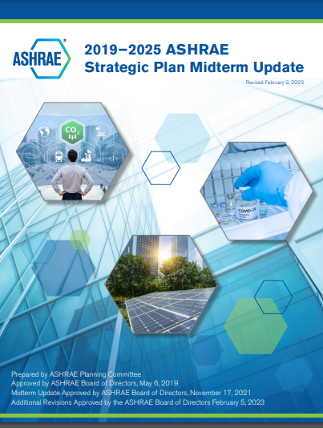





Charting Our Course
RESILIENCY AND DECARBONIZATION IN BUILDINGS
INDOOR ENVIRONMENTAL QUALITY
ORGANIZATIONAL STREAMLINING
IMPROVE CHAPTER ENGAGEMENT, CAPACITY AND SUPPORT
A new Strategic Plan will be announced in 2025
ashrae.org/strategicplan
Notes:
The 2019-2025 ASHRAE Strategic Plan Midterm Update guides the work of the Society from 2019-2025 and includes lessons learned during the COVID-19 pandemic and a focus on resiliency and decarbonization in buildings. The original Strategic Plan was developed through a process initiated by a stakeholder engagement exercise involving members of ASHRAE and key industry organizations who gave their views on ASHRAE’s position in the industry and its perceived strengths and challenges. The Plan addresses both outward-facing issues affecting the industry and society as well as inward-facing issues related to the needs of ASHRAE members and organizational efficiency.
A new Strategic Plan will be introduced in 2025.

Slide 8
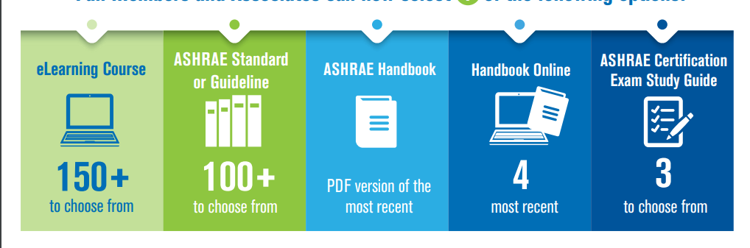

Membership
TECHNICAL RESOURCES
What are the Benefits of Membership?
Benefit Options for New & Renewing
Member & Associate Members
New Full Dues Paying Members
Automatically Get:
GroupPay
New! GroupPay allows for a single payment for all employees within an organization.
Memberships are still individual to the employee and cannot be transferred within the organization.
Primary contact at the organization will have access to an online portal to manage group.
Email to sign up GroupPay@ashrae.org
ashrae.org/membership ​
Notes:
The GroupPay program is designed to allow for an easy payment from a single invoice for all employees within an organization. Email GroupPay@ashrae.org to sign up, or for more information.

Slide 9


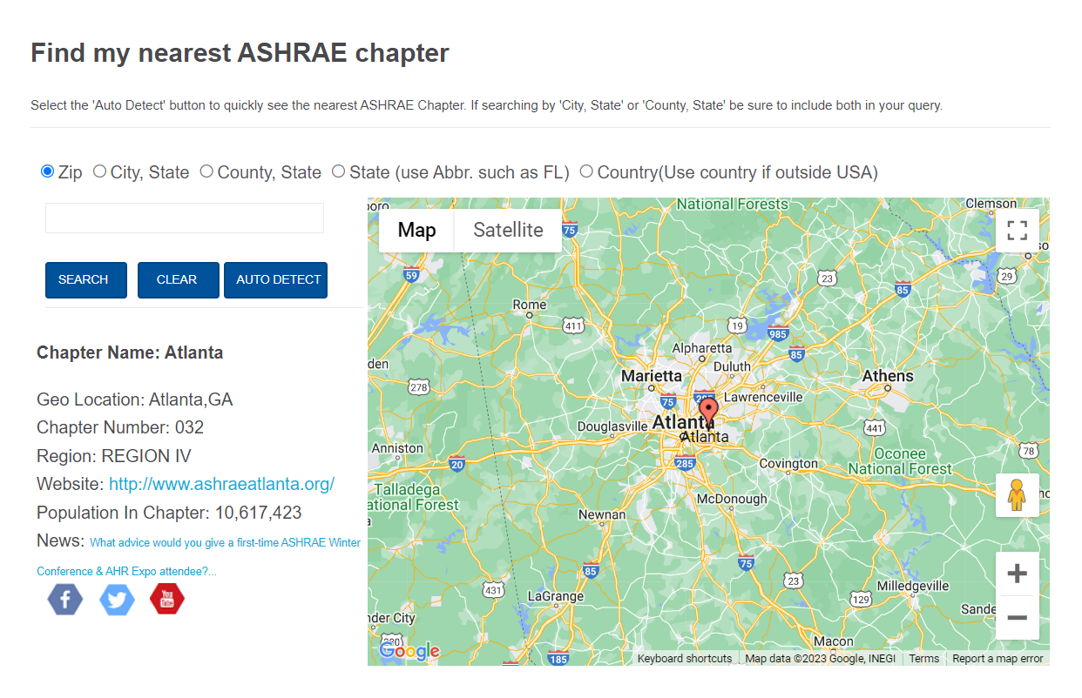
Where Can I Find My Chapter or Region?
Use the Chapters Map
ashrae.org/chapters

Slide 10

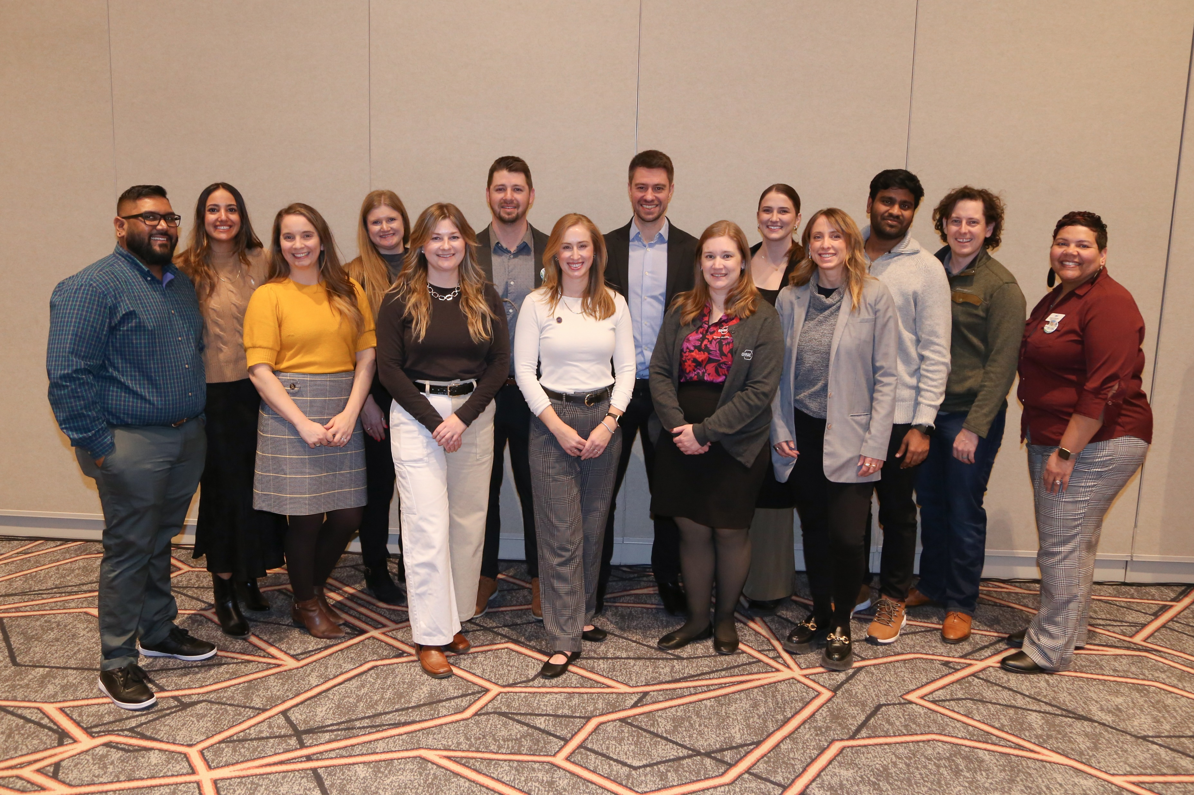
Empowering the Future
The Young Engineers in ASHRAE (YEA) committee focuses on offering relevant programs and services to young professional ASHRAE members (35 years old and younger).
ASHRAE has a robust Student Program catering to the needs of students at every age. Resources for student members include:
YEA Leadership Weekends
Leadership U
YEA Decarbonization Challenge
YEA HVAC Design Essential Scholarships
Scholarships & Grants
Awards and Competitions
Student Branches
Student Store
ASHRAE also offers resources for K-12 volunteers and educators
ashrae.org/yea
ashrae.org/students
Notes:
A primary focus of the Young Engineers in ASHRAE committee is to attract and develop members for future membership and leadership in ASHRAE and the HVAC&R industry. This is done through an exciting range of events and programming such as:
YEA Leadership Weekends – which provides an opportunity for young engineers to learn more about the Society, develop soft skills and network with other professionals.
Leadership U – where YEA members shadow ASHRAE officers during the ASHRAE Winter and Annual Conferences. LeaDRS is an ASHRAE regional program similar to the Leadership U.
YEA Decarbonization Challenge – was created to align with ASHRAE’s focus on decarbonization. It is a year-long competitive fund ($1,000-$10,000) program granted within local chapters to implement decarbonization projects.
YEA HVAC Design Essentials Scholarships – offers YEA members free registration in ASHRAE’s HVAC Design training courses.
ASHRAE offers a wide variety of programs and resources for K-12 students and educators.

Slide 11


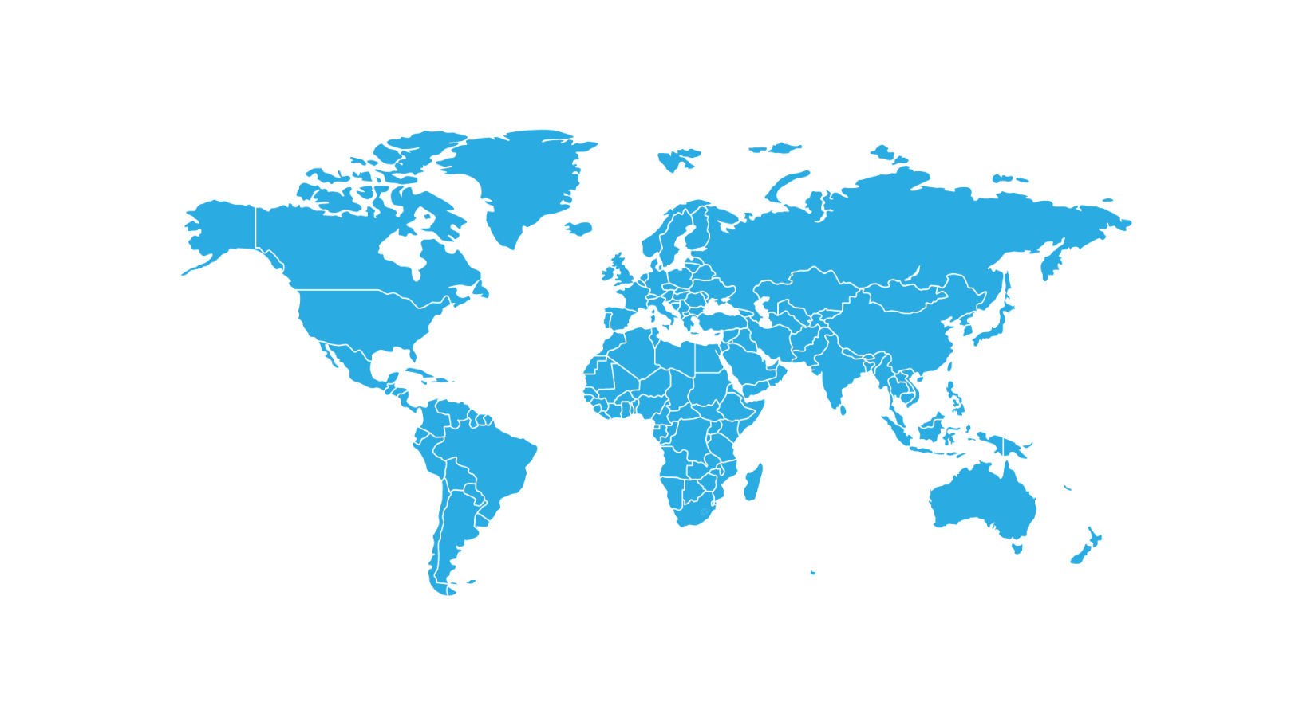








Connecting Minds at
ASHRAE Conferences
ASHRAE conferences feature peer-reviewed papers and presentations with hands-on information. Attendees earn professional development hours (PDHs), keep up-to-date on the latest technologies, and network with colleagues.
Chicago, September 26-27, 2024
Women in ASHRAE Leadership Symposium
Qatar, April 23-24, 2025
Third International Conference on Energy and Indoor Environment for Hot Climates
Beirut, Oct 3-4, 2024
The Sixth International Conference on Efficient Building Design
Phoenix, June 21-25, 2025
New York City, October 21-23, 2024
2025 ASHRAE Annual Conference
2024 ASHRAE Decarbonization Conference: Decarbonizing Existing Tall Buildings
Montreal, September 24-26, 2025
IEQ 2025 Conference
Orlando, February 8-12, 2025
2025 ASHRAE Winter Conference
ashrae.org/conferences

Slide 12
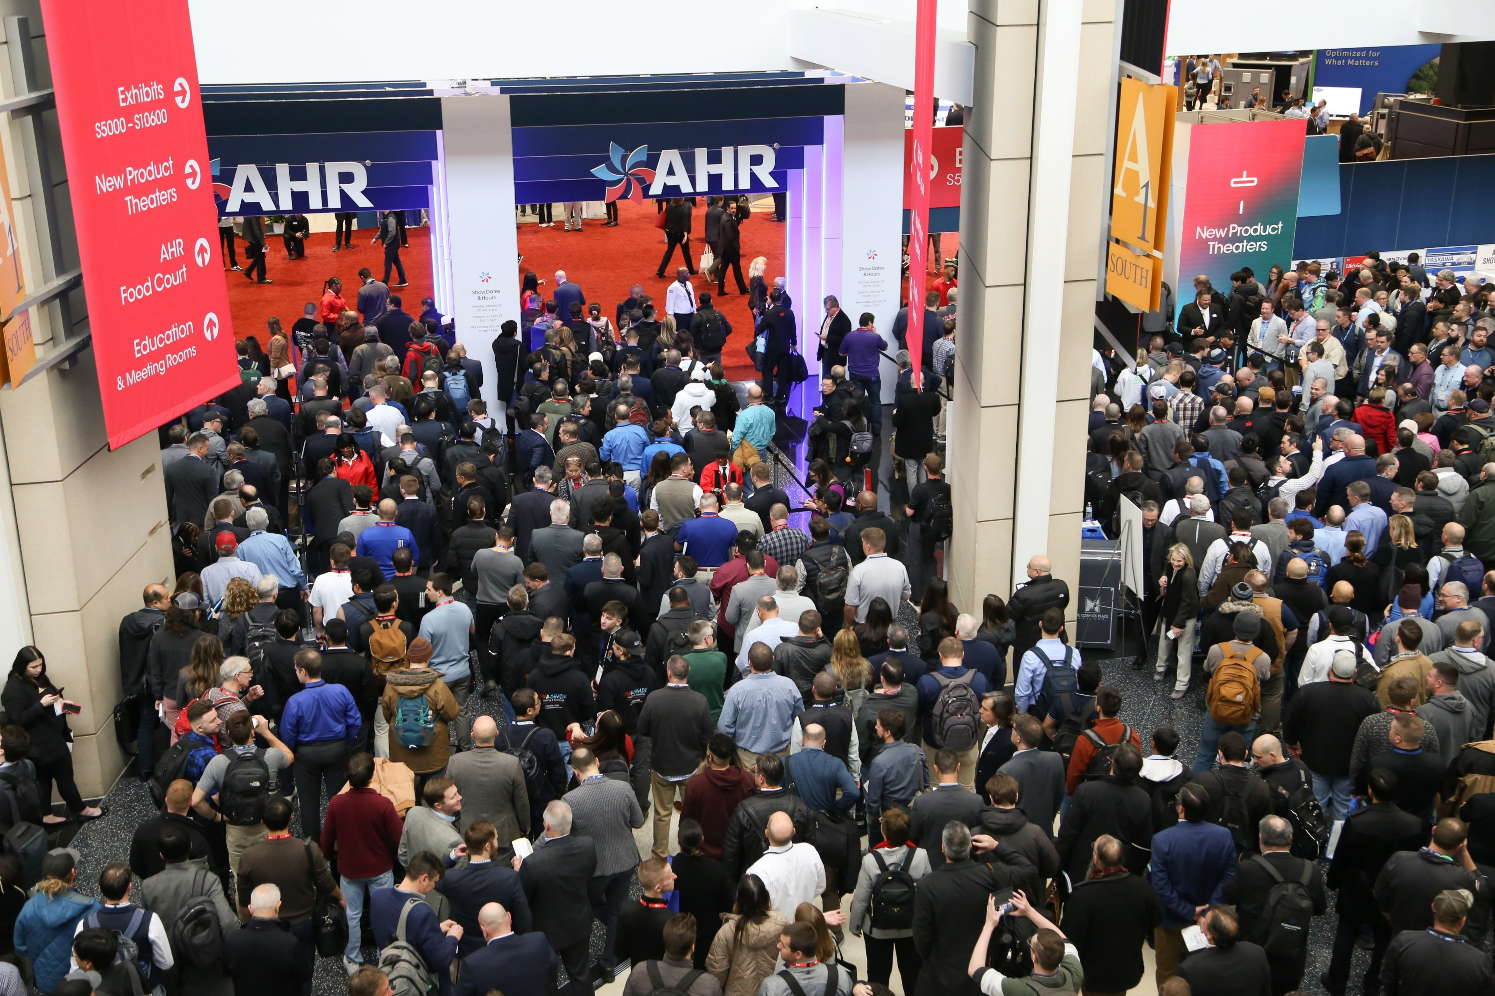



Showcasing Innovation at
Leading Industry Tradeshows
ASHRAE is a prominent advocate and participant in industry events and tradeshows. The Society’s participation of these events signifies its commitment to fostering innovation and collaboration with leading industry organizations.
AHR Expo
AHR Expo Mexico
ACREX India

Slide 13
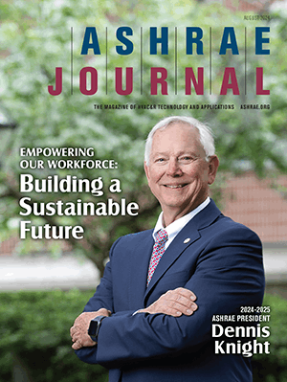


ASHRAE Journal
ASHRAE’s official monthly publication provides detailed insight on the latest HVACR technologies and applications for consulting engineers and professionals in the industry.
Articles are peer-reviewed and focus on technical topics, including green buildings, decarbonization, indoor air quality, energy management, thermal storage and alternative refrigerants.
ASHRAE Journal Podcast Discussions with leading ASHRAE experts to expand knowledge in the HVACR industry.
New! Hot Air Brief talks with ASHRAE Journal authors on HVACR content published in the Journal.
ashrae.org/ashraejournal

Slide 14

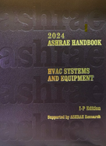
ASHRAE Handbook
ashrae.org/handbook
ASHRAE Handbook – Print Version
Continuously refined and updated, ASHRAE has published its Handbook series since 1920s
Volumes cover HVAC&R fundamentals, systems, equipment
and a wide variety of applications
Handbooks are also available in the ASHRAE Technology Portal
Available in hardback, PDF, and as an interactive handbook online.
ASHRAE Handbook Online
Mobile device responsive
Content from all four current Handbook volumes plus extra features such as videos, animations, spreadsheets and more
Easier than ever to search across all volumes, print, ask questions about technical content, access bonus features and look up new terminology
Eligible ASHRAE members can choose an ASHRAE Handbook Online subscription at a discounted rate during membership renewal

Slide 15
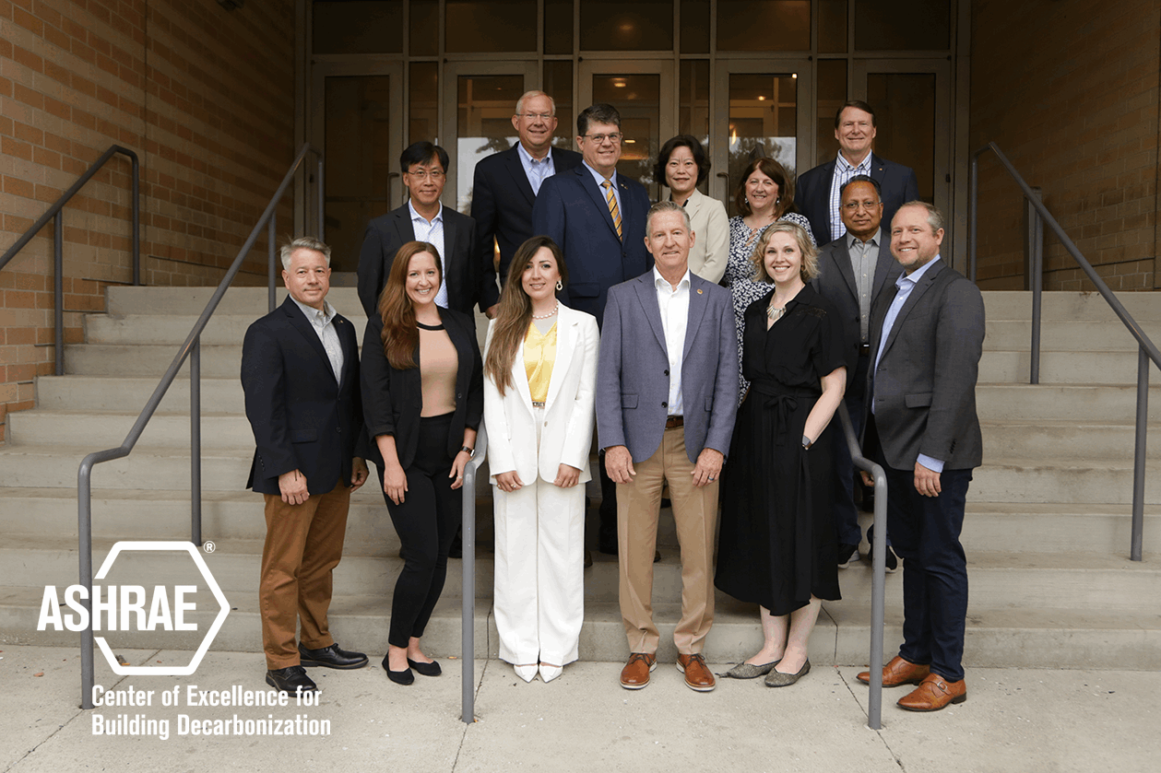
ASHRAE is Focused on Building Decarbonization
CONFERENCES
COMMUNITIES
MEMBERSHIP
Videos | Interviews | Publications | Education
Center for Excellence in Building Decarbonization (CEBD).
ashrae.org/decarb
Notes:
An initiative of ASHRAE’s Strategic Plan was to accelerate the Society’s focus on building decarbonization, driven by increasing global challenges associated with increasing building-related GHG emissions. ASHRAE made a commitment to work with building industry partners to accelerate innovation, define global best practices and develop technical guidance, standards, training and other tools to support building decarbonization while assuring high levels of indoor environmental quality, sustainability and resilience.
To further the Society’s efforts, ASHRAE formed it’s first center of excellence – the “Center for Excellence in Building Decarbonization” (CEBD). The focus of the CEBD is to provide strategic direction on the ongoing efforts of ASHRAE to provide resources for decarbonizing the built environment, on a permanent basis.
ASHRAE’s building decarbonization webpage features resources, including technical guides, video, position documents, related events schedule and media features.

Slide 16
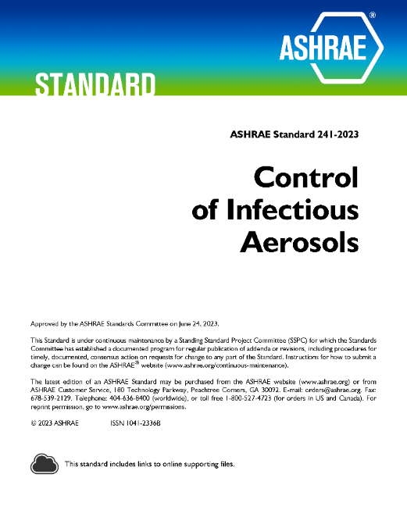
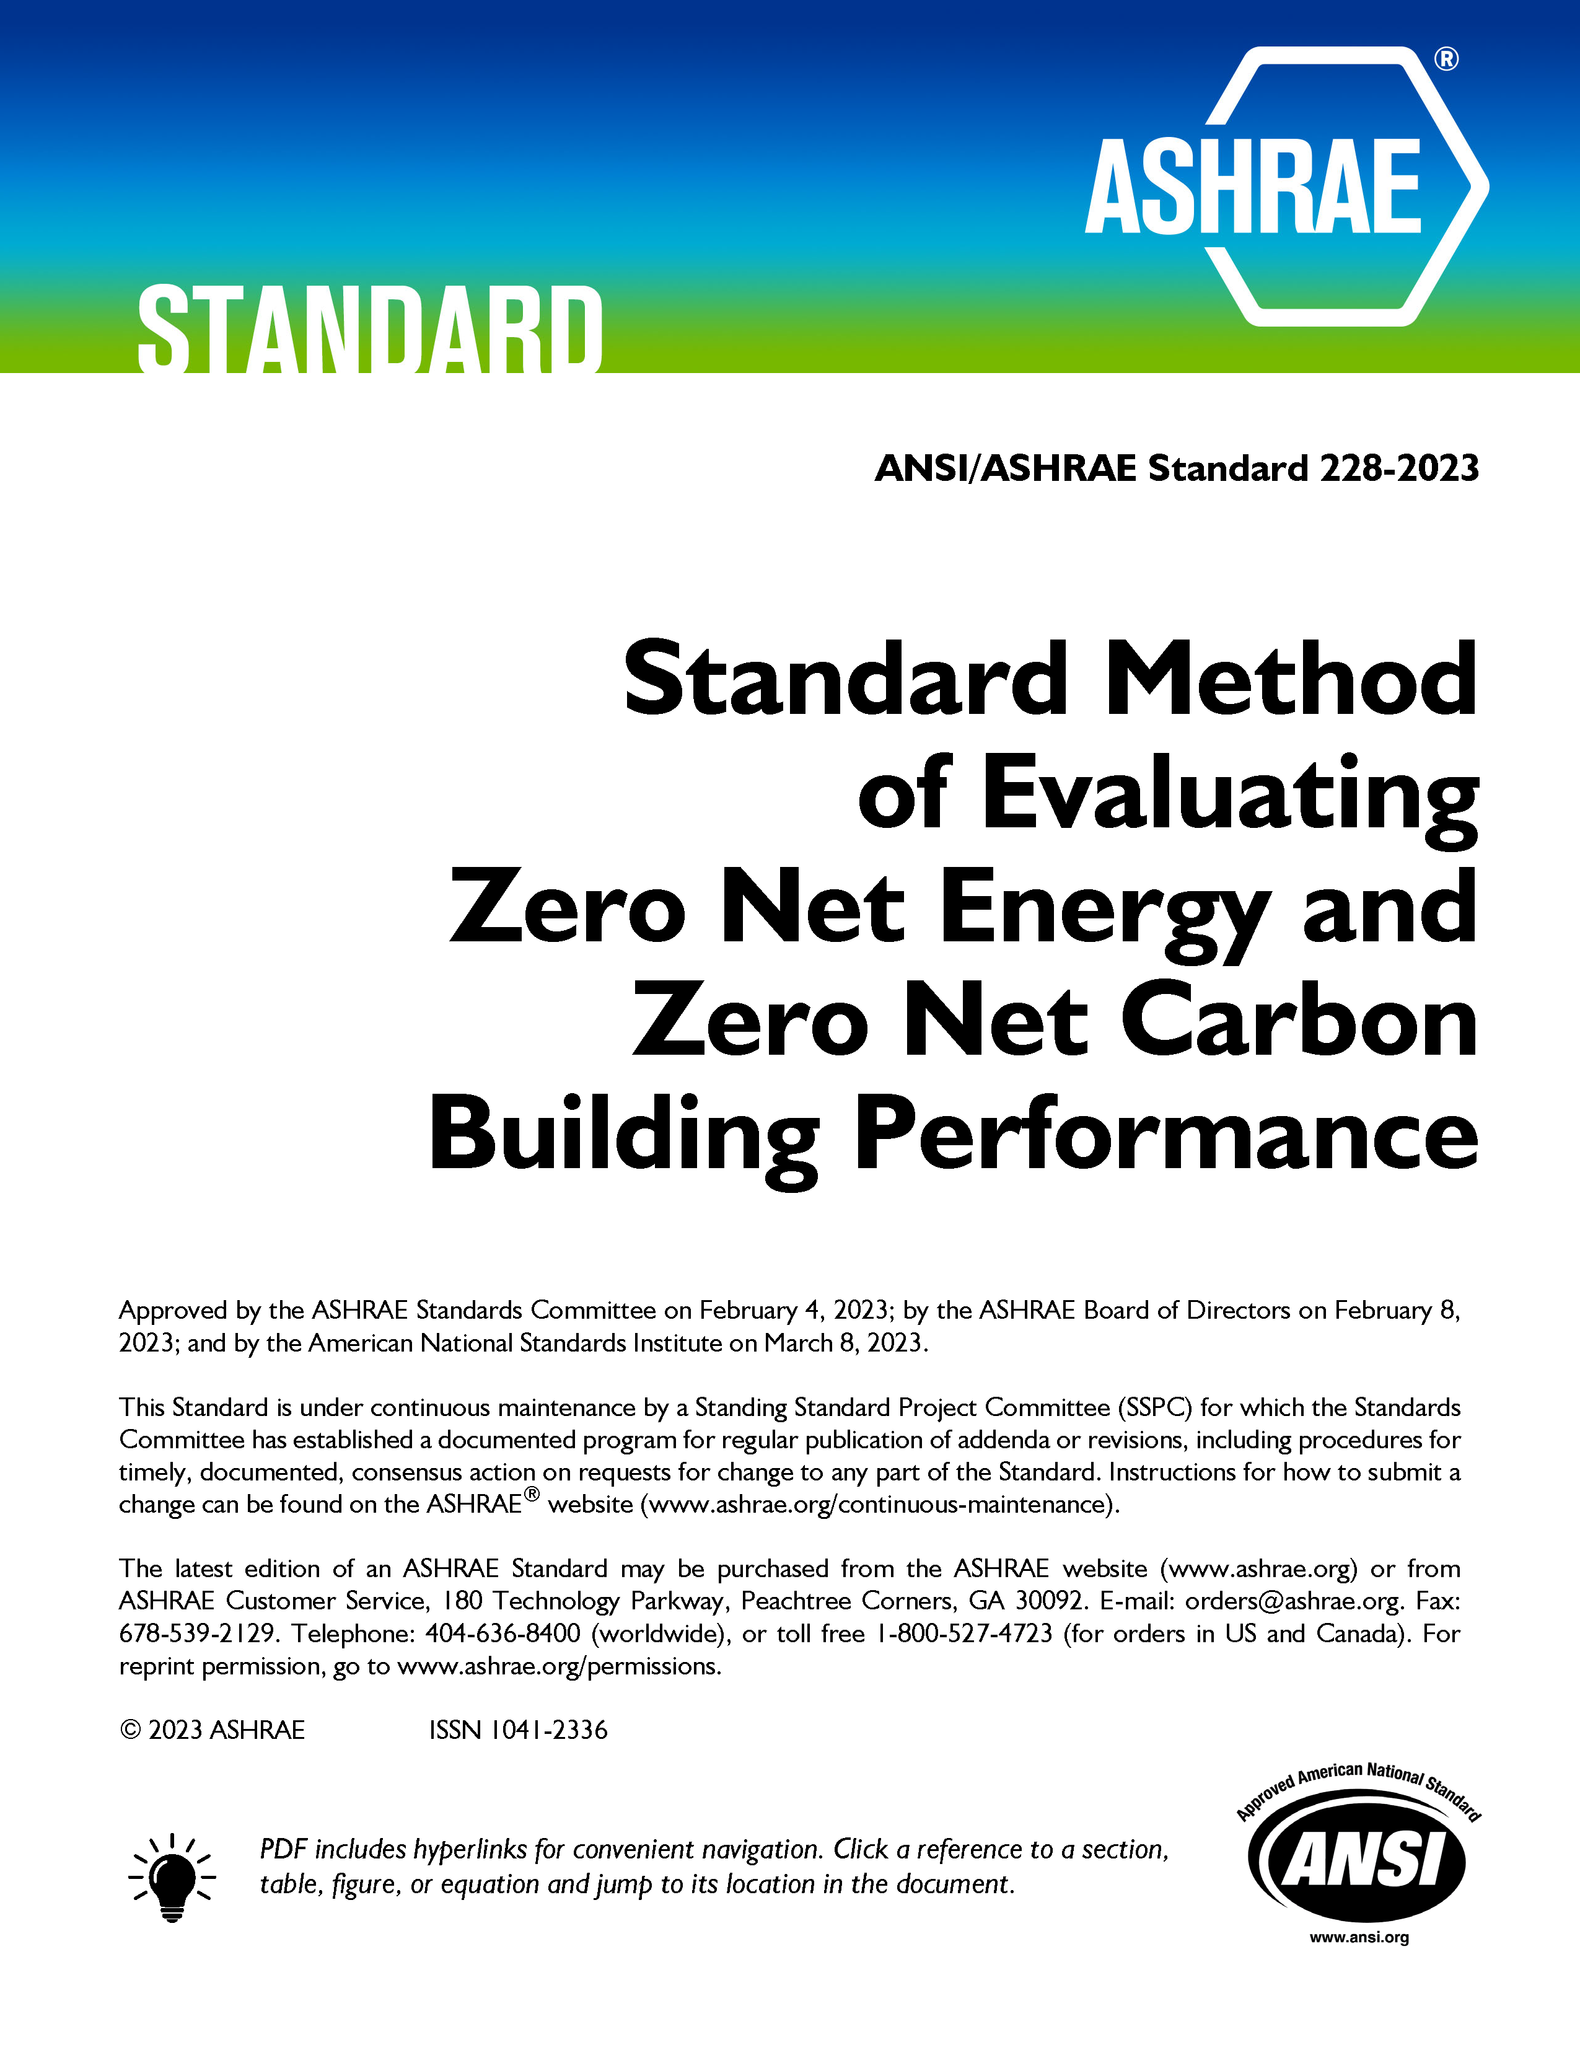
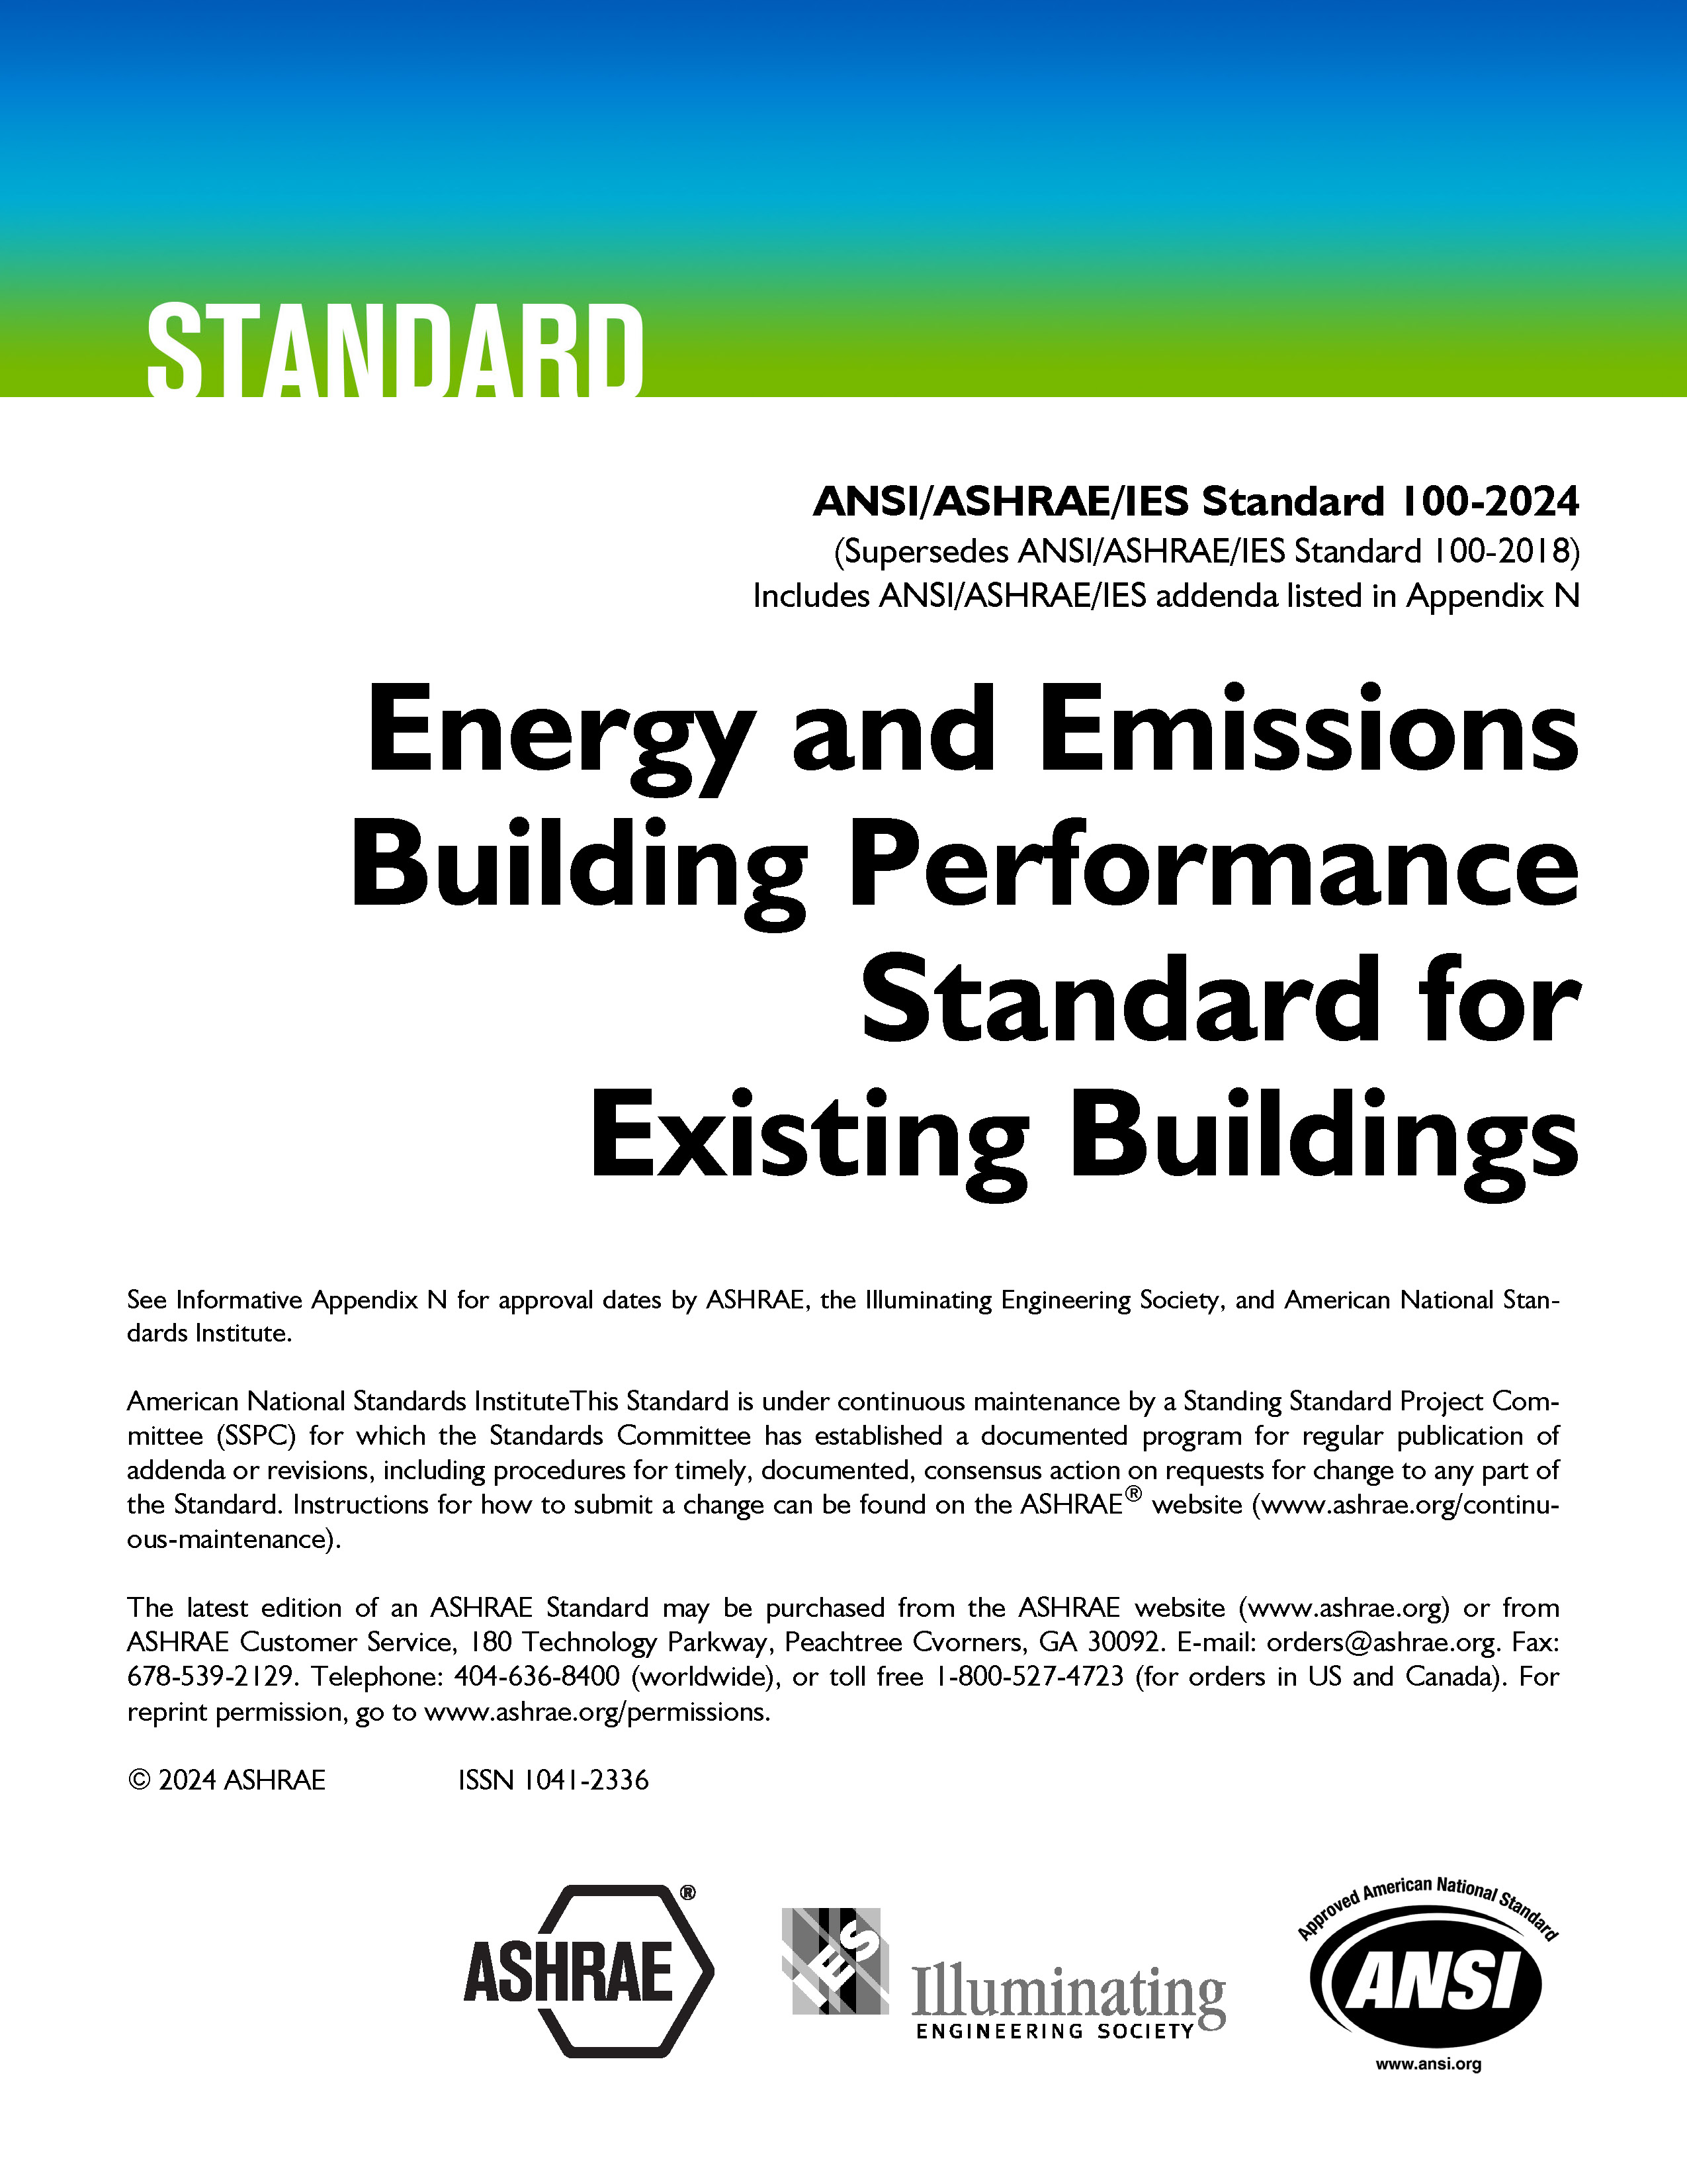
Well-Recognized Standards
ashrae.org/bookstore
PROFESSIONAL DEVELOPMENT
MEMBERSHIP
ASHRAE Standard 15, Safety Standard for Refrigeration Systems and Designation and Classification of Refrigerants
ASHRAE Standard 90.1, Energy Standard for Sites and Buildings Except Low-Rise Residential Buildings
ASHRAE Standard 62.2, Ventilation and Acceptable Indoor Air Quality in Residential Buildings
ASHRAE Standard 34, Designation and Safety Classification of Refrigerants
ASHRAE Standard 55, Thermal Environmental Conditions for Human Occupancy
ASHRAE Standard 62.1, Ventilation for Acceptable Indoor Air Quality
ASHRAE Standard 188, Legionellosis: Risk Management for Building Water Systems
2021 International Green Construction Code (IgCC): Powered by ASHRAE/ICC/USGBC/IES Standard 189.1-2021
ASHRAE Standard 241, Control of Infectious Aerosols
Now Available in Spanish
First of Its Kind
Newly Updated for 2024
Notes:
Standard 241: establishes minimum requirements aimed at reducing the risk of disease transmission through exposure to infectious aerosols in new buildings, existing buildings, and major renovations. Now available in Spanish!
Standard 228: sets requirements for evaluating whether a building or group of buildings meets a definition of “zero net energy” or a definition of “zero net carbon” during building operation.
New 2024 Update of Standard 100: This essential ASHRAE resource offers over 100 typical energy efficiency measures (EEMs) that can be applied to enable buildings to meet set energy targets, identifying commonly applied elements that can improve building performance.

Slide 17
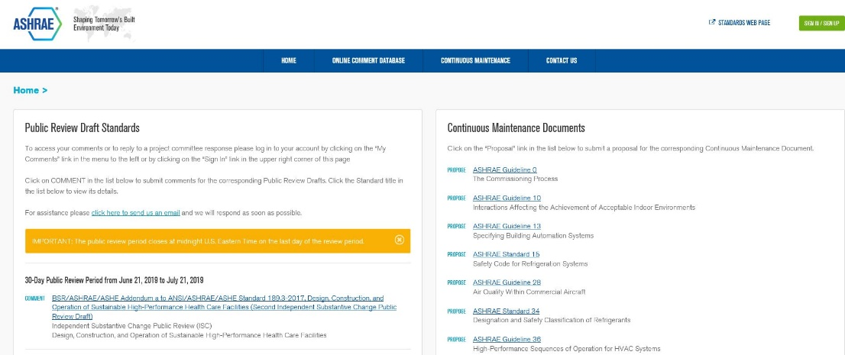
What is the Online Standards
Review Database?
The Online Standards Review Database allows
access to public review drafts for standards, guidelines and addenda and to submit comments.
The system offers a dashboard which highlights items that require attention, provides quick links to individual and committee comments, continuous maintenance proposals and outstanding ballot results.
Developing standards since 1922
130+ active standard or guideline projects
Standards are reviewed and republished to ensure they are up-to-date, e.g., existing code-intended standards are on a three-year review cycle
ashrae.org/publicreviews
ashrae.org/standards
Notes:
All standards go through public review and comment.
Existing standards are reviewed every three years.
Standards that are on continuous maintenance are republished with new addenda every three years.
Code utilized standards are republished every three years

Slide 18
Consider Participating in an ASHRAE Technical Committee
What do Technical Committees do?
Prepare the text of ASHRAE Handbook chapters
originate, coordinate, and supervise Society-sponsored research projects
present programs at ASHRAE meetings
review technical papers
evaluate the need for standards
Advise the Society on all aspects of the technology it embraces
Technical Committee Sections:
Section 1.0 - Fundamentals and General
Section 2.0 - Environmental Quality
Section 3.0 - Materials and Processes
Section 4.0 - Load Calculations and Energy Requirements
Section 5.0 - Ventilation and Air Distribution
Section 6.0 - Heating Equipment, Heating and Cooling Systems and Applications
Section 7.0 - Building Performance
Section 8.0 - Air-Conditioning and Refrigeration System Components
Section 9.0 - Building Applications
Section 10.0 - Refrigeration Systems
Network, give back and learn. ashrae.org/tcs
Notes:
ASHRAE Technical Committees consist of people who have a recognized proficiency in a specific field of interest. Participation in ASHRAE activities is an excellent way to advance your career – technically, personally, and from a business perspective. If you are involved in the HVAC&R field, or a closely related field, ASHRAE is the go-to organization for professional advancement.
Help ASHRAE shape the industry, advance research, and disseminate critical information.

Slide 19
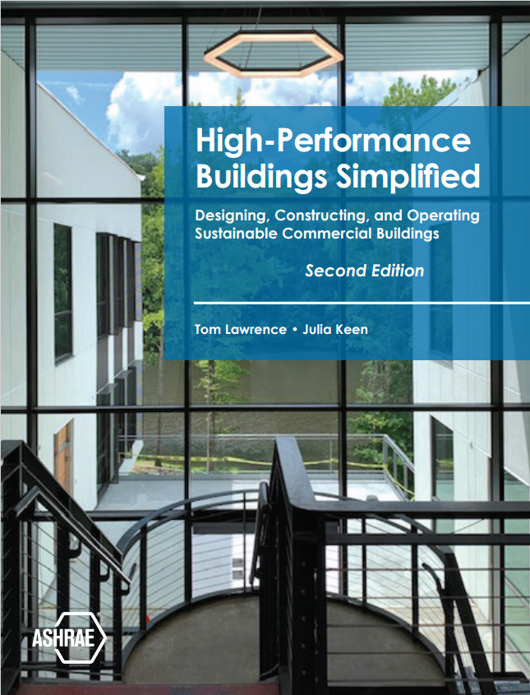
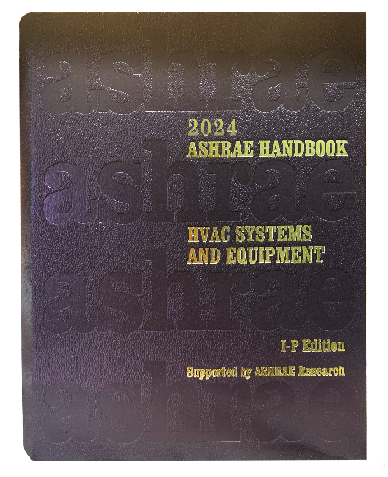


Find Thousands of Publications in the Bookstore
PROFESSIONAL DEVELOPMENT
CONFERENCES
MEMBERSHIP
Get the Latest and Greatest ASHRAE Publications
ashrae.org/bookstore
Notes:
The ASHRAE Bookstore is your go-to resource for industry-leading publications on HVAC&R, building design, energy efficiency and sustainability. Offering a wide range of technical standards, guidelines and educational materials, the bookstore supports professionals at every stage of their careers. Whether you're looking for the latest ASHRAE Standards, comprehensive handbooks or practical guides, the ASHRAE Bookstore has the tools you need to excel in the built environment industry.
Here are some of the latest titles.
Lucy Goes Green
In the second ASHRAE children’s book, Lucy goes with her classmates on a field trip to a sustainable farm, where they learn about using solar panels and windmills and conserving water through rainwater collection.
Commercial Kitchen Ventilation
One of the primary goals of this book is to share with the HVAC and food service industry the cumulation of decades of CKV research and design experience that has transformed the design and operation of CKV systems from rules of thumb into fact-based standards and best practices that are based on scientific research and practical experience.

Slide 20
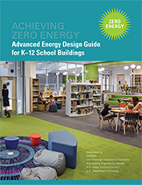
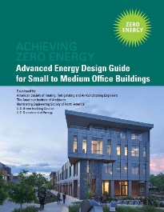


Blueprints for Energy Efficient Building Design
Advanced Energy Design Guides are published in coordination with partners to promote building efficiency.
Building-specific guidance that addresses various project aspects with multiple strategies that move the building design incrementally toward the zero-energy goal.
Zero energy goals and strategies will also move buildings towards decarbonization.
Advanced Energy Design Guide for K-12 School Buildings – Achieving Zero Energy
Applicable to all sizes and types of K-12 school construction.
Advanced Energy Design Guide for Small to Medium Office Buildings – Achieving Zero Energy
Applicable to office buildings 10,000 to 100,000 ft² with a building height of less than 75 feet.
Advanced Energy Design Guide for Multifamily Residential Buildings – Achieving Zero Energy
Applicable to construction of new multifamily buildings covered by ANSI/ASHRAE/IES Standard 90.1
ashrae.org/freeaedg
Notes:
The ASHRAE Advanced Energy Design Guides (AEDGs) are a series of publications that provide practical recommendations for achieving significant energy savings in various types of buildings. Developed in collaboration with industry experts, these guides offer strategies that are both cost-effective and easy to implement, with the goal of helping design teams create buildings that use 50% or 30% less energy than typical buildings. The AEDGs cover a wide range of building types and climates, making them valuable resources for architects, engineers and other professionals committed to sustainable design and energy efficiency.

Slide 21
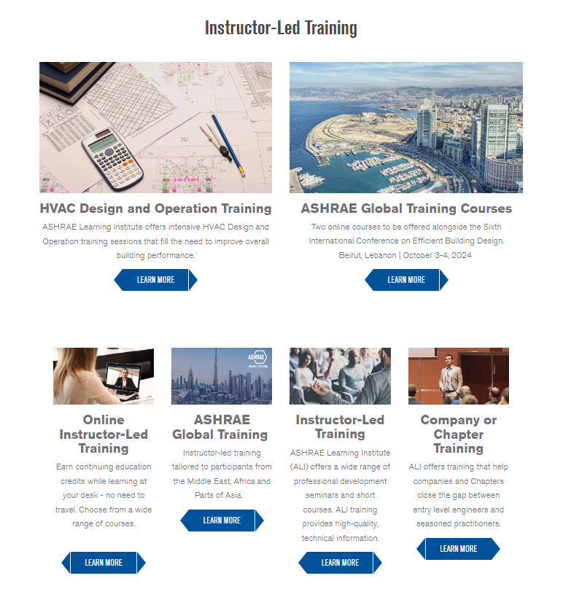
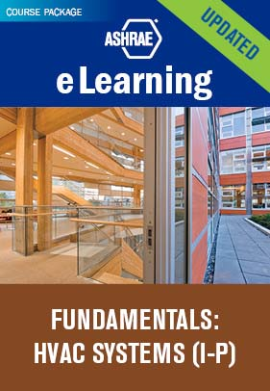


ABOUT
Stay Ahead of the Curve With
ASHRAE Professional Development
Sign up for the latest offerings
MEMBERSHIP
ashrae.org/education
ASHRAE offers a wide range of professional development opportunities to ensure that professional remain at the forefront of industry advancements and best practices.
In-person and group training for companies and Chapters is available.
eLearning
ASHRAE Learning Institute
Certification
Over 90 eLearning courses available
7 Certifications
New CDP Certification ​
Notes:
ASHRAE's Professional Development programs provide industry-leading opportunities to enhance your career in HVAC&R and building sciences. Offering a variety of resources—including eLearning courses, certifications and hands-on instructor-led training—ASHRAE helps professionals stay ahead of the curve in technological advancements and industry best practices. Whether you aim to sharpen your technical expertise, develop leadership skills, or stay current with the latest standards, ASHRAE's comprehensive professional development offerings are designed to empower you to achieve your career goals and make a meaningful impact on the built environment.

Slide 22
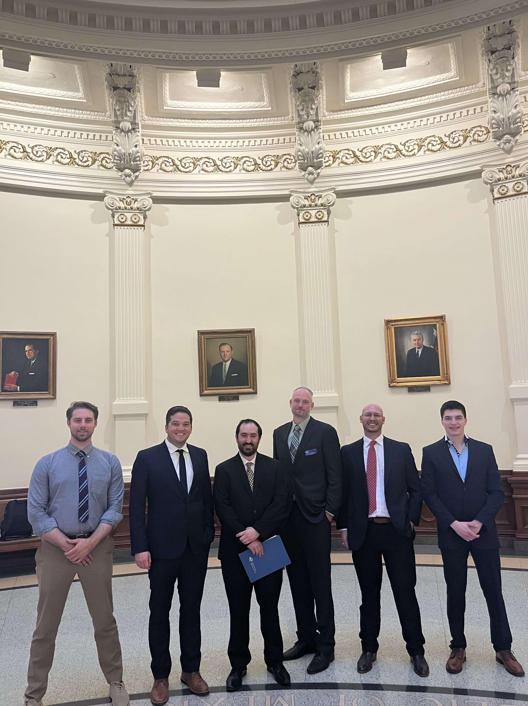
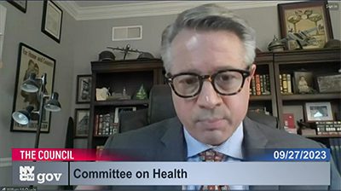
Shaping Policy with
ASHRAE Government Affairs
The mission of ASHRAE’s Government Affairs office is to establish ASHRAE as a leading source for expertise in the built environment and a resource for policy-makers in the development of legislation and regulations affecting the public, the HVAC&R community, and the engineering profession.
Stay Informed with our bi-weekly Government Affairs Update.
Sign up online ashrae.org/newsletters or email GovAffairs@ashrae.org
South America
Government Outreach Events connect ASHRAE volunteers with elected officials, government agencies, and aligned organizations.
ASHRAE’s Public Policy Priorities:
  Support Sustainable Building Practices including Building Decarbonization to
  Mitigate Climate Change
  Promote Healthy Buildings and Reduce Indoor Environmental Risks
  Advance Design and Construction of Resilient Buildings and Communities
  Ensure the Orderly and Safe Phasedown of High-GWP HFC Refrigerants
  Support Adoption of the Latest Edition of ASHRAE’s Energy Standards into Building Codes
  Strengthen and Increase Diversity in the HVACR Workforce
Canada
Canada
United States
South America
ashrae.org/government-affairs

Slide 23
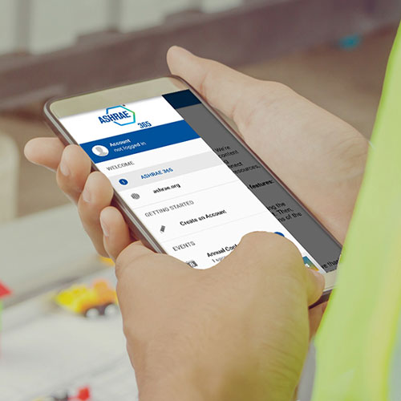

Stay Current with the ASHRAE 365 App
ASHRAE 365 is a free app providing year-round
updates on all things ASHRAE. Download in your app store.
Learn more at ashrae.org/365.
Notes:
Events
ASHRAE Conferences, Chapters Regional Conferences, Topical Conferences, Events Calendars, and Virtual Conferences as well as access exclusive technical content from ASHRAE Tech Hour.
Connect
Notifications and news pertinent to the Society and quick access to all of ASHRAE’s social media. Ability to direct message with fellow conference attendees.
Membership & Support
Chapter details, Distinguished Lecturers program resources, information on how to support the Society through donations or volunteering, and how to get in touch.
Resources section with access to ASHRAE volunteer resources, Standards and Guidelines information, continuing education courses as well as search features for industry jobs and materials to help you engage others with ASHRAE.

Slide 24

You Can Help Support ASHRAE’s Mission
ASHRAE Development supports
Technical Research
Programs for Young Engineers in ASHRAE (YEA)
Courses for ASHRAE Learning Institute (ALI)
Scholarships
General fund
Learn More and Donate at ashrae.org/development
Notes:
ASHRAE's mission is supported through donations that fund both development and research promotion efforts. Donations help technical research, education and professional development, scholarships and other efforts that drive innovation in HVAC&R technologies and practices. By supporting these areas, donations enable ASHRAE to advance industry knowledge, improve practices, and promote sustainable and efficient HVAC&R solutions.

Slide 25
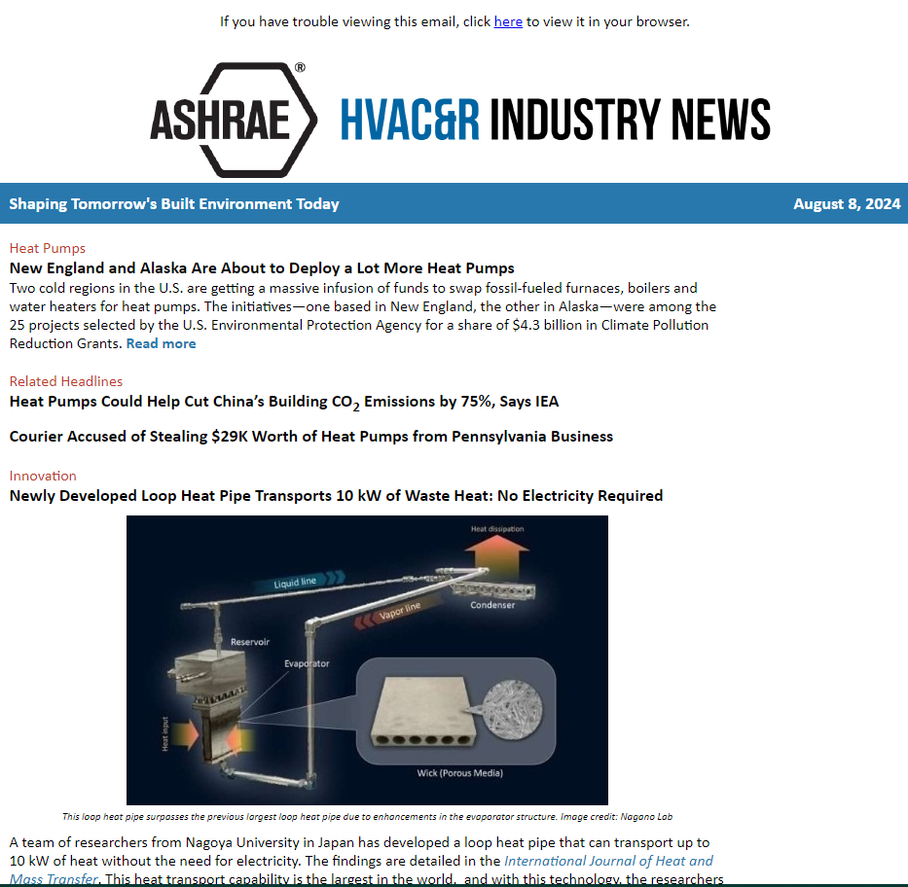


Find Resources and Stay In the Know
Get FREE resources for professionals, educators and consumers at ashrae.org/freeresources
Sign up to get ASHRAE Newsletters for the latest Society and industry updates at ashrae.org/newsletters

Slide 26
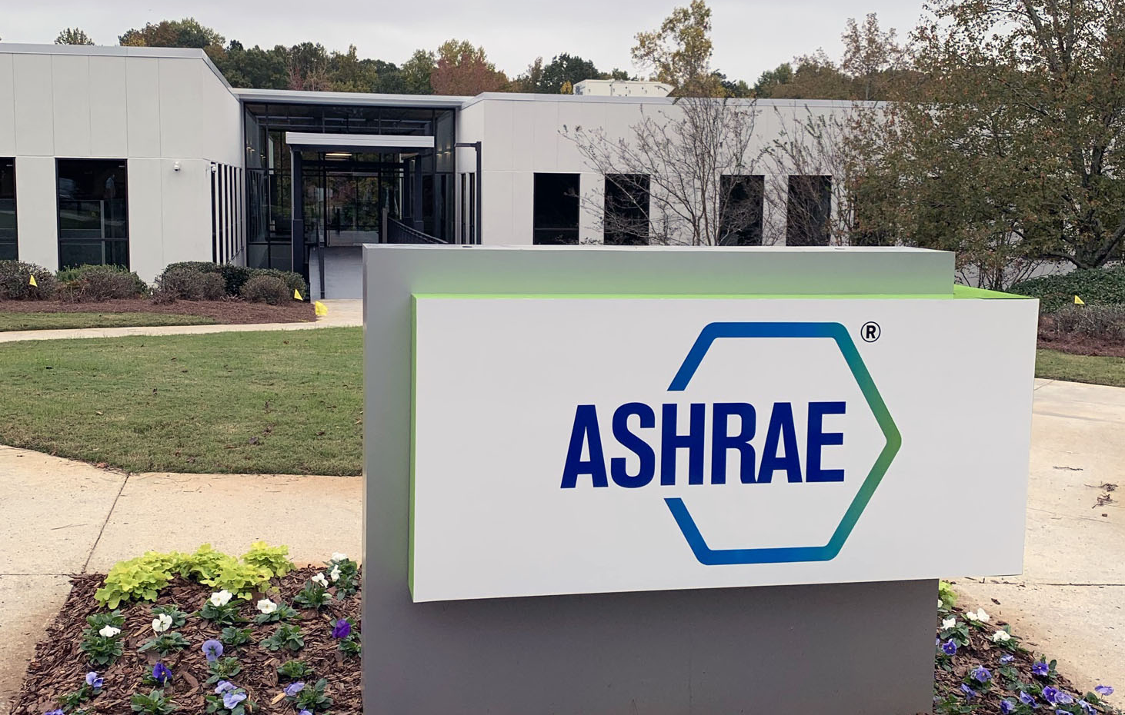




Connect With Us
Location
180 Technology Parkway, Peachtree Corners, GA
ashrae.org

