Slide 1
Social Media Guidelines and Best Practices for ASHRAE Groups
Provided by ASHRAE Communications Committee
Created 2018, Revised 2020

Slide 2
Disclaimer
This presentation is maintained by the Communications Committee of ASHRAE. It does not present official positions of the Society, nor reflect Society policy. The Communications Committee may not act for the Society and the information presented here has not had Society review. To learn more about ASHRAE activities on an international level, visit ashrae.org.
This presentation lists the most commonly used commercial names of Social Media platforms as examples only. There are many other Social Media websites currently available that are not listed. Neither ASHRAE, nor the presenter represent, endorse, or promote any of these platforms.

Slide 3
Objective
The purpose of this presentation is to serve as a comprehensive resource for using social media in your organization.
This presentation is NOT meant to be viewed or delivered in its entirety. Consider each section its own mini-presentation!
Use the hyperlinks to jump to the relevant sections for your organization’s needs

Slide 4
Topics
Social Media Basics
Types of Social Media
Building a Social Media Presence
Facebook Best Practices
ASHRAE Chapter Facebook Case Study
Appendix
Twitter
LinkedIn
Instagram
Pinterest
YouTube
The purpose of this presentation is to serve as a comprehensive resource for using social media in your organization.
This presentation is NOT meant to be viewed or delivered in its entirety. Consider each section its own mini-presentation!
Use the hyperlinks to jump to the relevant sections for your organization’s needs

Slide 5
Social Media Basics
Back to List of Topics

Slide 6
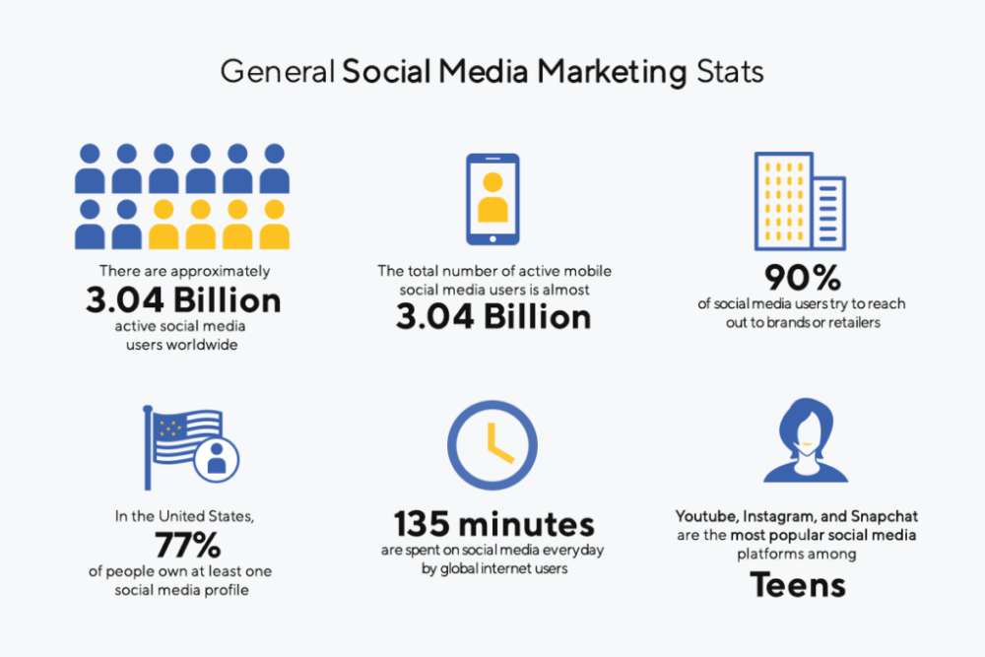
What is Social Media?
Social Media is... “Websites and Applications that enable users to create and share content or to participate in social networking”
The Proof is in the Numbers…
Facebook = from 1 Billion Users in 2015 to 2.7 Billion in 2020
Twitter = 340 Million Users, 500 Million Tweets sent every day
LinkedIn = 300 Million Users in 2015 to 766 Million in 2020
Instagram = 1 Billion Users in 2020
YouTube = 2 Billion Users in 2020
Notes:
With 1 billion Facebook users, 340 million active Twitter users and 370 more apps, again, this is NOT just a fad!! I would strongly suggest to jump on the train sooner than later.
Who has a personal FB account? Who uses it? Why do you use it?
Who has a personal twitter account? Who uses it? Do you know how to use it?
Who is on Linkedin? Who has its company or the company they worked for on Linkedin? Who uses it?

Slide 7
Non-Profit Use of Social Media
92% of marketers said social media is important to their business.
Top Benefits:
88% of all marketers indicated their social media efforts have generated more exposure for their businesses.
Increasing traffic was the second major benefit, with 78% reporting positive results.
Most marketers use social media to develop loyal fans (69%) and gain marketplace intelligence (66%).
Social Media audiences are growing faster than email and webpage audiences
Source: https://clairification.com/2017/05/30/nonprofit-social-media-marketing-whats-trending/

Slide 8
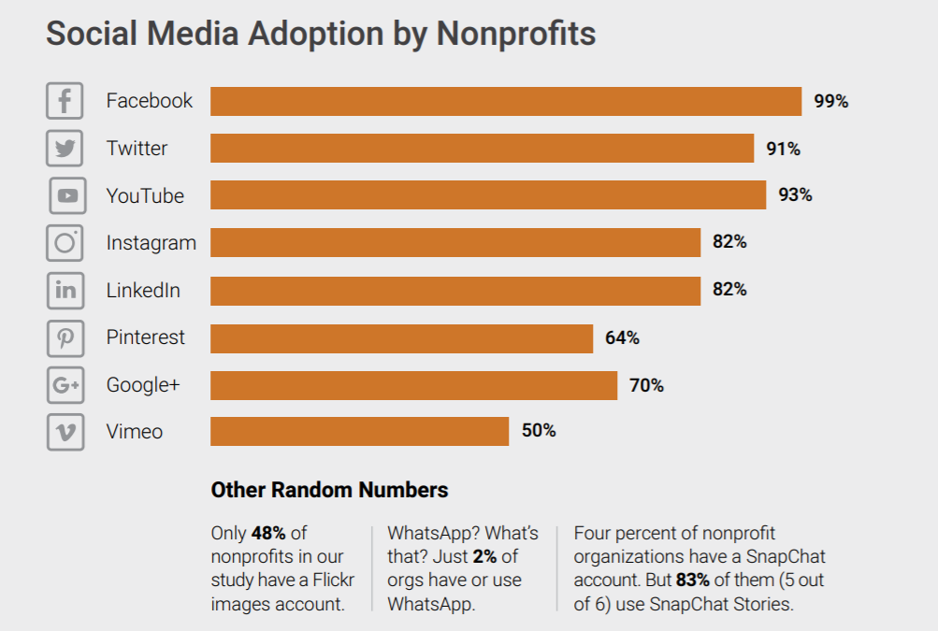
Non-Profit Use of Social Media
Source: http://www.dunhamandcompany.com/wp-content/uploads/2019/02/D-C-22Nonprofits-Social-Media-A-Missed-Connection22-2018.pdf

Slide 9
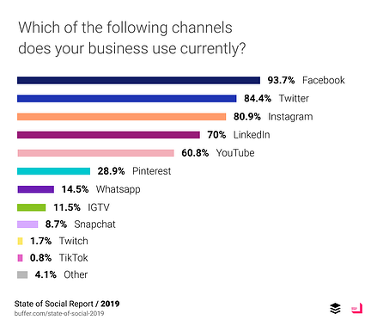
Small Business Use of Social Media
Source: https://www.flagshipbanks.com/blog/an-introduction-to-social-media-marketing-for-small-business-owners

Slide 10
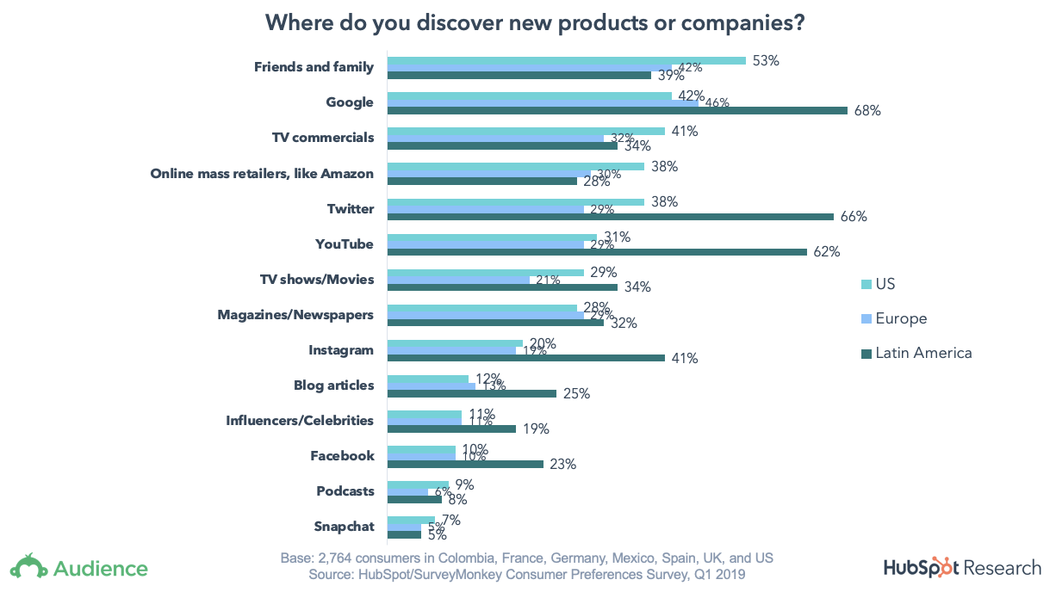
Individual Use of Social Media
Friends, family, and Google are the top discovery sources for new products or services overall
81% of consumers are influenced by their friends’ social media posts
Engagement = “New Word of Mouth”
People Trust their “Friends”
74% use social networks to guide purchase decisions
48% discover non-profits on social media

Slide 11
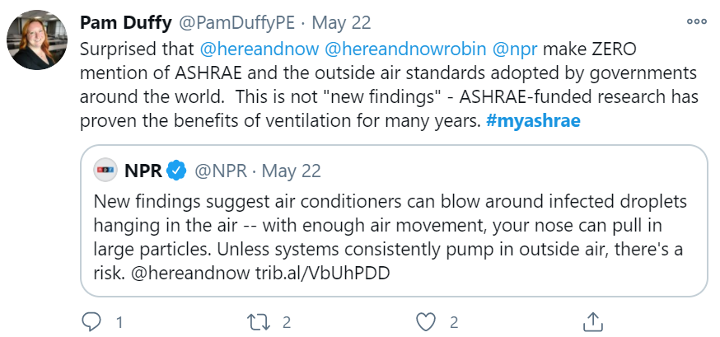
What is a #Hashtag?
Hashtags connect social media content to a specific topic, event, theme or conversation.
Identified by the symbol # followed by the topic
Method to group social media posts on a specific topic
Why use hashtags?
Increased engagement with your followers
An opportunity to build your brand
Add context to a social media post
Help your target audience discover you
#myashrae is an example of a hashtag. This image shows search results when searching twitter for #myashrae

Slide 12
Account Nomenclature
Facebook/Instagram/Twitter
Name: This is your display name (ASHRAE).
Username: This is your one-of-a-kind handle. It appears after an @ sign in your Facebook profile/page (@ASHRAEupdates) and in the associated URL (https://www.facebook.com/ASHRAEupdates/)
LinkedIn/YouTube
LinkedIn and YouTube will prompt you to login using a phone number or email address. From there, you can edit your display name, so it reflects your brand name.
Back to List of Topics

Slide 13
Types of Social Media
Back to List of Topics

Slide 14
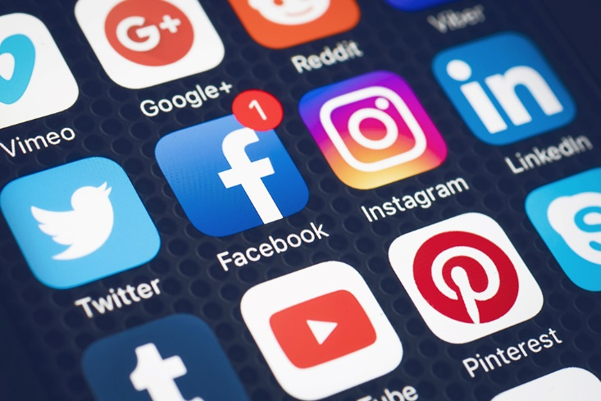
Social Media Networks
Facebook
Instagram
LinkedIn
Pinterest
Twitter
SnapChat
YouTube
And More!
Notes:
Presenter should be prepared to talk about the differences between these social media venues.

Slide 15
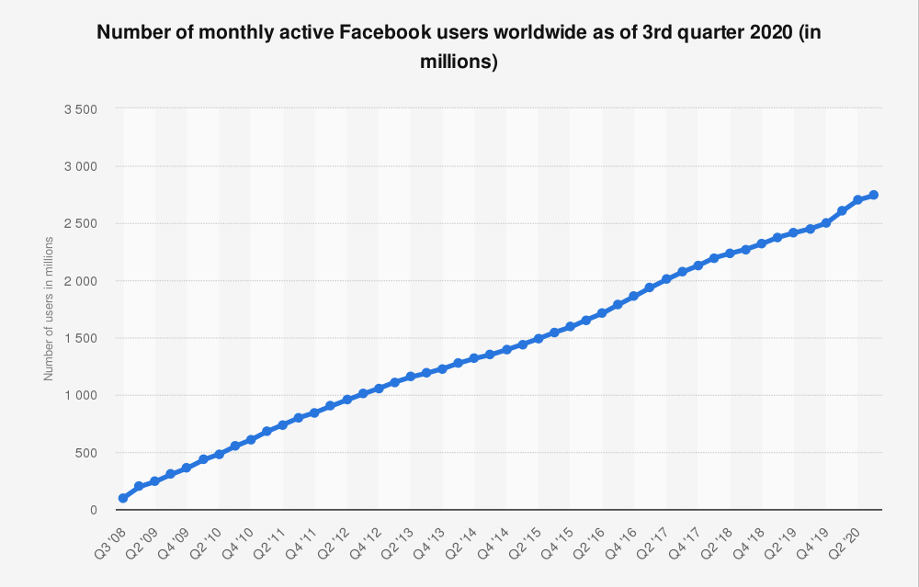
What is Facebook?
Facebook is a popular free social networking website that allows registered users to create profiles, upload photos and video, send messages and stay connected with friends, family and colleagues.
Use it to connect and share information
Facebook has…
1.82 billion daily active users
2.70 billion monthly active users
Primary Audience = Everyone
Source: https://www.statista.com/statistics/264810/number-of-monthly-active-facebook-users-worldwide/

Slide 16
Why have a page on Facebook?
Provide a new – and additional – platform for people to engage with your organization.
Share information in “real time” compared to a monthly newsletter or other traditional communication channels.
Increase your reach beyond your current membership or distribution list.
Learn about your target audience with direct communication and Facebook Insights.
Direct traffic to your website.
Back to List of Topics
Notes:
Having a Page Helps Increase your Google Search Priority
With 1 Billion + Users, Primary Audience = Everyone
People Want Useful, Interesting, Informative Content, so make sure it is quality not quantity you are posting
Best Social Media Network for Sharing All Media Forms
Reach a Large Audience
Can Link Other Social Media Networks to your Page! www.facebook.com/twitter (to link facebook posts to twitter). Never blast out one message to all sites, keep the sites engaging on their own.

Slide 17
Building a Social Media Presence
Back to List of Topics

Slide 18
Where to Start?
Establish a point-person or team to manage social media efforts
Identify the best platform(s)
Determine specific goals
Develop and plan a content strategy
Use photos and logos that are consistent with your brand
Invite members

Slide 19
Guidance for Beginners
Start with Facebook
Why?
User-Friendly
Powerful Analytics
Accessible, Effective and Versatile
Low/No Cost
Engagement with Members and a Global Community
Customer/Member Retention
Most Popular Social Media Platform
Overall – it will provide the most value and have the highest impact

Slide 20
Facebook Account Types
Example
Profile: Mike Smith
Page: Suburban Adult Soccer Association
Group: Kickin’ Cardinals
Mike Smith has a Facebook profile. On Facebook, he Likes the Suburban Adult Soccer Association Facebook page to receive updates on the league in his Facebook News Feed. Mike is also a member of his team’s private group, Kickin’ Cardinals, where his team discusses team practices and strategy.
A Facebook Profile is where a person can share information about themselves, add friends and share personal updates.
A Facebook Page is used by brands, businesses, organizations, public figures and other entities to establish a public presence.
A Facebook Group is a place for people with common interests and opinions to connect.
All individuals should set up a Facebook Profile.
Generally, most ASHRAE Chapters, Regions, and other Groups with want to set up a Facebook Page.
Most businesses will want to set up a Facebook Page.

Slide 21
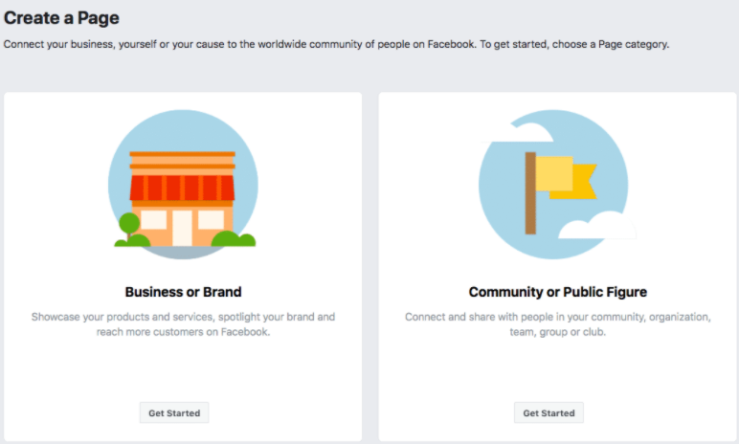
Appropriate use of Facebook for your group
Individuals should set up a Facebook Profile.
ASHRAE Chapters, Regions, Committees and other Groups will want to set up a Facebook Page. This is so more than one user can post to the page.
Facebook requires every business page to be linked to a personal Facebook profile, but all the information—posts, comments, photos, updates, etc.—are separate.
To create a Page:
Go to https://www.facebook.com/pages/create
Click to choose a Page category.
Enter company/organization information
Select a more specific category from the dropdown menu and fill in the required information
Click Continue and follow the on-screen instructions.

Slide 22
Best Practices for Facebook
Back to List of Topics

Slide 23
Consider…
What do you like to see when YOU are on Facebook?
What catches your eye?
What encourages you to “Like”?
Why do you comment?
What do you share?

Slide 24
Consider…
Have this Discussion With Your Social Media Team
Incorporate What you Like Into your Page!

Slide 25
Quick-Start Guide
Complete your profile
Include a relevant “About” page with detailed information
Develop a posting strategy
Know your audience and plan engaging content
Determine how often and when to post
Include visuals (photos and video) often
Engage with followers and network with other organizations
“Like” other pages (ASHRAE Society or ASHRAE Chapters) and share posts
Use Facebook Analytics to measure the success of your page

Slide 26
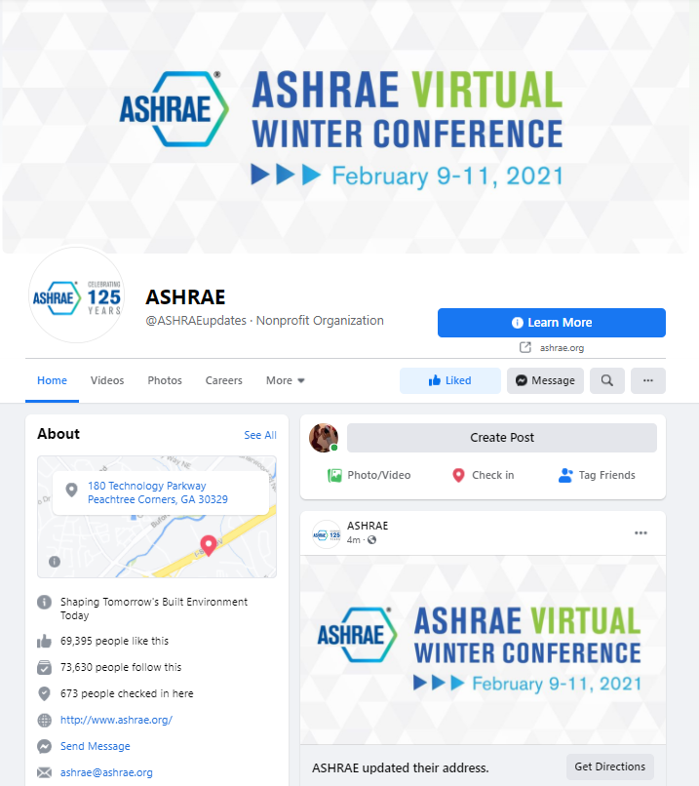
Fill Page with Information
Fill in appropriate fields and information:
Name
@username
Profile and Cover Photos
Category (non-profit organization)
Contact Information (address, phone number)
Chapter highlights, history and story
Call to Action (link to website)

Slide 27
Log In and Post Often
A reliable strategy is essential as you plan your Facebook for business page: think, plan and manage your page based on your target audience, brand story and the desired reaction you want to obtain.
Consider every piece of content you post an opportunity for increased and specific engagement.
Develop a balanced posting schedule and use the scheduling tool.
Respond to and engage with followers.
Notes:
Frequent Posts Keep you in Front of your Members
Keep Current On Your Member’s Interests
Use Scheduling Tool to Help
Use Insights Feature to Tailor your Posts (If people really engage in surveys, but don’t engage as much in “fill in the blanks” do more surveys)

Slide 28
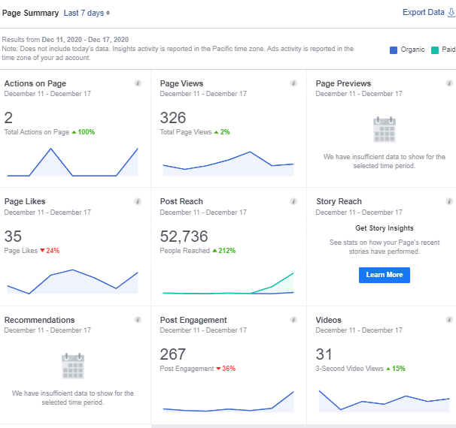
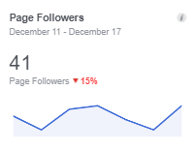
Use Facebook’s Insights Tool
Facebook Insights: detailed analytics for your Facebook Page, so you can track what works, learn how people interact with your content, and improve your results over time.
What to track using Facebook Insights:
Reach and Engagement: number of people who saw your posts and combined total of post likes, comments, shares, etc.
Actions: combined total clicks
People: number of followers, demographics of people who visit your page and when they visit
Views: total views of your Facebook page
Posts: how posts are performing over time
Notes:
Hootsuite and SproutSocial are Just a Few Management Tools for Social Media

Slide 29
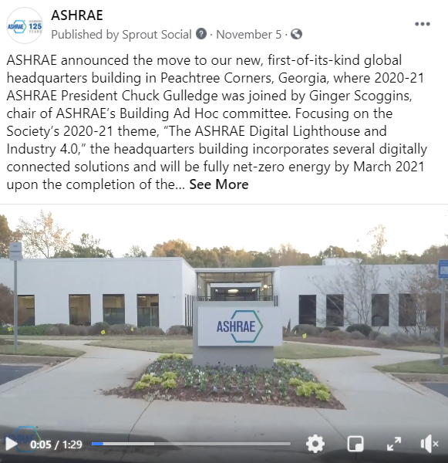
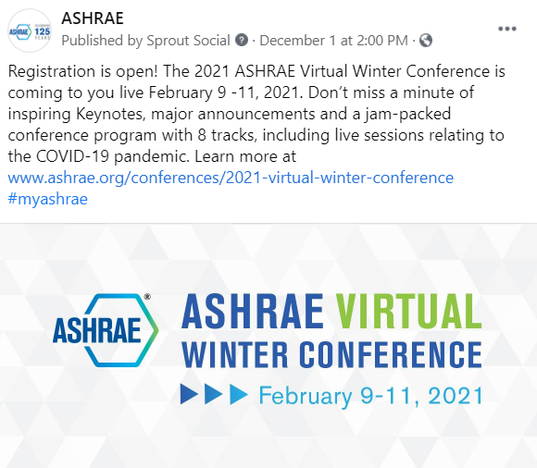
Keep Content Interesting
Facebook is a visual media
Eye-catching images
Include movement with a video or gif
Achievements/Awards
Announcements
Behind-the-Scenes
Communicate value
Contests and giveaways
Discounts, promotions and sales
Educational content
Notes:
Good Pictures
Meetings (Presenters, People Attending, Etc)
Chapter Events (Golf, Parties, Awards Banquets, Etc)
Member Spotlights (Get to Know your Board)
Local Projects
Conferences
Surveys
Questions
Videos
Statistics
Events
Thank Your Members/Sponsors

Slide 30
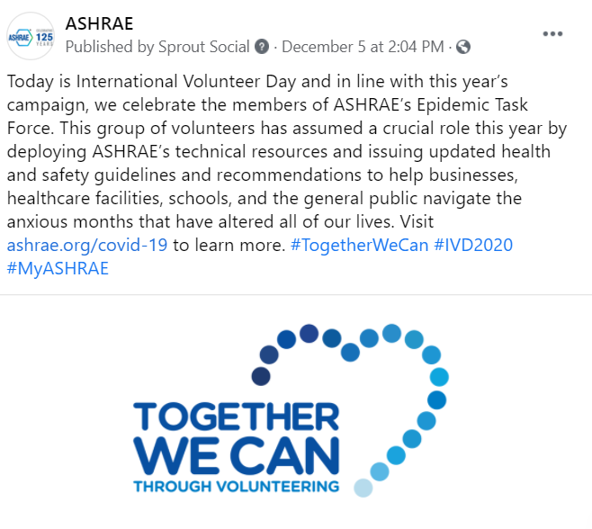
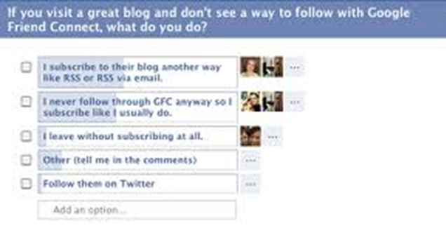
Keep Content Interesting
Events
Facts/Statistics
Fill-in-the-Blanks
Industry-Related Holidays/Observations
Industry News and Tips
Inspirational Quotes
Member/Volunteer Spotlights
Polls
Questions
Research/Technical Articles
Stories
Surveys
Testimonials

Slide 31
Network with Other Organizations
Examples:
Other ASHRAE Chapters
ASHRAE Society Groups
ASPE Chapters
City Councils
Local News
NAWIC Chapters
USGBC Chapters
Share Relevant Information
Contribute to Mutual Growth

Slide 32
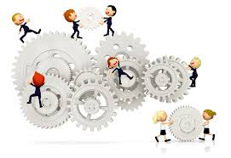
Stay Engaged
Answer Private Messages
Respond to and “Like” Comments on your Posts
Be Timely in Responses (within 24 hours)

Slide 33
More Advice!
Include a Call to Action and link in your posts
Be personable, not just promotional.
Include relevant #Hashtags
Include chapter history stories and pictures
Share relevant content from other sources.
Pin your best performing post or one you wish to highlight at the top of the page
Create and promote Events, invite people and share specific information
Link other social media sites for your organization to your Facebook page
Leverage Facebook ads and boosted posts
Continue to learn and stay current about social media topics and networks

Slide 34
Consider…
What Drives you Crazy When You See it Posted?
Do you Have a “Friend” Whose Posts Annoy You?
Why? What is it about their Posts?
What Drives you to Remove Someone?
What Drives you to Hide Someone?

Slide 35
Consider…
Have this Discussion With Your Social Media Team
Avoid Being the “Unliked” Page

Slide 36
Avoid these common mistakes!
Don’t Do It Alone
Rely on your team and your board – assign many admins
Don’t Leave your “About” Section Blank
Don’t Forget to Post
Stay up to date and be consistent
Use scheduling tool
Don’t Post Just to Post
Your posts should be of value
Don’t Post Low-Quality Images
Don’t Use Poor Grammar
Don’t be Overly Promotional
Don’t Advertise Products
ASHRAE has a Non-Commercialism Policy

Slide 37
Avoid these common mistakes!
Don’t Ignore Posts or Messages by your Members
Don’t Post “Questionable” Images, Statuses, etc.
Ensure Your Page Stays Family, Business and ASHRAE Friendly
Don’t Post Irrelevant Content for the Sake of Engagement
Don’t Forget to Test Links
Don’t Hesitate to Ask for Help
Back to List of Topics

Slide 38
Facebook Case Study
Back to List of Topics

Slide 39
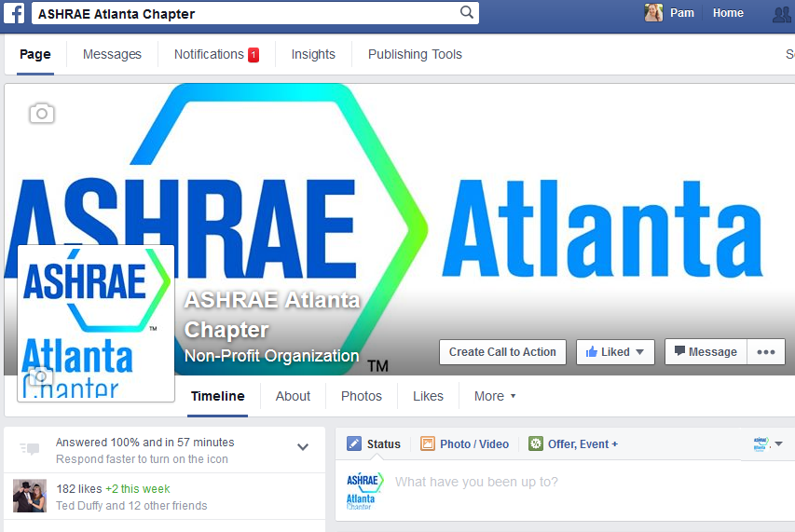
Case Study
ASHRAE Atlanta: ~1,000 members
ASHRAE Atlanta Facebook page: 135 Likes (at start of the study)
Goal:
Determine which Facebook posts receive the best responses from members

Slide 40
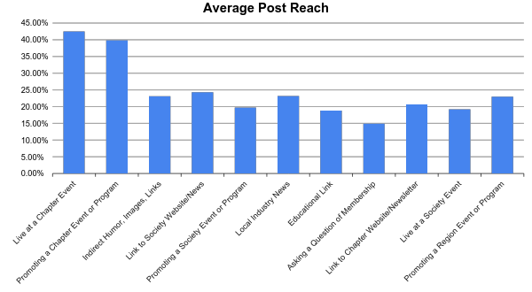
Case Study

Slide 41
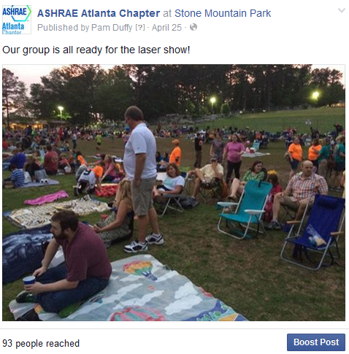
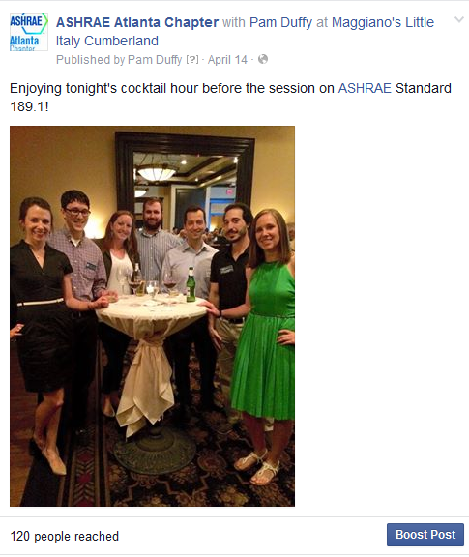
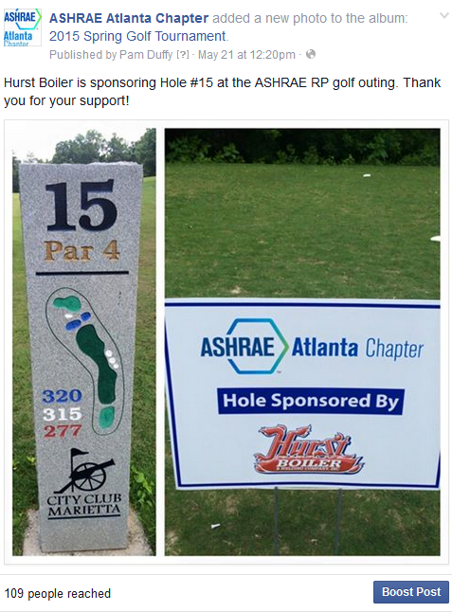
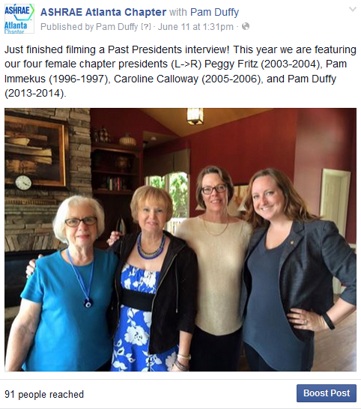
Example posts LIVE from Chapter Events

Slide 42
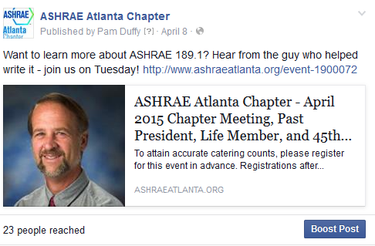
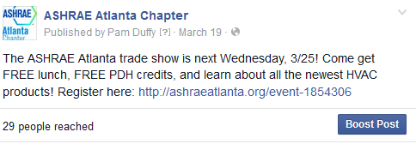
Example posts promoting events

Slide 43
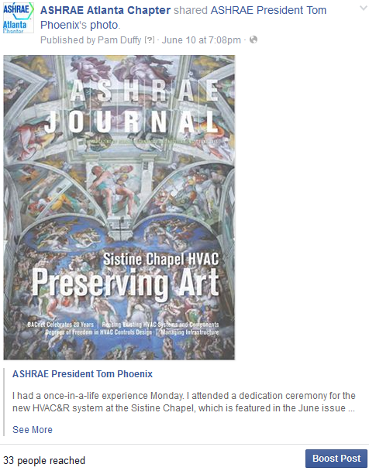
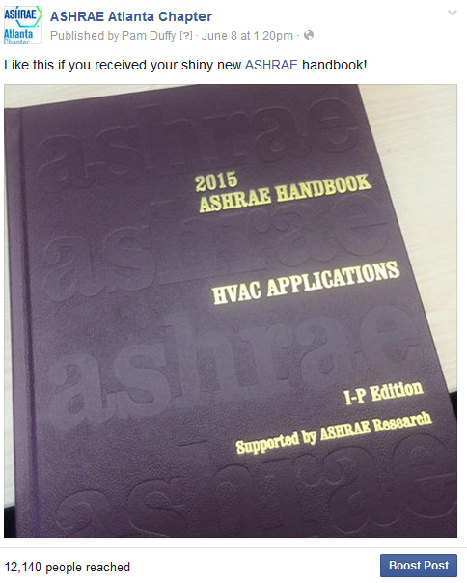
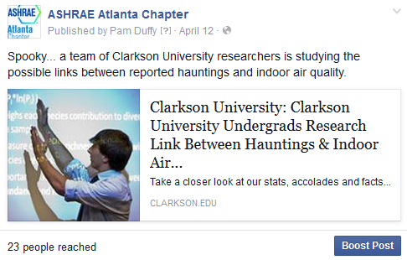
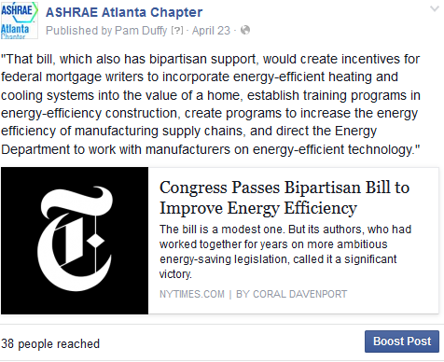
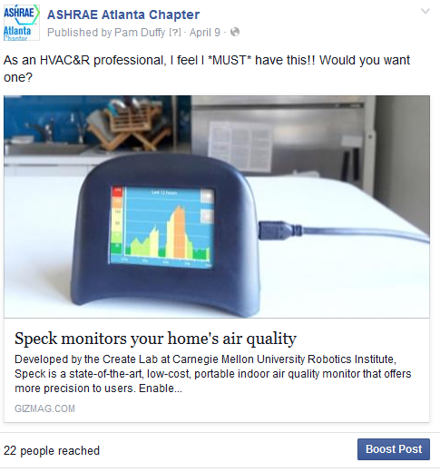
More example posts
This post was shared by ASHRAE
Sharing ASHRAE-related posts.
Indirect posts of interest
From the weekly ASHRAE news e-mail, interesting story.

Slide 44
Case study lessons learned
Engage with other ASHRAE chapters, or other local chapters (ASME, ASCE, SWE).
Use the scheduling tool to schedule out posts for a week or two at a time. This reduces the total workload required.
Regular posts helps increase likes and reach over time.
Users prefer images to links or text.

Slide 45
Case study lessons learned
Live-posting at events works particularly well
…but only if your social media person is at the event!
If multiple people help run the page, they can all individually post at events.
Tagging the main ASHRAE page and having our post shared gained us ~50 new likes over the course of 24 hours.
We gained ~30 new likes over the course of 6 months with our regular posting.
Keep the ASHRAE Commercialism Policy in mind.

Slide 46
Sourcing unique content for your page
Images and posts live at Chapter Events (including BOG meetings!)
Follow other people or pages of interest from your group’s Facebook Page and share posts:
ASHRAE and other ASHRAE Chapters or Groups
ASME, AIA, BOMA, ACCA, SWE, NSBE, SHPE, USGBC, and local chapters of these group
Local government entities
Local universities (especially if there is a large alumni base in your chapter from a university)

Slide 47
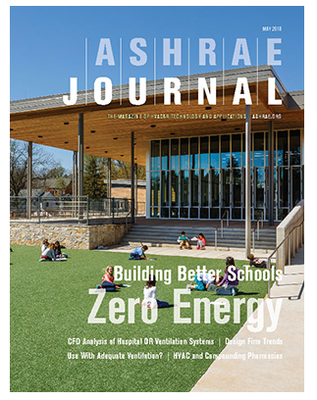
Sourcing unique content for your page
Weekly e-mails from ASHRAE (ASHRAE News)
ASHRAE Journal
Articles from your chapter newsletter
Your chapter’s history archives (#ThrowbackThursday / #tbt)
YouTube (ASHRAE Page)
Ask Questions / Create a Poll
Would you prefer lunch or dinner meetings?
Which ASHRAE Certification do you have?

Slide 48
Conclusions
3.6 Billion Social Network Users Worldwide
Social Media is the new word of mouth, so be heard!
Facebook is a quick and effective way to share information with members.
Post frequently and engage with members.
Need help or have questions? Contact ASHRAE’s Communications Committee at ccchair@ashrae.net .
Back to List of Topics

Slide 49
Appendix
Back to List of Topics

Slide 50
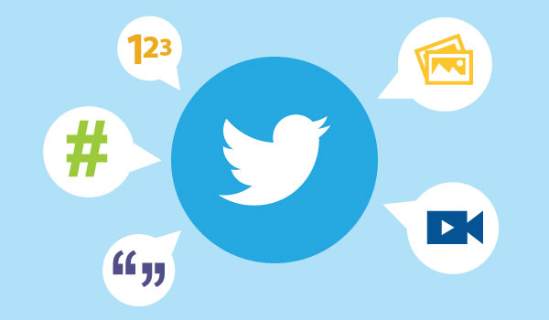
What is Twitter?
330 Million Monthly Users
Short 280-character Messages Called “Tweets"
Primary Audience: Adults 18-49 Years
Used to Read News, Share Opinions on Trending Topics and Connect
Ideal for Sharing News, Original and Curated Content (Custom Search)
Notes:
Build a relationship with very influential people, can ask favors of them

Slide 51
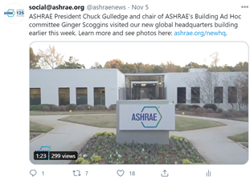
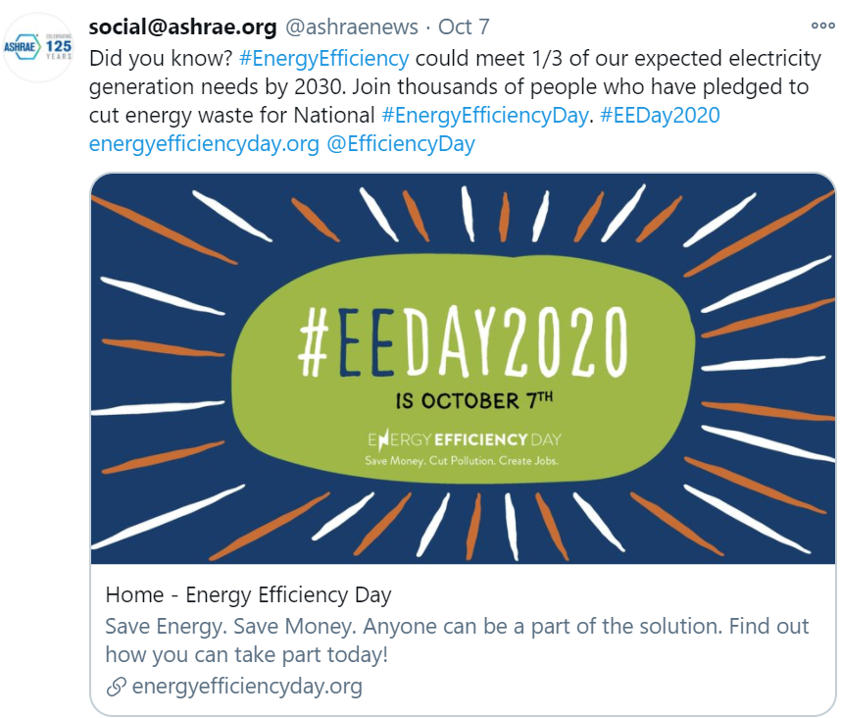
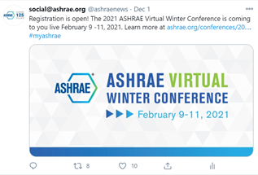
Twitter Do’s
Link your Facebook and Twitter Accounts
www.facebook.com/twitter
Use hashtags to maximize engagement
Research hashtags relevant to your location, industry and products and add up to two of them per tweet, where appropriate.
#MyASHRAE, #AHRExpo
Use mentions to call attention to or draw the attention of other Twitter accounts by using @
@ashraenews, @ahrexpo
Include a clear call-to-action where applicable.
“Read the full story…”

Slide 52
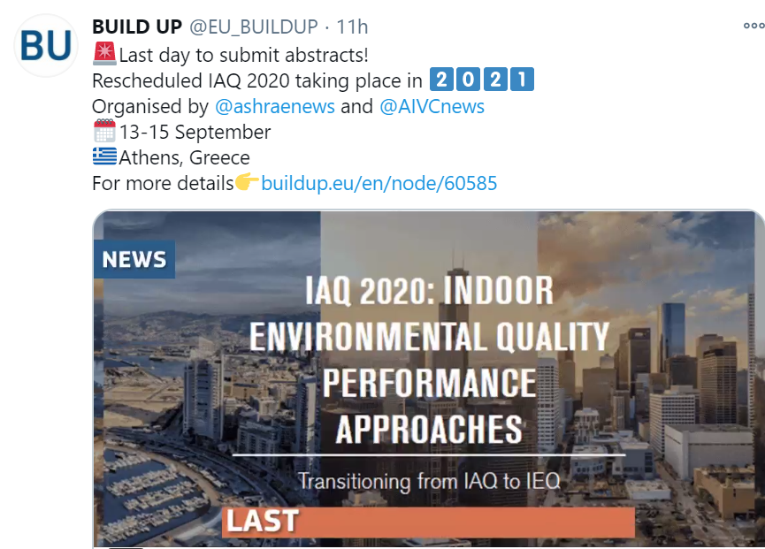
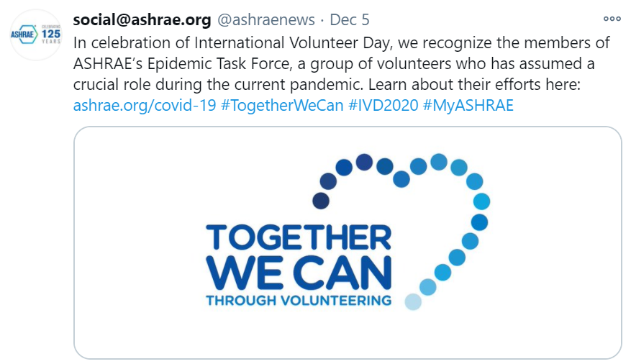
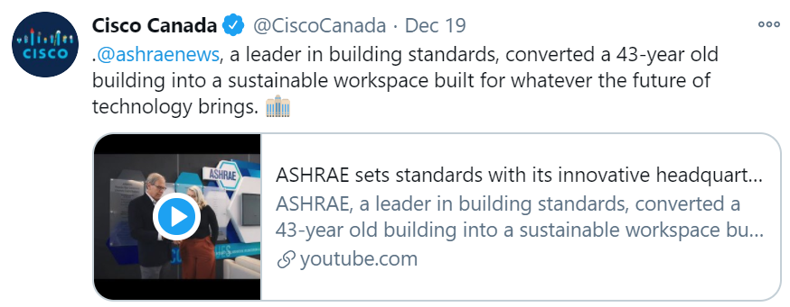
Twitter Do’s
Be Visual/Include Images with Tweets
Be Consistent with Tone and Voice
Follow Specific, Relevant Accounts
Re-Tweet Applicable Posts
Credit the account when re-Tweeting
Develop Relationships and Connections
Include Website Links and be Strategic
Use a URL shortener
Pin Posts to your Profile
Analyze your Account

Slide 53
Twitter Don’ts
#Don’t #Abuse #Hashtags!
Hashtags are used to help search for specific keywords
Don’t use it on every word
Hashtags should be easy to remember
The goal is to create a hashtag that people use!
Don’t use other people’s content or hashtags and claim them to be yours
Don’t be insensitive
Don’t over-promote
Don’t use abbreviations that are too confusing

Slide 54
Twitter Don’ts
Don’t be “Needy”
Don’t Use “Retweet this Tweet Please”
Don’t Beg Friends to “Like” your Page
Produce Unique Ways to Encourage These Actions
Don’t Link Every Post to Facebook and Vice Versa
Incorporate variety and cater the post to the platform
Back to List of Topics

Slide 55
What is LinkedIn?
The World’s Largest Professional Network
766 Million Users
172 Million in the US
40% of Users Engage with LinkedIn Daily
Main Audience – Professionals
People Use LinkedIn to:
Post a resume and search for jobs
Connect with former and current colleagues
Participate in groups and network
Write articles, post photos and videos
Notes:
You can export LinkedIn contacts to a spreadsheet with emails, so you can do an outreach email
LinkedIn has not only professionals:
Companies
Groups
Jobs opportunity
Articles
Universities
Messaging

Slide 56
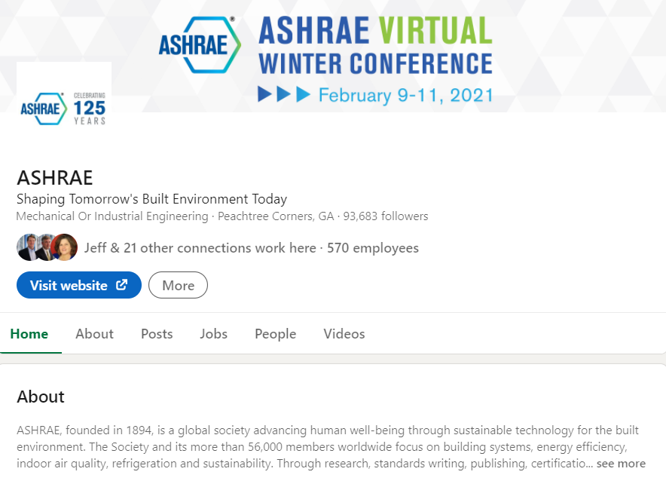
LinkedIn Do’s
Treat your Profile like a Professional Brochure
Update as needed with current officers and board members
Provide a detailed description, using simple language
Provide Link Between Website and LinkedIn Pages

Slide 57
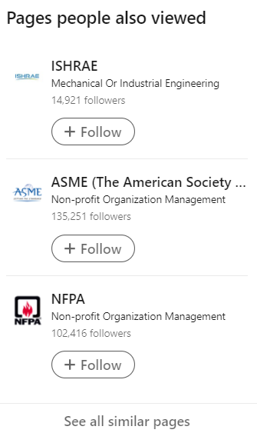
LinkedIn Do’s
Establish Connections and Cultivate your Online Network
Follow associates in your area (i.e. members, other chapters, other “peer” organizations, potential members, relevant companies/organizations)
Use “Connections” to increase Chapter membership
Choose Groups Wisely

Slide 58
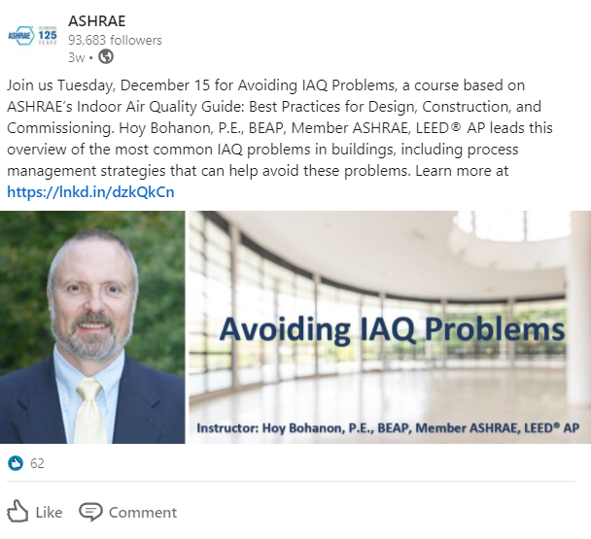
LinkedIn Do’s
Stay Active with Posts and Updates
Respond promptly to messages
Post relevant articles and events to engage members
Encourage your employees to follow the company page and share company updates

Slide 59
LinkedIn Don’ts
Don’t use LinkedIn as a “Social” Site
It is considered a “professional” site and is different from your Facebook page
Provide professional articles, discussions and research
Don’t Allow your Profile to be Stagnant
Don’t Post Faulty Links
Don’t Only Post about your Chapter

Slide 60
LinkedIn Don’ts
Don’t Connect without Researching First
Don’t Send Spammy/Irrelevant Messages
Don’t Allow “Poaching” on Your LinkedIn Site
You can post job opportunities (based on Your Chapter’s rules)
“Poaching” or “Headhunting” should be discouraged as it can create a negative association with your LinkedIn page and/or your Chapter
Back to List of Topics
6/17/2015

Slide 61
What is Instagram?
1 Billion Monthly Active Users
500 Million Daily Active Users
Primary Audience - Young Adult
64% of 18 – 29 U.S. adults use Instagram
Instagram Uses:
Photo and Video Sharing/Viewing
Editing capabilities with filter options
Captions with @ tagging and hashtags
Instagram Stories
Company/Organization Brand Building
Promotional Contests
Follow Accounts of Interest and Share Content

Slide 62
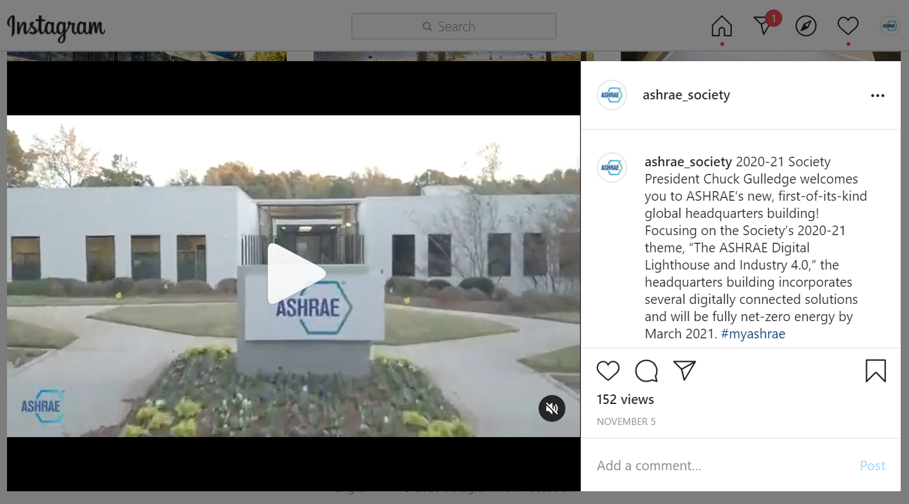
Instagram Do’s
Connect Instagram with your Facebook Page
Capitalize on your Bio
Develop a Posting Rhythm that Suits you
Stay on Brand
Update Link in Bio to be Consistent with Recent Post(s)
Include a Variety of Photos/Videos
Use Instagram Stories
Engage and Interact with your Audience
Ask questions
Like and Comment on others’ content
Measure Performance
6/17/2015

Slide 63
Instagram Don’ts
Don’t Post for the Sake of Posting
Like all social channels, never post content on Instagram without a purpose.
Don’t Abuse Hashtags
Only use hashtags that are applicable to your post
Don’t Post Low-Quality Images/Video
Don’t Neglect your Captions
Back to List of Topics

Slide 64
What is Pinterest?
Pinterest is a visual discovery engine where people can search for inspiration and ideas for their interests and hobbies.
Primary Audience - Women, Foodies, Crafters
Share Visual Content:
DIY Projects
Home and Style Inspiration
Recipes
Tutorials
98% of Users Say They’ve Tried Something New They Found on Pinterest

Slide 65
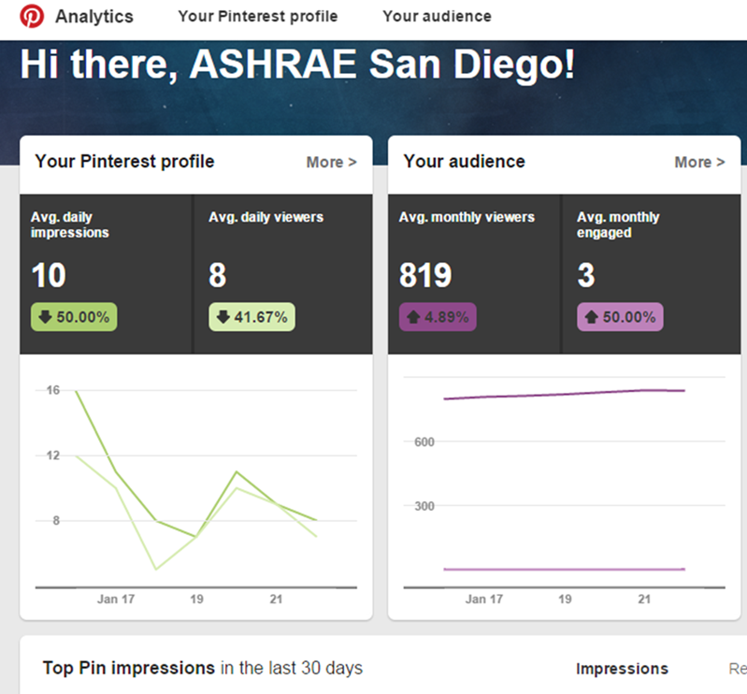
Pinterest Do’s
Create Private or Public Boards to Help Plan Your Chapter’s Special Events
You Can Limit Access to Specific People/Members
Event Examples
Banquets
Fundraisers
Golf Tournament
YEA* Events
Use Analytics
YEA = Young Engineers in ASHRAE

Slide 66
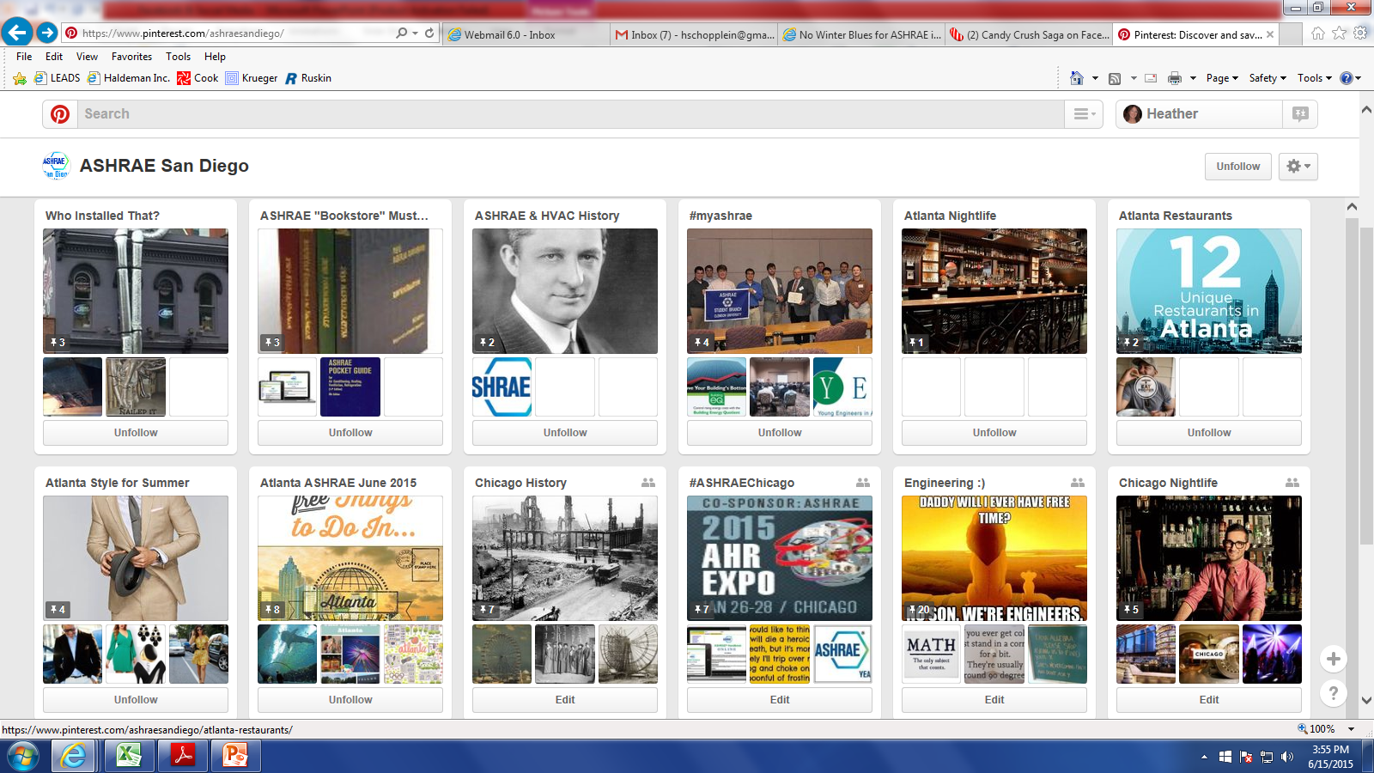
Pinterest Do’s
Have a Board Dedicated to your Chapter
Pictures Link to your Website!
Link Images to Your Facebook Page

Slide 67
Pinterest Do’s
Create Interesting Boards that are Relevant
Conference Boards (CRC’s, Winter/Annual Conference)
What to Wear in… (i.e. Chicago in Winter)
What to Do in…
Where to Eat in…
Historical Notes about…
Engineering Humor
Field Pictures

Slide 68
Pinterest Don’ts
Don’t Expect to have as Many Followers as Other Social Media Sites
Pinterest is Still New for Many People
It an Image Based Media, so it May be Difficult to Translate to ASHRAE
Don’t Post “Personal” Boards
Boards should be ASHRAE Related
Back to List of Topics

Slide 69
What is YouTube?
2 Billion Monthly Active Users
Over 1 Billion Hours of YouTube Videos Watched per day
YouTube Uses:
Search for and watch videos
Start a YouTube channel and upload videos
Like/Comment/Share other YouTube videos
Subscribe/Follow other YouTube channels and users
Create playlists to organize videos
Types of Videos:
Commentary
Educational
Product Reviews
Tips and Tutorials

Slide 70
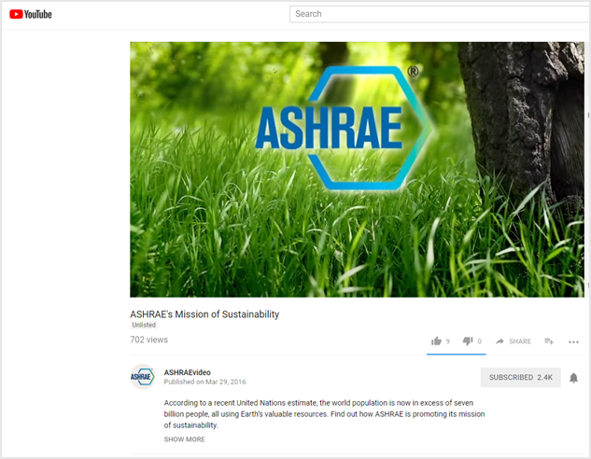
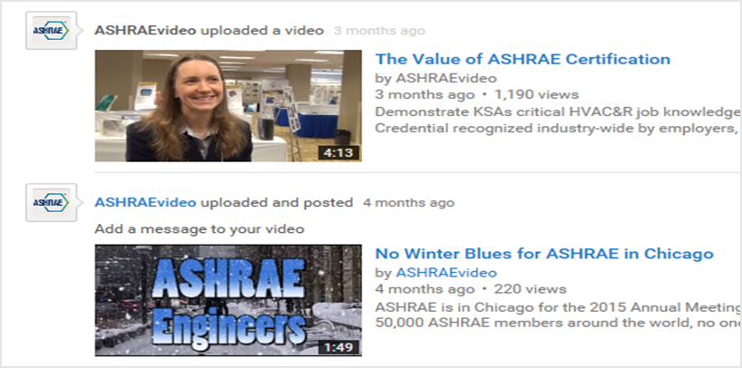
YouTube Do’s
Have Fun!
Upload Unique Videos that Engage your Audience and Interest Members:
Clips from Meetings
Demonstrations (i.e. How to Apply ASHRAE Standards)
Webinars
“What ASHRAE Means to Me”

Slide 71
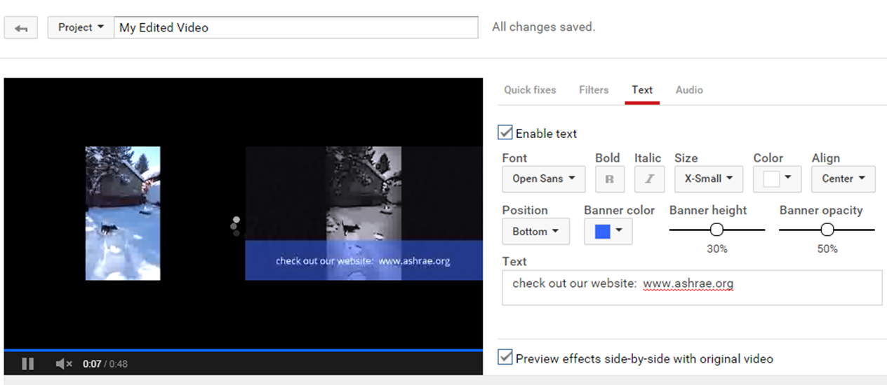
YouTube Do’s
Include Effects for more Interesting Videos
Share Videos on your Other Social Media Sites
Add Link to your Website

Slide 72
YouTube Don’ts
Don’t Ignore Feedback
Don’t Over Post
Don’t Lie in your Post Descriptions
Don’t Forget your Audience
Don’t Assume Everyone Has the Same Background or Experience
If Posting an “Advance” Topic, Note it in the Title
Don’t Cut Corners on How To’s
Don’t Use Acronyms
Back to List of Topics

