Slide 1


Chapter Operations Workshop
Presenter Name
Date
Location

Slide 2
Leadership Attributes
5
Willingness and ability to share time , information, ideas, responsibility and spotlight
Vision
1
Commitment
2
3
Enthusiasm
4
Curiosity

Slide 3
Chapter Goals
Serve as liaison between an individual member and ASHRAE
Make every chapter meeting work while
Provide professional and personal growth opportunities
Attract the best graduates and young professionals to HVAC&R

Slide 4
Keys to Chapter Success
Plan
What are the Chapter’s goals?
Delegate
Provide opportunities for other members to gain experience
If the goals are achieved, will the Chapter be stronger than it was?
How will everyone recognize that a goal has been achieved?
President’s Award of Excellence (PAOE) can help
Get other members involved and engaged
Set reasonable and enjoyable expectations for “next person up”
Encourage officers to focus on strategy and planning rather than implementation and execution
Ashrae.org > Communities > Chapters > PAOE Information

Slide 5
Keys to Chapter Success
Efficient & Effective
Ensure that volunteers’ time is spent efficiently and effectively
Believe
Believe: in yourself, the Chapter’s mission, ASHRAE’s mission
Manage meetings so that they are productive, and all voices are heard
Offer valuable programs
Be prepared (for whatever the event is: meeting, technical program, volunteer activity)
If you don’t believe, why will anyone else?
Enthusiasm is contagious
Ashrae.org > About > Mission & Vision

Slide 6
Relationships Among Members, Chapters and Society
ASHRAE
54,000+ Members
200 Chapters
16 Regions
Members Council
Board of Directors
Chapter & Regional Conference (CRC)
ashrae.org > Conferences > Chapters Regional Conferences
ashrae.org > Communities > ASHRAE Chapters
ashrae.org > About > Leadership > Board of Directors
ashrae.org > Communities > Regions
ashrae.org > Communities > Members Council
Notes:
Society has 54,000+ members
Most members are assigned to one of the 200 Chapters
Each Chapter is assigned to one of 16 Regions
Each Region is represented on Members Council (RMCR) and the Board of Directors (DRC)
Each Region holds an annual Chapters Regional Conference (CRC)
Society-level motions are sent to Members Council or other relevant body
Each motion is discussed and voted upon; results are reported at the next CRC and updates available throughout the year in the CRC Motion Database.

Slide 7
How to Use
Chapter Reports, CIQ, and PAOE
Notes:
[It is recommended to stop the Power Point during this time and Share your Screen and do a live demo of these aspects and their importance. If you are not able to share your screen and do a live demo of these sites, screen shots have been included in the next few slides.]

Slide 8

Ashrae.org > Communities > Chapters > Chapter Reports, CIQ and PAOE

Slide 9
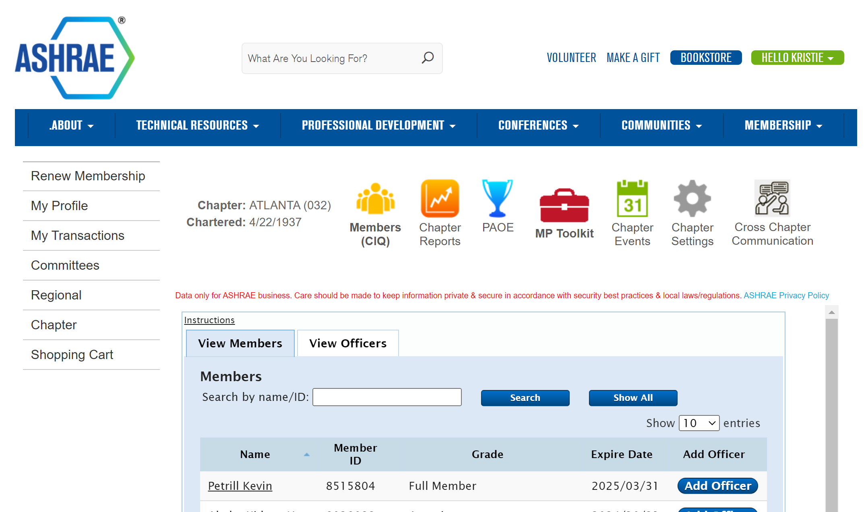

Slide 10
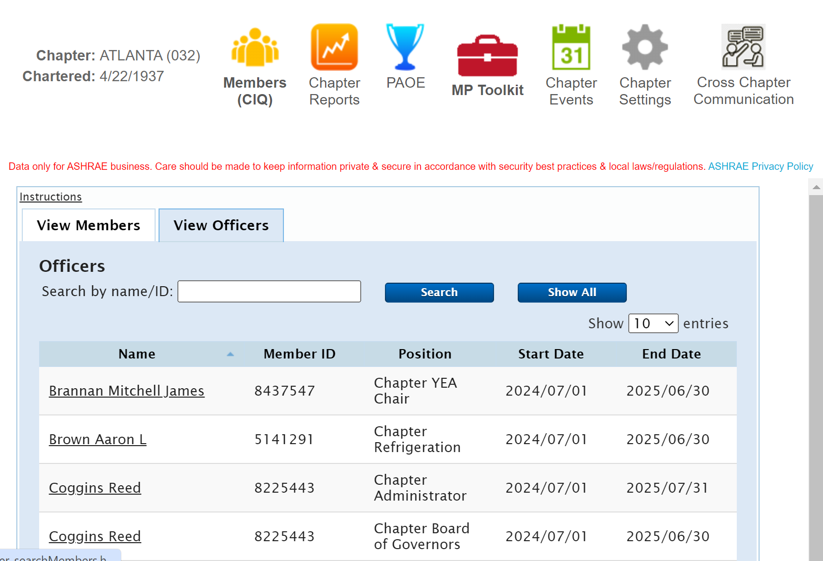
Chapter Information Questionnaire (CIQ)
Must be updated by June 1 before Society Year begins July 1
Notes:
Discuss how to add/remove someone as your officers. Emphasize the importance of the deadline and correct people are listed. Travel reimbursements are only given to people listed in the CIQ in eligible roles.
SPRING CRCS: Change deadline listed in the above slide to 60 days before your CRC.

Slide 11

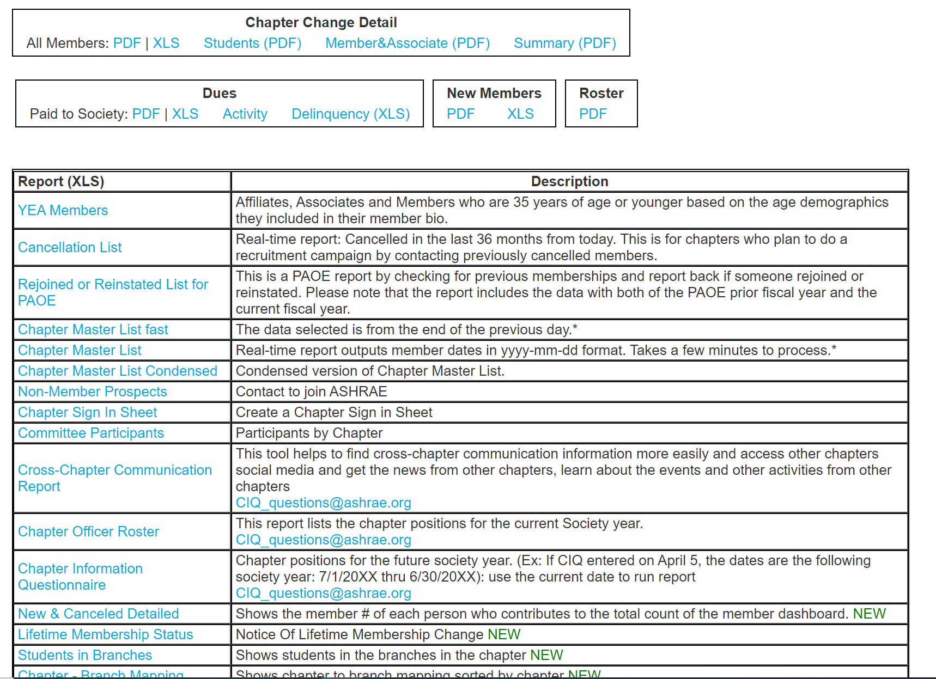
Chapter Reports
Notes:
Review the important reports and any expectations, you, or the DRC, RVCs may have related to these reports.

Slide 12
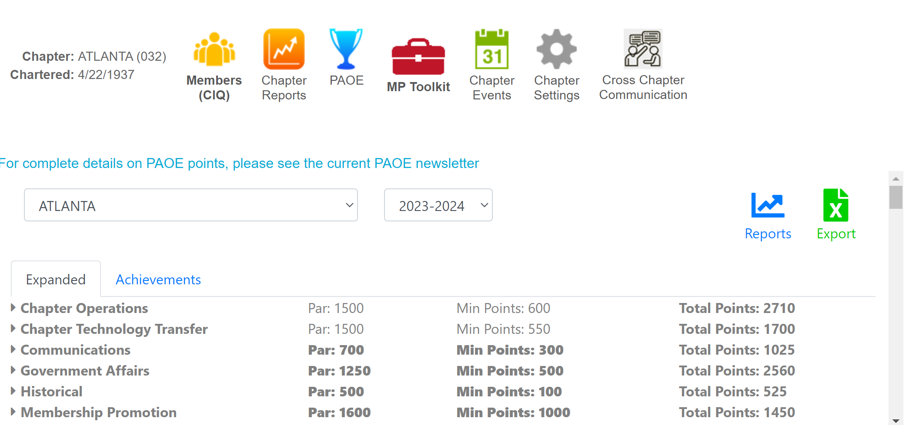
PAOE
Additional PAOE Training or Resources can be found at ashrae.org > Communities > Chapters > PAOE Information

Slide 13
2024-2025 Chapter Operations PAOE
Minimum: 600 points / PAR: 1500 points
Categories:
  Presidential Initiatives
  Effective Use of Volunteers’ Time
  Meetings
  Honors & Awards Activities
  Planning
  DRC Assigned / Entered Points

Slide 14
2024-2025 Chapter Operations PAOE
To reach minimum:
The Chapter Information Questionnaire (CIQ) must be complete and updated by June 1 or 60 days prior to CRC.
The completed CIQ will represent the incoming chapter officers and chapter committee chairs for the next Society year.
The DRC is responsible for determining if criteria are met.
All individuals serving in a chapter position must be an ASHRAE Full Member or Associate grade member (except Webmaster and Newsletter Editor who can be a student member; Affiliate grade for YEA).
No person can serve in more than one officer position (exception, two positions for chapter with less than 75 members).
A chapter officer may also serve in one committee chair position.

Slide 15
2024-2025 Chapter Operations PAOE
Helpful hints and reminders:
PAOE, especially the Chapter Operations category, can help you plan and structure your year.
July 1, 2024: PAOE for 2024-2025 is open to view categories and start to enter point values.
June 30, 2025: Deadline to submit PAOE points for 2024-2025.
Start entering points EARLY and throughout the year.
Visit ashrae.org > Communities > Chapters > PAOE Information for:
  2024-2025 PAOE Guide (list of all categories and point values)
  PAOE Training video (how to enter points, overview & FAQs)
  Who has access to enter points and how to do it.
Questions? Contact regioninfo@ashrae.org.

Slide 16
2024-2025 Chapter Operations PAOE
Highlights:
COXX (XXX points / XXX max) – DESCRIPTION
COXX (XXX points / XXX max) – DESCRIPTION
COXX (XXX points / XXX max) – DESCRIPTION
COXX (XXX points / XXX max) – DESCRIPTION
COXX (XXX points / XXX max) – DESCRIPTION
COXX (XXX points / XXX max) – DESCRIPTION
COXX (XXX points / XXX max) – DESCRIPTION
COXX (XXX points / XXX max) – DESCRIPTION
Notes:
Enter any of the line CO items/point values you would like to highlight in this category relevant to your chapters and chapter presidents. Explain why these are important to your chapters.

Slide 17
Additional
Chapter Resources
from Society

Slide 18
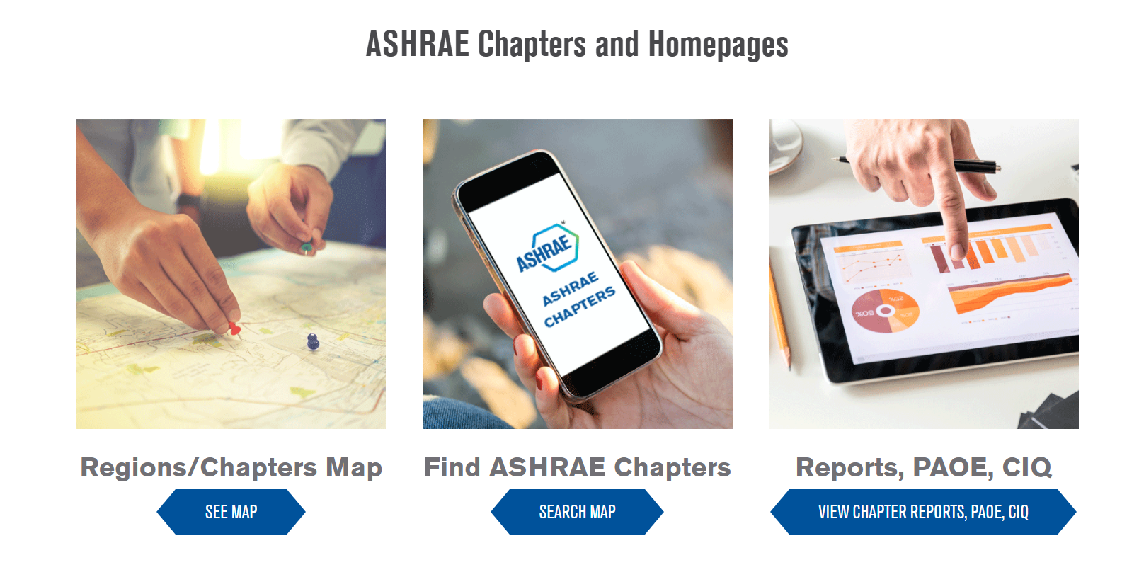
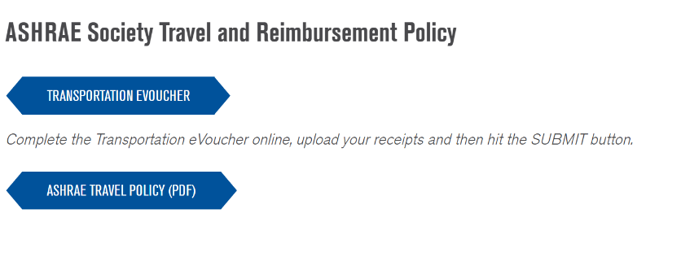
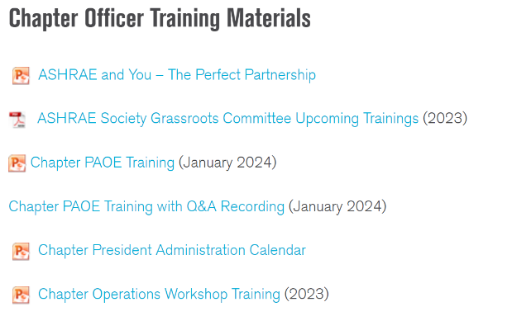
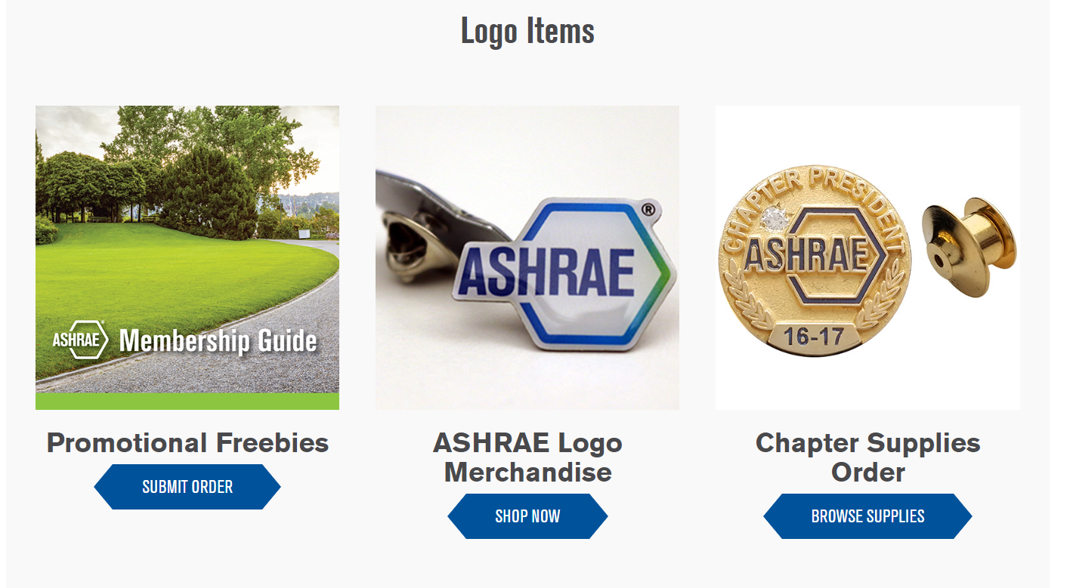
Chapter Resources
Created for the chapter officers, Chapter Resources is a single page resource for chapters
Resources available:
Basecamp for Chapters
How to schedule a Presidential Visit
Request Distinguished Lecturers
FAQs
Order Chapter Supplies
Order Chapter Bulk Publications
Chapter Educational Opportunities
Chapter Scholarship Opportunities
Chapter Officer Training Materials
NEW! Chapter and Region Carbon Guide
Templates and Tools for Chapters
Society Travel & Reimbursement Policy and e-Voucher
ashrae.org > communities > chapters > chapter-resources

Slide 19
Important Manuals
Manual of Chapter Operations (MCO)
Explains Chapter positions and roles
CRC Manual
A manual for CRC General Chair and Host Chapters
Suggests a calendar for accomplishing tasks
Provides model Chapter bylaws
Provides templates for Chapter Charter ceremony and other events
Gives guidance for Chapter programs
Timeline
Budget template
Planning Guidance
How to use Helms Briscoe to select a venue
Ashrae.org > About > Mission & Vision
Notes:
It is important to share the MCO with your chapter officers and chapter chairs for guidance on their roles. The MCO also reviews all policies and procedures related to ASHRAE Chapters. The CRC Manual support General Chairs and Host Chapters and can be shared years in advance for planning support.

Slide 20
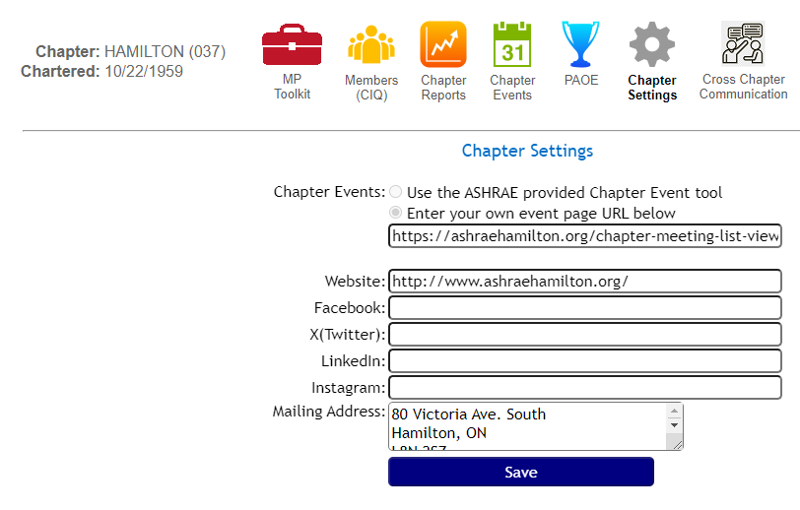
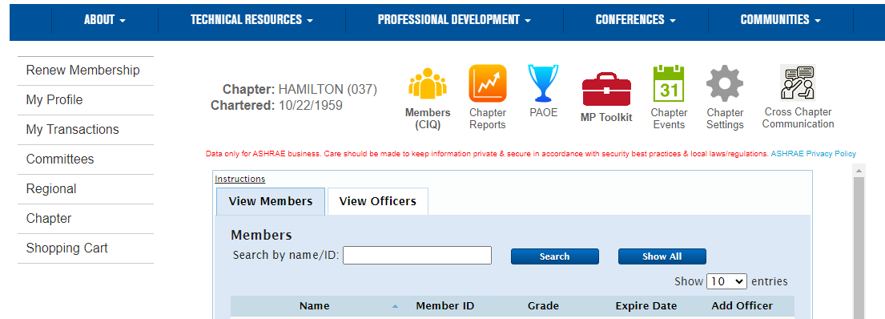
NEW Chapter Tools Available in CIQ
Link your chapter’s event page to the Chapter Meetings page on ashrae.org.
Update “Chapter Settings” in CIQ:
Notes:
This new tool was recently created as a result of a Region II CRC motion. You can either link your direct chapter events URL in Chapter Settings or you can manually enter all of your chapter events by checking the box “Use the ASHRAE provided Chapter Events tool.”
While you’re at it, go ahead and all your website, and all of your social media links here.

Slide 21
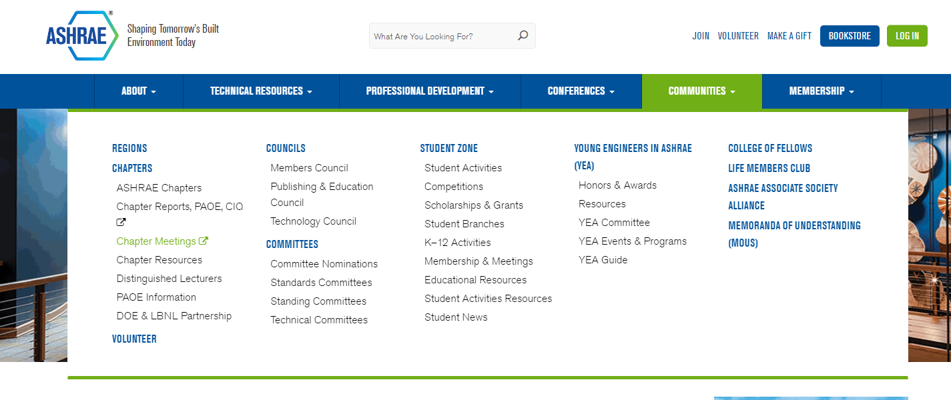
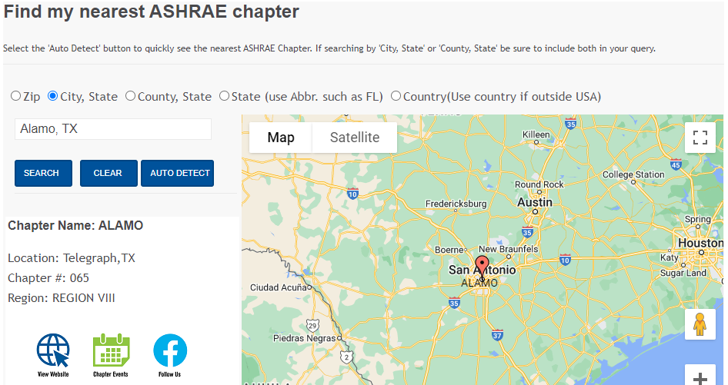
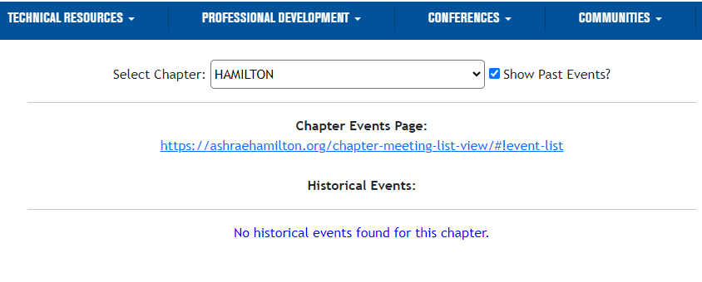
Chapter Settings: Chapter Events
Updates shown on Chapter Meetings and Find my nearest ASHRAE Chapter map:
This new tool is brought to you by a Society motion from the Hamilton Chapter.
Notes:
Everything you add into that Chapter Settings section will be viewable when you go to ashrae.org > Communities > Chapters > Chapter Meetings and when you search for your chapter using the Find my nearest ASHRAE Chapter Map.

Slide 22
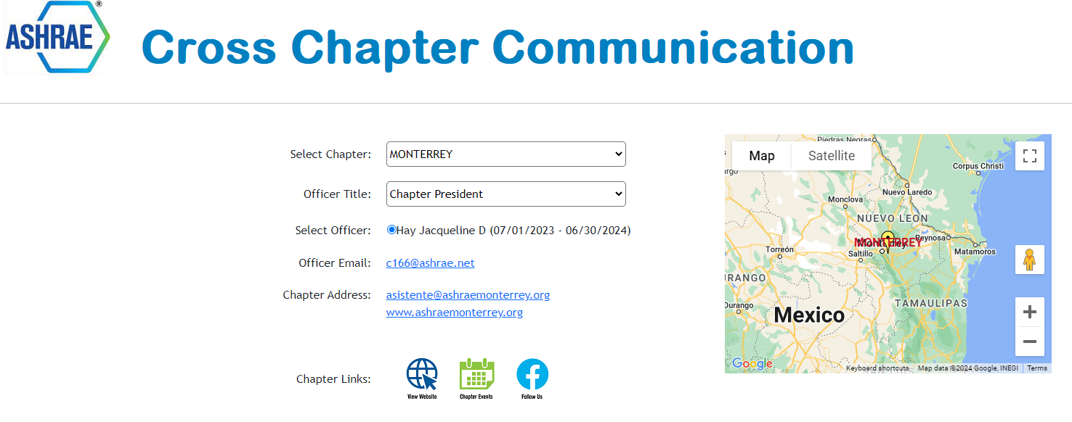
Cross Chapter Communications
Quickly connect with other chapter officers from chapters across the world using the new “Cross Chapter Communications” tool.
Click “Cross Chapter Communications” in CIQ:
Select Chapter and Officer you wish to contact:
This new tool is brought to you by a Society motion from the Monterrey Chapter.
Notes:
This second tool was also created as a result from a motion made at a Region VIII CRC. If you want to connect with someone at another chapter to share ideas, ask a question and make connections click the “Cross Chapter Communications” icon when logged in. You can select which chatper and which position you want to connect with. The member’s name and email address will populate.

Slide 23
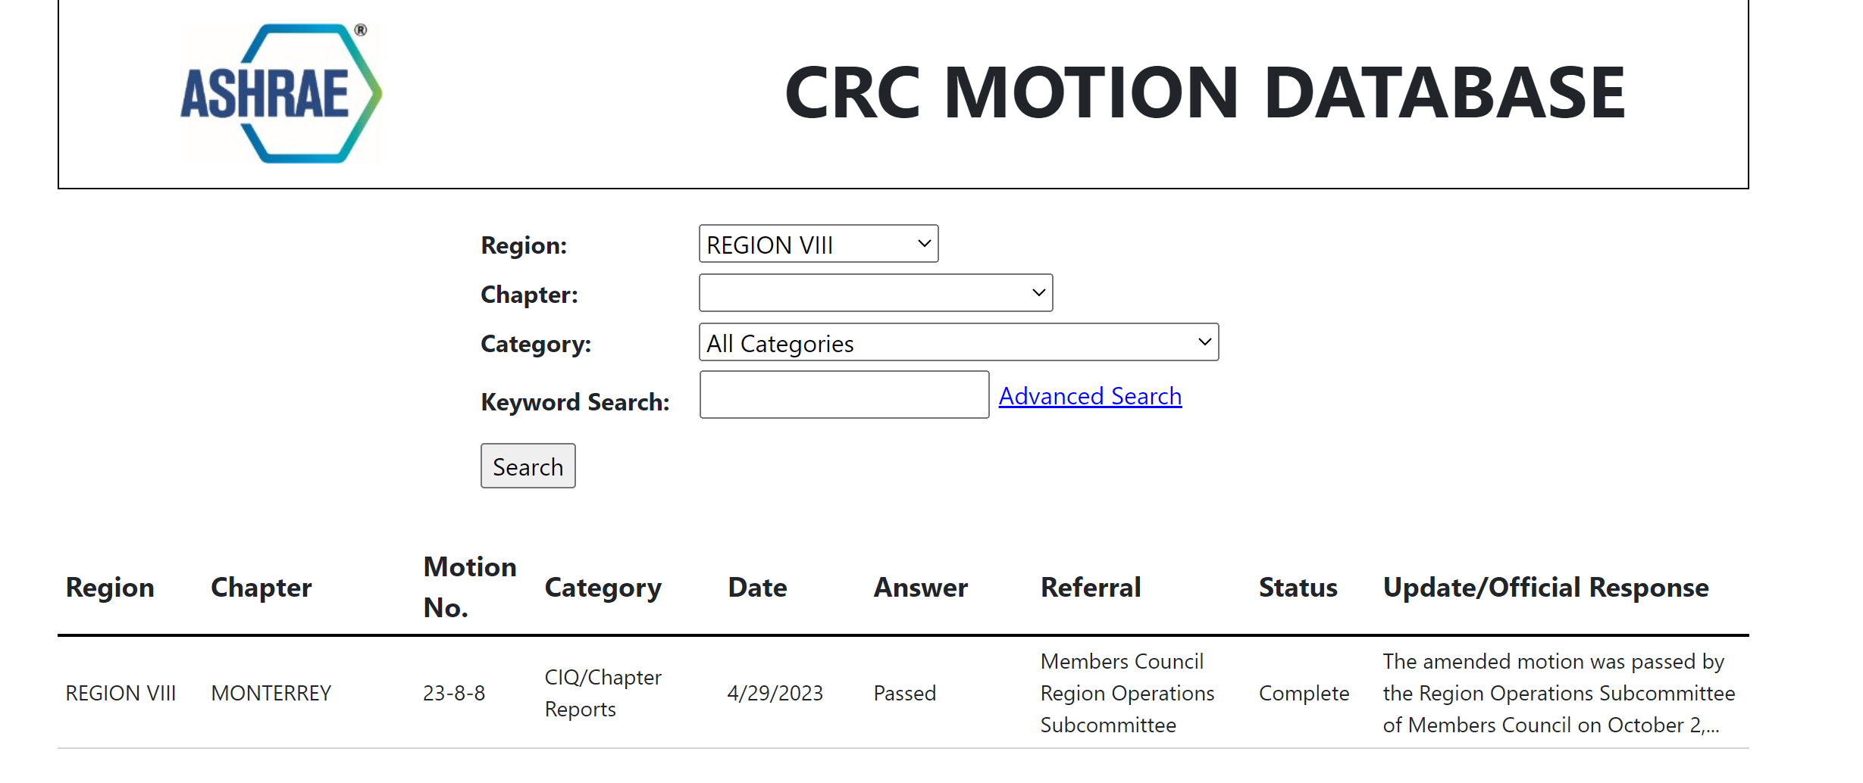
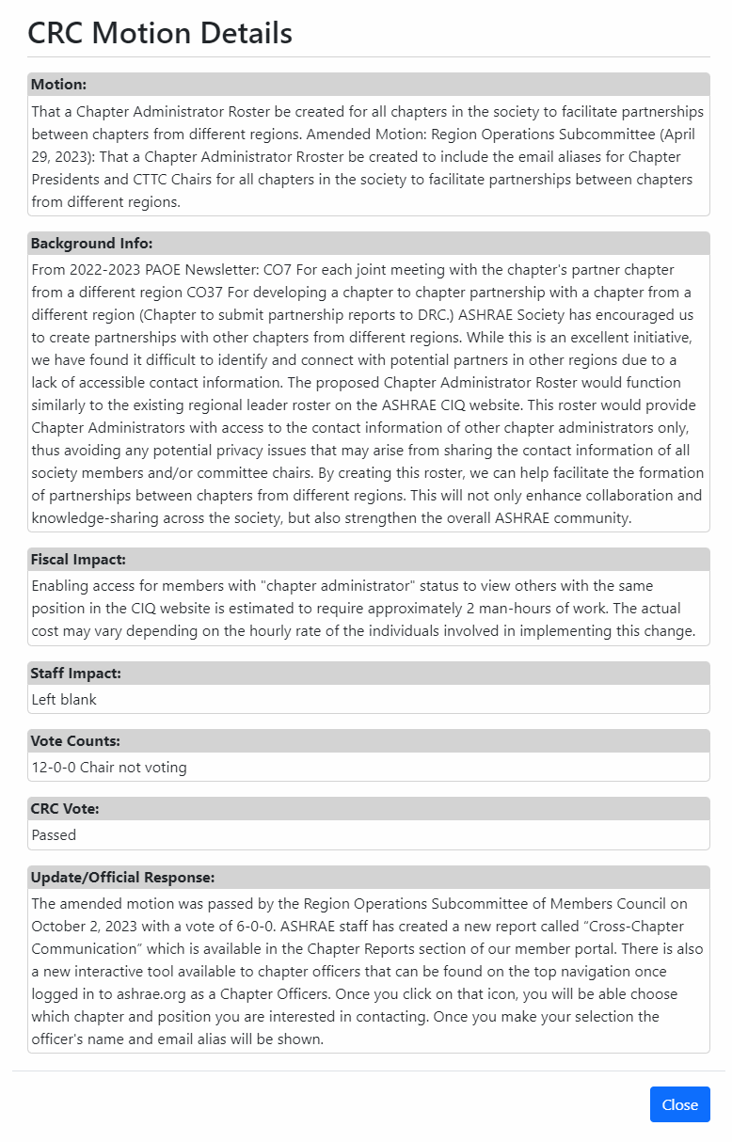
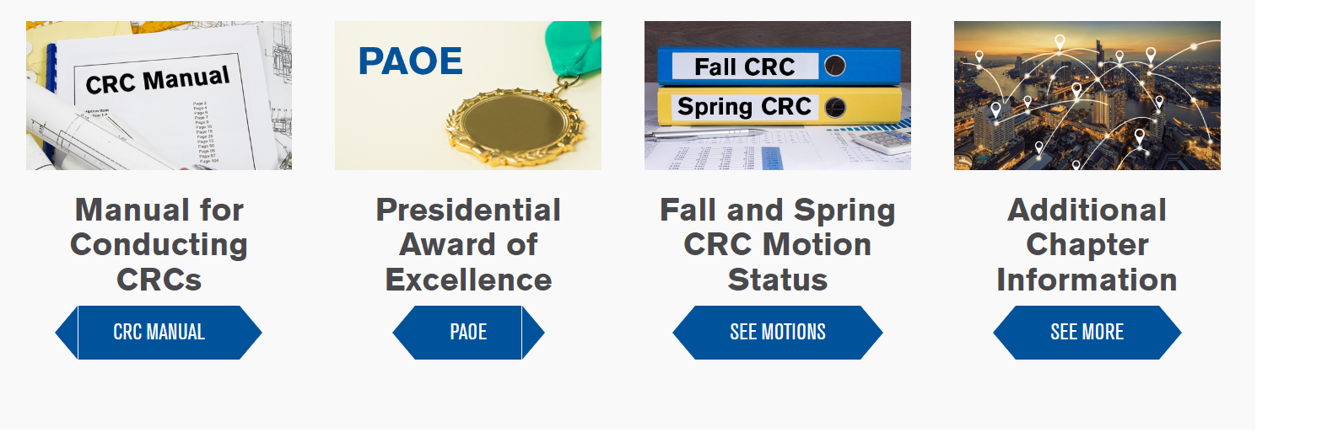
NEW! CRC Motion Database
Notes:
All Society level motions that are passed at CRC will now be entered into the CRC Motion Database. Anyone can view the ASHRAE Motion Database by going to ashrae.org > Communities > Chapters and click the “See More” button under Fall and Spring CRC Motion Status. When an update is made to a motion, the DRC, RMCR and Chapter President of the chapter that made the motion will get an automatic email notification that an update has been made with a link to view the update.

Slide 24
Phishing Email Guidance
If you receive an email that is from the Chapter President, DRC, RMCR, RVC or any Society officers like the Society President asking you to do something you don’t normally do (buy gifts, transfer money), it’s likely a scam. Suggested actions:
Don’t respond to the email.
Contact the person face to face, if possible, to question the email or contact them via telephone.
Do nothing until you can contact that person to confirm the request.
If you send money and are scammed, contact your company or if no policy is in place:
  Contact your bank immediately.
  Contact law enforcement.
  File a complaint.
  Brief the Board and Senior Management.

Slide 25
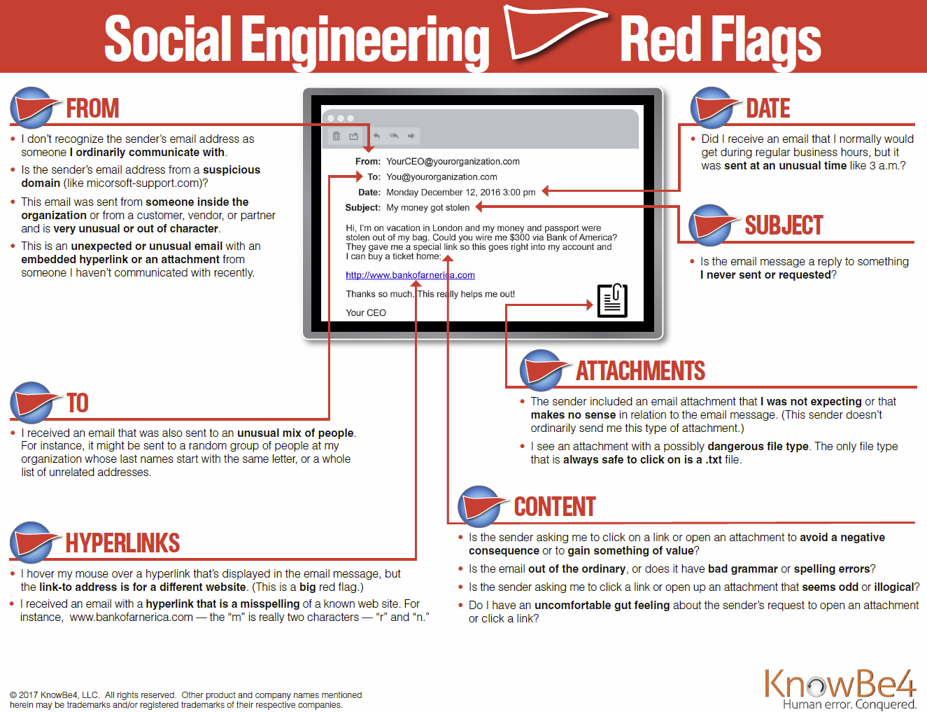

Slide 26



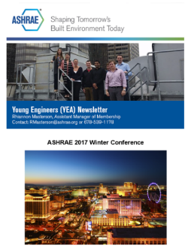
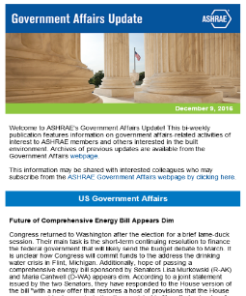
ASHRAE Newsletters
Want to subscribe or submit?
Email marketing@ashrae.org
Visit ashrae.org/newsletters
Student Newsletter
Professional Development Newsletter
Quarterly distribution
+7,000 subscribers
Distributed to Student Activities Chapter Chairs and Co-Chairs, Student Branch Advisors and Student Members
Monthly distribution
+56,000 subscribers
Distributed to current members, online subscribers and previous course attendees
Chapter Notes
Monthly distribution
1,800 subscribers
Distributed to Region and Chapter officers
YEA Newsletter
Government Affairs
Quarterly distribution
+9,200 subscribers
Distributed to YEA Members (under age 35)
Bi-weekly distribution
+2,400 subscribers
Distributed to Government Affairs
Chapter Notes is a volunteer focused newsletter created to be a welcome source of tools and resources to help ASHRAE volunteers do their job.

Slide 27


Marketing Central & Logo Merchandise
Where to Find Marketing Central on ashrae.org:
Search for “Marketing”
Look under the About tab
Check the Footer
Marketing Central
Resource for Society-related marketing materials
Resources organized by file type:
PowerPoint Presentations
Videos
Images /logos
Templates
Toolkits
Websites & Forms
News & Events
Going to a show? Order a pull-up banner or tabletop sign with your Chapter logo!
Hosting a Membership Event? Contact marketing@ashrae.org for stickers, pens, or brochures for your meeting or event.
Check out the Acronym Guide and Short URL List!
Check out the ASHRAE Logo Store for a selection of gifts and apparel.
ashrae.org/marketing
ashrae.org/merchandise

Slide 28
Chapter Resources
Director and Regional Chair (DRC) | Region Members Council Rep (RMCR) | Regional Vice Chairs (RVCs) | ASHRAE Staff
NAME | NAME | NAME, YEA | Tammy Catchings
EMAIL | EMAIL | NAME, MP | Pacia Williamsons
 |  | NAME, GAC | Lizzy Seymour
 |  | NAME, RP | regioninfo@ashrae.org
 |  | NAME, CTTC
 |  | NAME, SA

