Slide 1
LEADERSHIP PRESENTATION
Notes:
Welcome! The topics presented today will follow the 6 main headers in the menu of ashrae.org to assist viewers in navigating where to learn more about information presented today.

Slide 2
ABOUT
ASHRAE Policies
TECHNICAL RESOURCES
PROFESSIONAL DEVELOPMENT
CONFERENCES
COMMUNITIES
MEMBERSHIP
Code of Ethics
Harassment and Discrimination
Commercialism
We will act with honesty, fairness, courtesy, competence, inclusiveness and respect for others, which exemplify our core values of excellence, commitment, integrity, collaboration, volunteerism and diversity, and we shall avoid all real or perceived conflicts of interest.
ASHRAE strictly prohibits and does not tolerate discrimination against members or applicants for membership because of such individual’s race, color, religion, age, sex, sexual orientation, national origin, physical or mental disability, pregnancy, genetic information, veteran status, uniformed service member status, or any other category protected under applicable law.
ASHRAE’s Commercialism Policy allows for Society activities that fulfill the mission of technological advancement with adherence to business plans that generate income to offset operational expenses such as AHR Exposition, ASHRAE periodicals, website, and Society conference events such as the Welcome Party, luncheons, registration kits, and receptions.
Value Statement
In ASHRAE meetings, we will act with honesty, fairness, courtesy, competence, inclusiveness and respect for others, which exemplify our core values of excellence, commitment, integrity, collaboration, volunteerism and diversity, and shall avoid all real or perceived conflicts of interest. Our culture is one of inclusiveness, acknowledging the inherent value and dignity of each individual. We celebrate diverse and inclusive communities, understanding that doing so fuels better, more creative and more thoughtful ideas, solutions and strategies for the Society and the communities our Society serves. We respect and welcome all.
Notes:
View ASHRAE Governing Documents at ashrae.org/about/governance

Slide 3
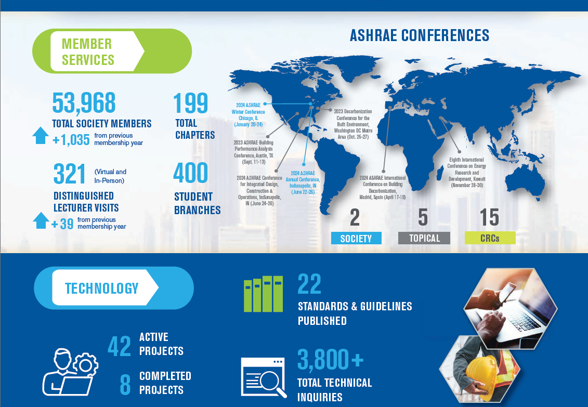
ABOUT
ASHRAE Resources
TECHNICAL RESOURCES
PROFESSIONAL DEVELOPMENT
CONFERENCES
COMMUNITIES
MEMBERSHIP
SOCIETY SNAPSHOT
MARKETING CENTRAL
Logos & Branding Guide
Flyers | Brochures | Presentations | Graphics | Canva Templates
Notes:
Additional resources in the ‘About’ section include the latest Society Snapshot for download and review, as well as Marketing Central. If you haven’t looked at Marketing Central it’s a wealth of information for members and chapters to assist in their promotion efforts. This page provides presentations, social media templates, branding guides, and much more.

Slide 4
ABOUT
ASHRAE Resources
TECHNICAL RESOURCES
PROFESSIONAL DEVELOPMENT
CONFERENCES
COMMUNITIES
MEMBERSHIP
The Planning Committee and ASHRAE Board of Directors are seeking feedback regarding the next Strategic Plan.
We are looking for your feedback on:
High-priority industry topics
ASHRAE products and services
ASHRAE’s industry impact
Submit feedback via the Strategic Plan Feedback Form on ASHRAE’S homepage.
The new ASHRAE Strategic Plan is to be announced at the
2025 Winter Conference.
Submit
Notes:
A few of the many resources in the ‘About’ section of ashrae.org include the Strategic Plan. The Planning Committee and ASHRAE Board of Directors are seeking feedback from you as we gear up to create the next plan. Check the Strategic Plan page in the About Section to submit feedback.

Slide 5
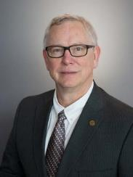
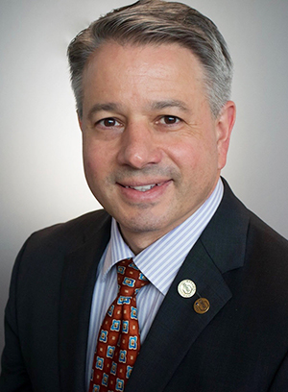
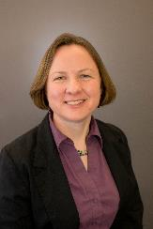
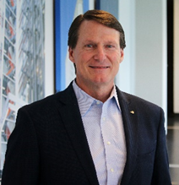
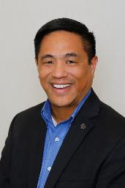
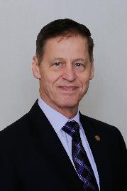
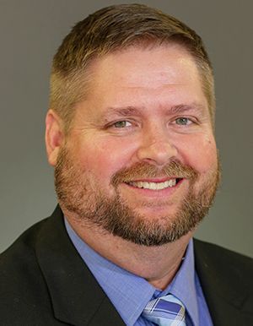
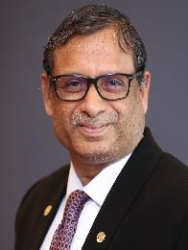
ABOUT
ASHRAE Board of Directors
TECHNICAL RESOURCES
PROFESSIONAL DEVELOPMENT
CONFERENCES
COMMUNITIES
MEMBERSHIP
President
President-Elect
Treasurer
Secretary
M. Dennis Knight, P.E.
BEMP, Fellow Life Member ASHRAE
Mt. Pleasant
South Carolina
Bill McQuade, P.E.
Fellow ASHRAE
Jessup,
Maryland
Sarah Maston, P.E., BCxP, LEED AP
Hudson, Massachusetts
Jeff Littleton
Peachtree Corners, Georgia
Vice Presidents
Kenneth Fulk, P.E.
Allen, Texas
Wade Conlan, P.E.
BCxP, CxA Maitland, Florida
Chandra Sekhar, Ph.D., CPEng.
Fellow ASHRAE
Singapore
Devin Abellon, P.E.
Portland, Oregon
Notes:
2024-25 Board of Directors Executive Committee
Through an elaborate committee structure, including committees and councils, ASHRAE policies are established by a Board of Directors comprised of Society members elected by the membership. Board members serve terms of one to three years, including the President who serves a one‐year term.

Slide 6
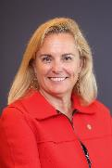
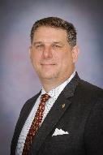
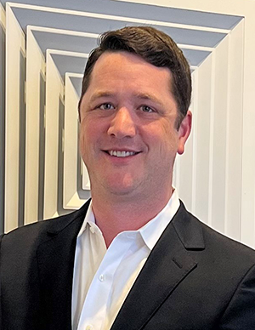
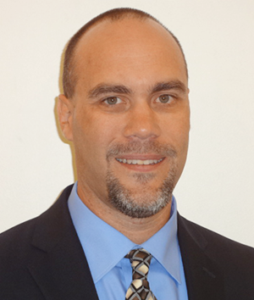
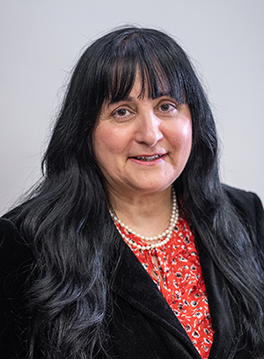
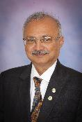
ABOUT
ASHRAE Director and Regional Chairs
TECHNICAL RESOURCES
PROFESSIONAL DEVELOPMENT
CONFERENCES
COMMUNITIES
MEMBERSHIP
Region I
Region II
Region III
Region IV
Region V
Charles Bertuch
Manlius, New York
Genevieve Lussier
Quebec, Canada
Sherry Abbott-Adkins, P.E., CPD, GPD, LEED AP Westminster, Maryland
Bryan Holcomb
Oak Ridge, North Carolina
James Arnold, P.E.
Dublin, Ohio
Region VI
Region VII
Region VIII
Region IX
Region X
Susanna Hanson
La Crosse, Wisconsin
Scott Peach, P.E.
Mobile, Alabama
Joseph Sanders Oklahoma City, Oklahoma
Jonathan Smith, P.E.
Lenexa, Kansas
Buzz Wright, P.E.
Tucson, Arizona
Region XI
Region XII
Region XIII
Region XIV
Region XV
Region-at-Large
Submit nominations for others and/or yourself
ashrae.org/committee-nominations
Rob Craddock
Saskatchewan, Canada
John Constantinide, P.E.
Merritt Island, Florida
Cheng Wee Leong, P.E.,
Singapore
Mahroo Eftekhari, CEng., DPhil
Loughborough, UK
Richie Mittal, Fellow ASHRAE
New Delhi, India
Bassel Anbari, P.E.
Abu Dhabi, United Arab Emirates
Notes:
2024-25 Board of Directors Director and Regional Chairs

Slide 7
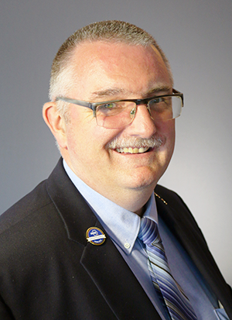
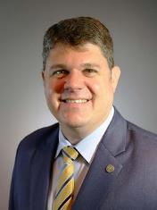
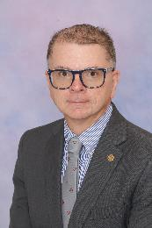
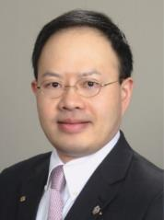
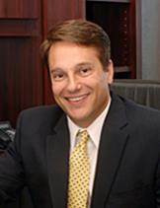
ASHRAE Directors at Large
ABOUT
TECHNICAL RESOURCES
PROFESSIONAL DEVELOPMENT
CONFERENCES
COMMUNITIES
MEMBERSHIP
Doug Cochrane, P.Eng.
Mississauga, Ontario, Canada
Blake Ellis, P.E.
Overland Park, Kansas
Patrick Marks, P.E.
York, PA
Corey Metzger, P.E. Ames, Iowa
Carrie Brown, Ph.D.
Oakland, California
Wei Sun, P.E.
Ann Arbor, Michigan
David Yashar, Ph.D.
Gaithersburg, Maryland
Luke Leung, P.E, BEMP
Clarendon Hills, Illinois
Heather Schopplein-Anderson, P.E.
Santee, California
Submit nominations for others and/or yourself
ashrae.org/committee-nominations
Notes:
2024-25 Directors-at-large

Slide 8
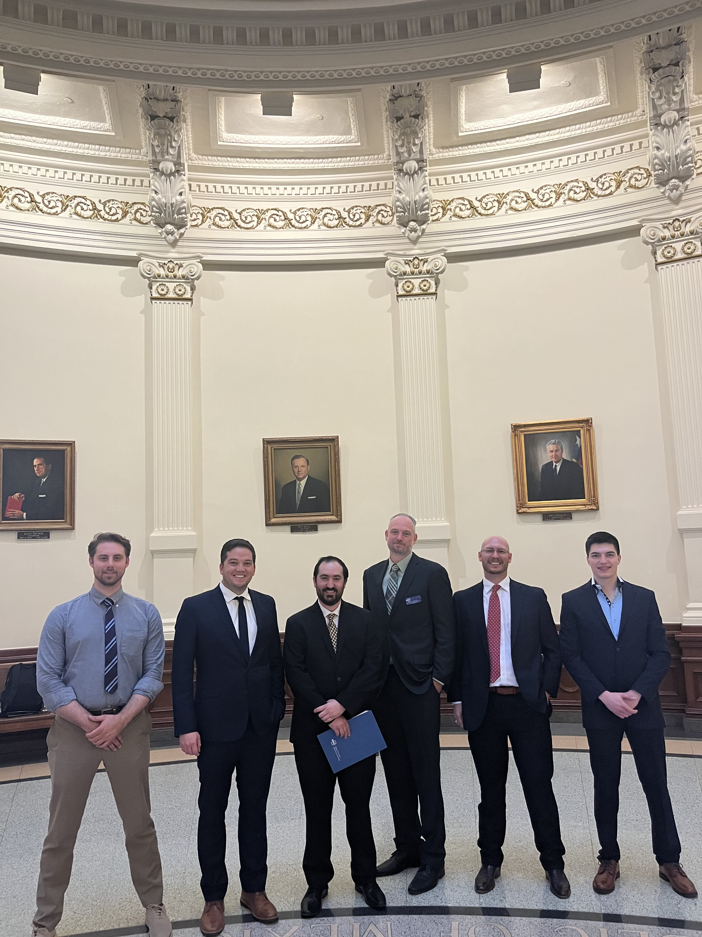
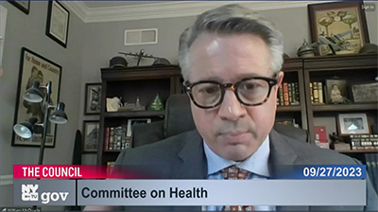
Government Affairs
ABOUT
TECHNICAL RESOURCES
PROFESSIONAL DEVELOPMENT
CONFERENCES
COMMUNITIES
MEMBERSHIP
GOVERNMENT OUTREACH
GOVERNMENT AFFAIRS UPDATE
LETTERS & TESTIMONY
BI-WEEKLY NEWSLETTER
Submit nominations for others and/or yourself
ashrae.org/committee-nominations
Sign up online or email GovAffairs@ashrae.org
Get Involved!

Slide 9
ABOUT
Research: Supporting ASHRAE’s Mission
TECHNICAL RESOURCES
PROFESSIONAL DEVELOPMENT
CONFERENCES
COMMUNITIES
MEMBERSHIP
Society Year 2023-2024
$2.7M Research Promotion Campaign
(Research, YEA, ALI, Scholarships, General)
$1.5M Raised for Endowments
$232,100 Awarded through 52 Scholarships
$2M Raised for Research
$1.1M Given by ASHRAE
Regions, Chapters and Sections
$57,600 Raised by College of Fellows and Life Members Club
More than 4,000 contributions from Members, Organizations and other Associations

Slide 10
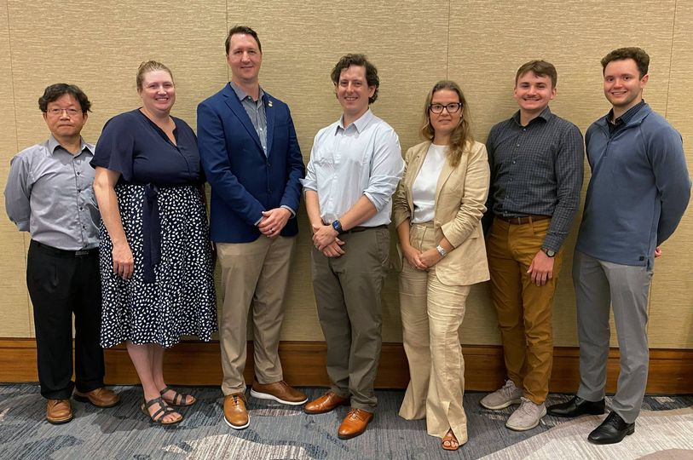
ABOUT
Decarbonization Challenge Fund
TECHNICAL RESOURCES
PROFESSIONAL DEVELOPMENT
CONFERENCES
COMMUNITIES
MEMBERSHIP
The Decarbonization Challenge Fund is a year-long competitive fund offering $1,000-$10,000 to implement decarbonization projects within local chapters.
Contact your Chapter YEA Representative for more information.
Applications due November 15, 2024.

Slide 11
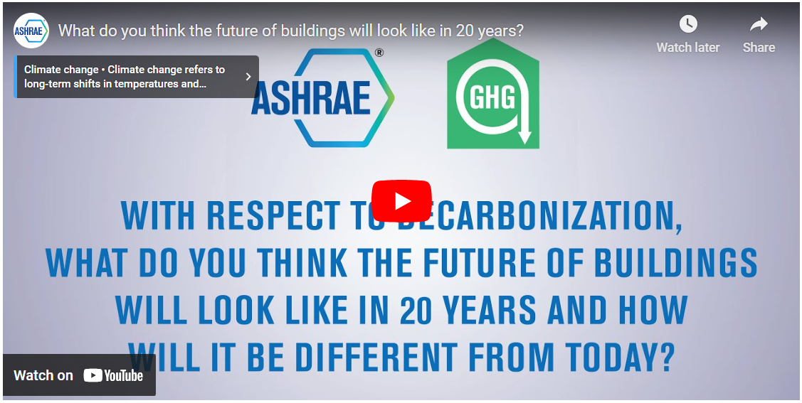
ABOUT
Center for Excellence in Building Decarbonization
TECHNICAL RESOURCES
PROFESSIONAL DEVELOPMENT
CONFERENCES
COMMUNITIES
MEMBERSHIP
Task Force for Building Decarbonization
is now called:
Center for Excellence in Building Decarbonization (CEBD).
Coming this Fall: Training On the Grid Guide and Hospital Guide
Notes:
Starting July 1 the Task Force for Building Decarbonization is now known as the “Center for Excellence in Building Decarbonization” (CEBD). No longer a task force but a standing committee in Society. The focus of the Center will be providing strategic direction on the ongoing efforts of ASHRAE to provide resources for decarbonizing the built environment, on a permanent basis.
The webpage reflects the name change and the decarbonization related resources will continue to made available from the CEBD including videos from ASHRAE’s bimonthly video series on Youtube and the webpage.

Slide 12
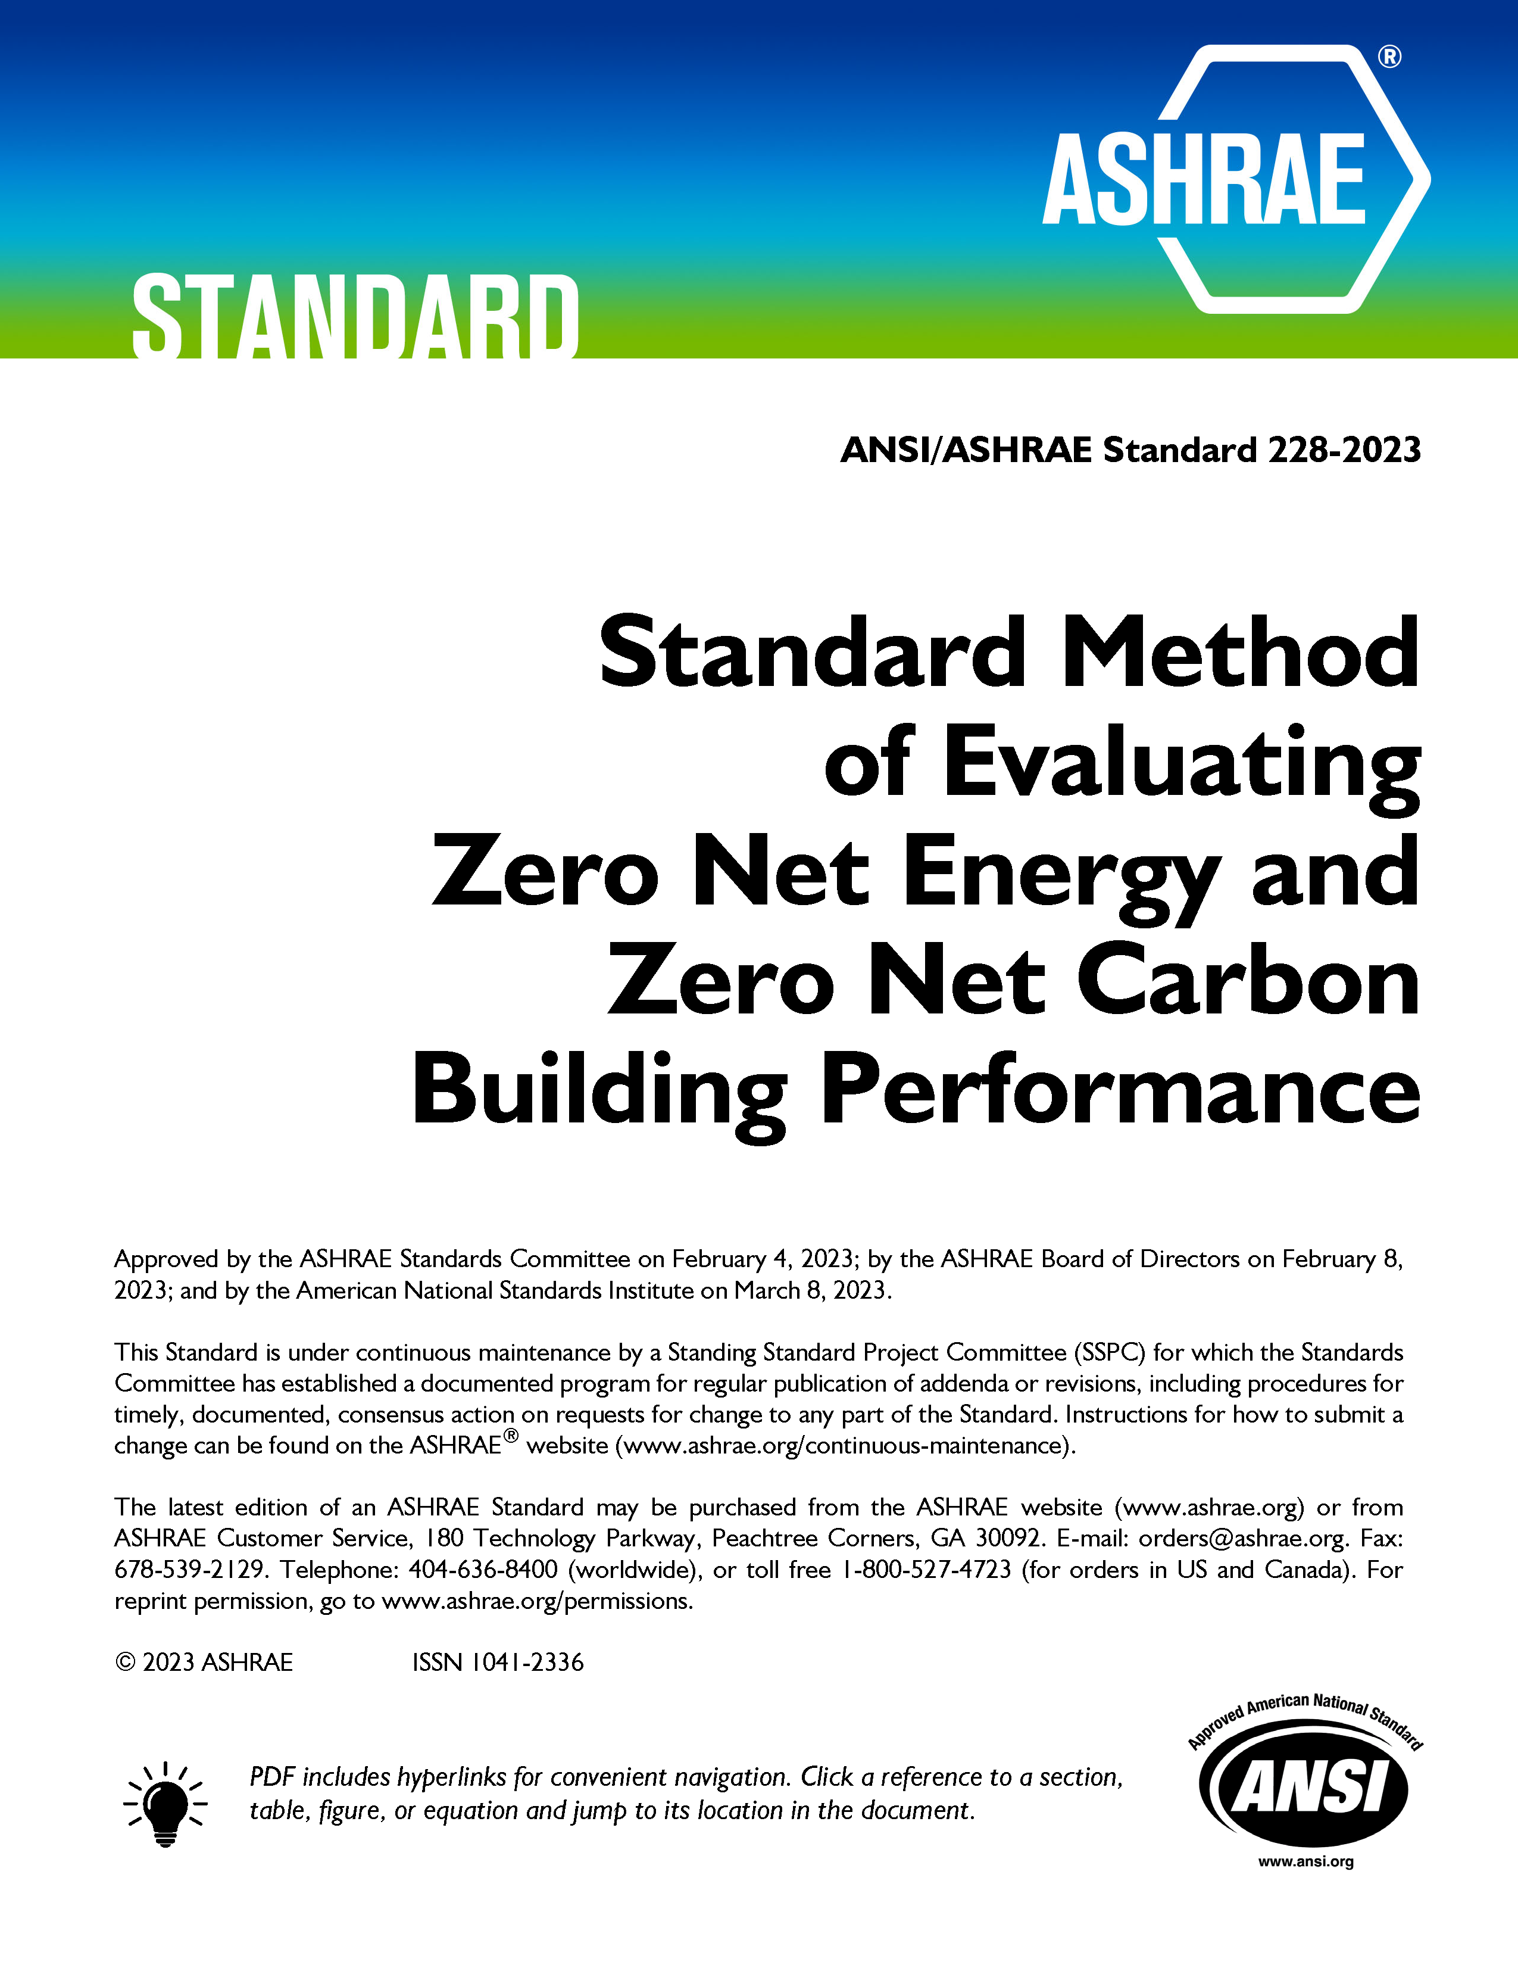
ABOUT
Standards
TECHNICAL RESOURCES
PROFESSIONAL DEVELOPMENT
CONFERENCES
COMMUNITIES
MEMBERSHIP
Now Available in Spanish
First of Its Kind
Newly Updated for 2024
Notes:
Standard 241: establishes minimum requirements aimed at reducing the risk of disease transmission through exposure to infectious aerosols in new buildings, existing buildings, and major renovations. Now available in Spanish!
Standard 228: sets requirements for evaluating whether a building or group of buildings meets a definition of “zero net energy” or a definition of “zero net carbon” during building operation.
New 2024 Update of Standard 100: This essential ASHRAE resource offers over 100 typical energy efficiency measures (EEMs) that can be applied to enable buildings to meet set energy targets, identifying commonly applied elements that can improve building performance.

Slide 13
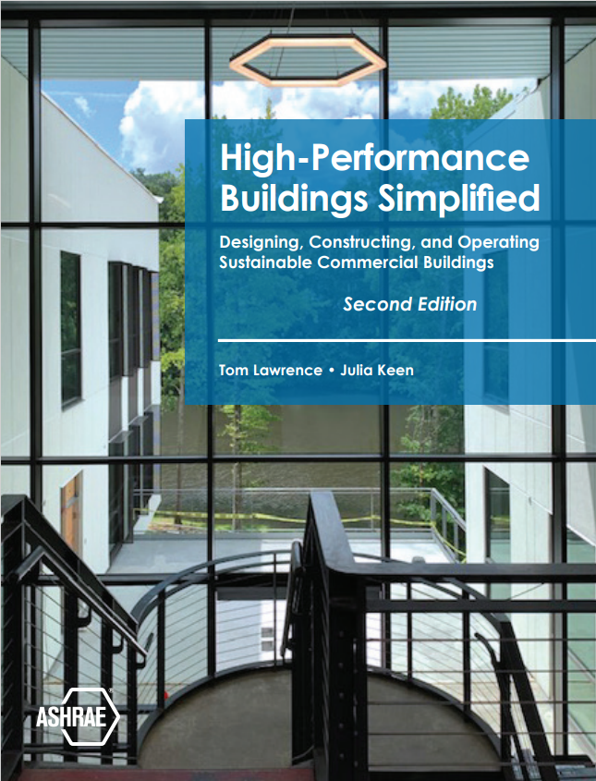
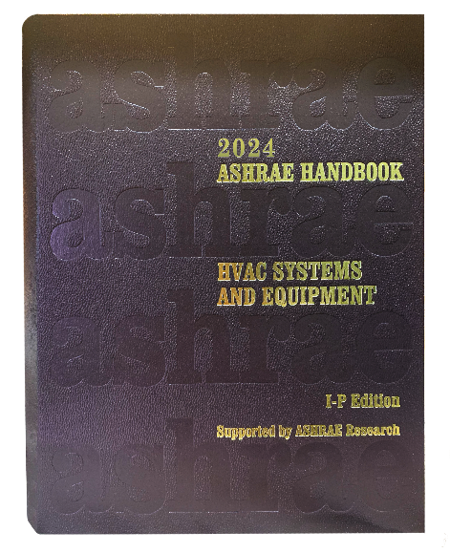
ABOUT
ASHRAE Bookstore
TECHNICAL RESOURCES
PROFESSIONAL DEVELOPMENT
CONFERENCES
COMMUNITIES
MEMBERSHIP
Get the Latest and Greatest Publications from 2024
Notes:
High-Performance Buildings Simplified 2nd Edition
Explore the intricacies of high-performance building design with the newly updated edition of High-Performance Buildings Simplified. Designed for both engineering students and early career professionals, this comprehensive book offers a clear, accessible approach to the fundamental principles of sustainable building practices.
The Authors Tom Lawrence and Julia Keen will give an author talk on Sunday, June 23, from 3-4 PM at the Indianapolis Bookstore.
The 2024 ASHRAE Handbook—HVAC Systems and Equipment
The HVAC Systems and Equipment volume has been extensively updated and revised to help engineers understand their systems and make their jobs easier, covering everything from residential split systems to industrial gas cleaning, germicidal UV, solar panels, and boiler and liquid-chilling systems.
Lucy Goes Green
In the second ASHRAE children’s book, Lucy goes with her classmates on a field trip to a sustainable farm, where they learn about using solar panels and windmills and conserving water through rainwater collection.
Commercial Kitchen Ventilation
One of the primary goals of this book is to share with the HVAC and food service industry the cumulation of decades of CKV research and design experience that has transformed the design and operation of CKV systems from rules of thumb into fact-based standards and best practices that are based on scientific research and practical experience.

Slide 14
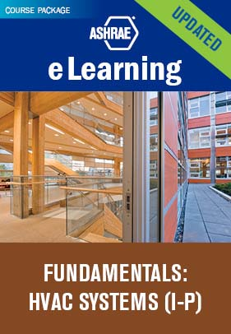
ABOUT
Professional Development
TECHNICAL RESOURCES
PROFESSIONAL DEVELOPMENT
CONFERENCES
COMMUNITIES
MEMBERSHIP
eLearning
ASHRAE Learning Institute
Certification
Recently Updated
New Trainings in Indianapolis
Standard 241
Control of Infectious Aerosols
New Certification ​
Understanding Standard 241
June 25 | 9 AM
Applying Standard 241
June 25 | 1 PM
Notes:
Elearning
Our newly updated Fundamentals: HVAC Systems eLearning course package has been meticulously crafted to provide you with the knowledge and skills you need to excel in the HVAC field.
ALI
NEW! Understanding ASHRAE Standard 241 Control of Infectious Aerosols – Background, Overview, and Key Requirements This course provides background on airborne transmission and airborne infection risk mitigation and gives a comprehensive introduction to Standard 241. Key definitions and requirements for compliance, including equivalent clean airflow rates and air cleaner effectiveness and safety testing, are discussed in detail, and illustrated with examples. Assessment, planning, and operation and maintenance are summarized.
9:00 a.m. – 12:00 p.m., JW Marriott – Indianapolis
NEW! Is Your Building Ready? Applying ASHRAE Standard 241 Control of Infectious Aerosols – Facility Assessment, Planning, and Implementation
This course focuses on effectively applying ASHRAE Standard 241 to reduce the indoor risk of airborne disease transmission with minimal cost and energy use impact. 1:00 p.m. – 4:00 p.m., JW Marriott - Indianapolis
Certification
NEW! ASHRAE Certification launched: Certified Decarbonization Professional (CDP) certification validates competency of the professional to Assess, analyze, and develop effective and sustainable strategies that reduce/eliminate the life-cycle carbon footprint of new and existing buildings.
CDP certification application opened in March and examination at over 1,000 test centers worldwide begins on June 25.

Slide 15
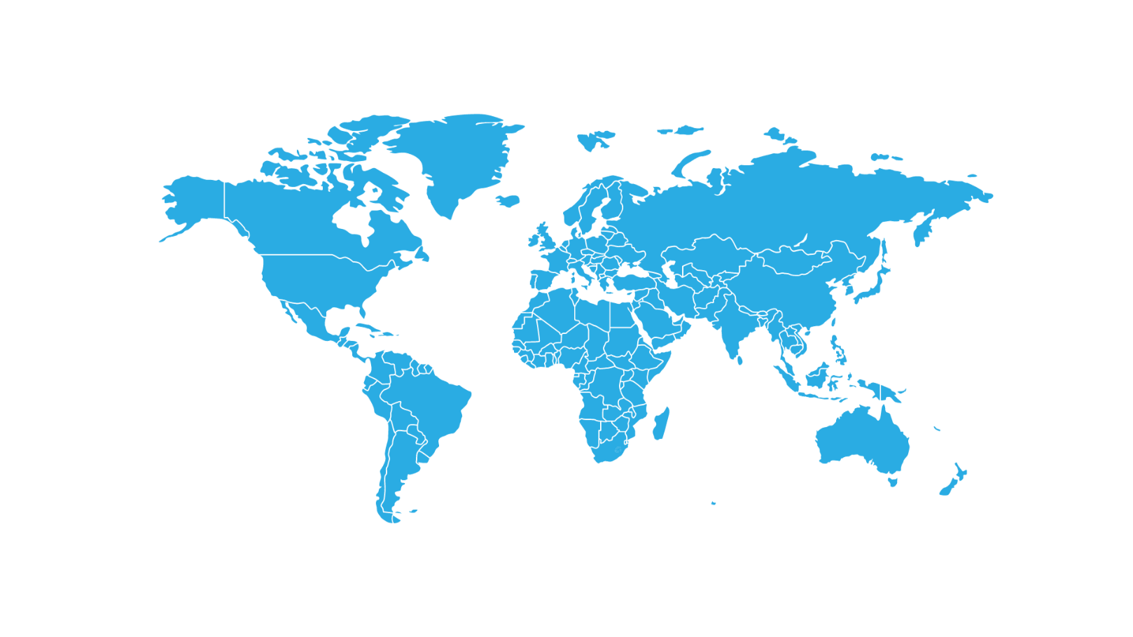
ABOUT
2024-25 Topical Conferences
TECHNICAL RESOURCES
PROFESSIONAL DEVELOPMENT
CONFERENCES
COMMUNITIES
MEMBERSHIP
Chicago, September 26-27, 2024
Women in ASHRAE Leadership Symposium
Beirut, Oct 3-4, 2024
The Sixth International Conference on Efficient Building Design
New York City, October 21-23, 2024
2024 ASHRAE Decarbonization Conference: Decarbonizing Existing Tall Buildings
Qatar, April 23-24, 2025
Third International Conference on Energy and Indoor Environment for Hot Climates
Montreal, September 24-26, 2025
IEQ 2025 Conference

Slide 16
ABOUT
2025 ASHRAE Winter Conference
TECHNICAL RESOURCES
PROFESSIONAL DEVELOPMENT
CONFERENCES
COMMUNITIES
MEMBERSHIP
Registration opens in fall 2024. See you in Orlando!

Slide 17
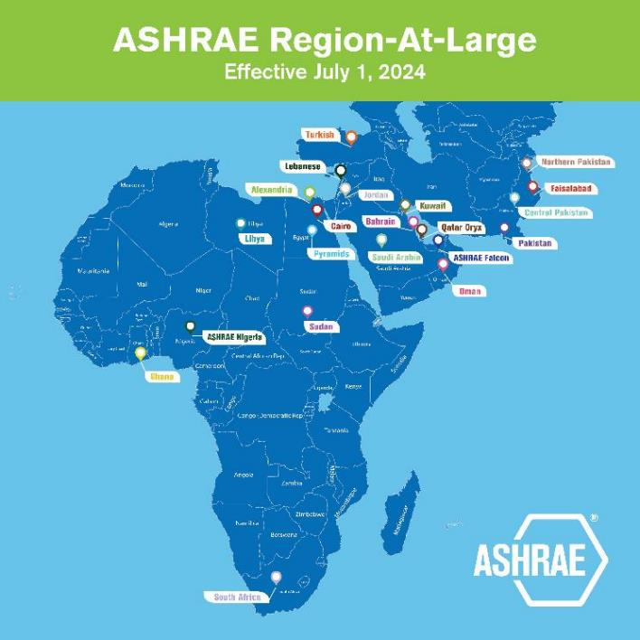
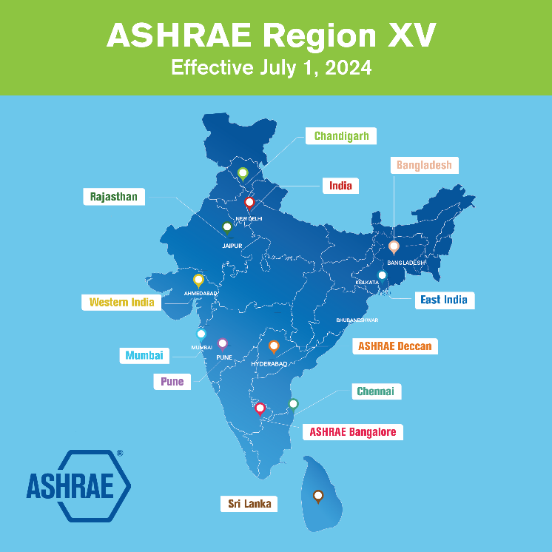
ABOUT
New ASHRAE Region XV
TECHNICAL RESOURCES
PROFESSIONAL DEVELOPMENT
CONFERENCES
COMMUNITIES
MEMBERSHIP
Director and Regional Chair: Bassel Anbari
Director and Regional Chair: Richie Mittal
Notes:
Effective July 1, the Region at Large has split and created a new Region XV. Please see details at ashrae.org/regions.

Slide 18
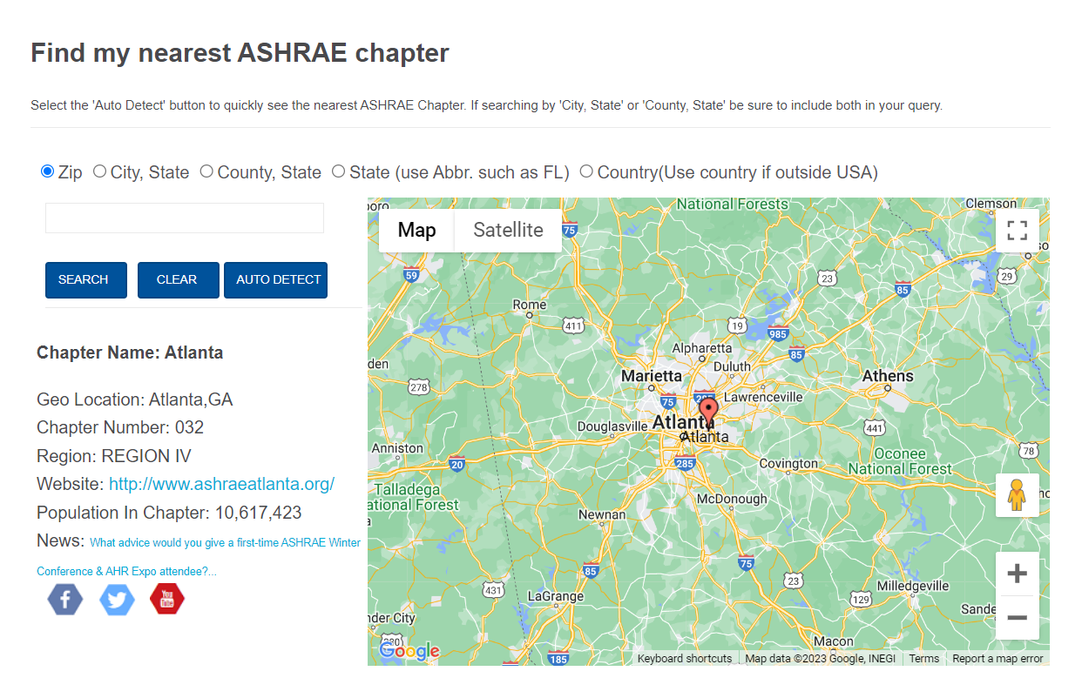
ABOUT
Get Involved with Committees & Chapters
TECHNICAL RESOURCES
PROFESSIONAL DEVELOPMENT
CONFERENCES
COMMUNITIES
MEMBERSHIP
Find Committees and Nominate Yourself or Others
Find Chapter Information Using the Chapters Map
FEB
2024
February: Nominations for appointed committees are due.
JUN
2024
June: Speak with your committee ExO/CO if your current appointment/elected position ends to be nominated for another.
September: Nominations for elected positions are due. (Publications & Education Council, Tech Council, RAC, TAC,
Standards, Handbook, Nominating)
SEP
2024
Notes:
Submit nominations for others and/or yourself for council or committees in the Committee Nominations page in the Communities section.
Also in the Communities section is a convenient map to search for ASHRAE Chapters – just use autodetect or search by location to find the nearest chapter including the Chapter’s website info.

Slide 19
ABOUT
Membership
TECHNICAL RESOURCES
PROFESSIONAL DEVELOPMENT
CONFERENCES
COMMUNITIES
MEMBERSHIP
New! GroupPay allows for a single payment for all employees within an organization.
Memberships are still individual to the employee and cannot be transferred within the organization.
Primary contact at the organization will have access to an online portal to manage group.
Learn more and sign up! Email GroupPay@ashrae.org
GroupPay
HONORS & AWARDS
The following award nominations have a DEC 1 deadline:
Fellow | Honorary Member | ASHRAE Hall of Fame | F. Paul Anderson Award
ASHRAE Pioneers of the Industry | Award for Distinguished Public Service
Notes:
The GroupPay program is designed to allow for an easy payment from a single invoice for all employees within an organization. Email GroupPay@ashrae.org to sign up, or for more information.

Slide 20
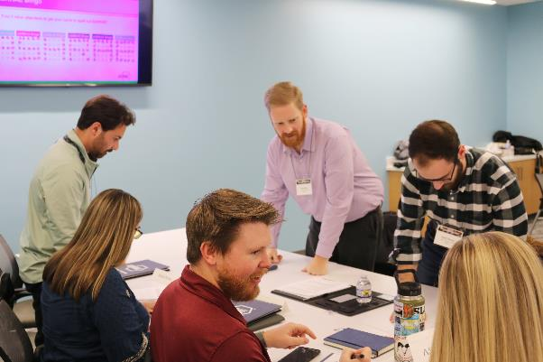
ABOUT
2025 Chapter Leadership Academy
TECHNICAL RESOURCES
PROFESSIONAL DEVELOPMENT
CONFERENCES
COMMUNITIES
MEMBERSHIP
January 10-11, 2025
ASHRAE Headquarters
Peachtree Corners, GA
Interested? Tell Your DRC by Oct. 11
Chapter Leadership Academy is a 1.5-day crash course designed to simplify the learning curve of all things ASHRAE.
Navigating the ASHRAE organizational structure
Understanding the tools and resources available to help Chapters and their members succeed
Delegating to and motivating volunteers toward the ASHRAE mission
Notes:
Chapter Leadership Academy is a 1.5-day crash course designed to simplify the learning curve of all things ASHRAE. Attendees will gain a better understanding of how ASHRAE Society functions and obtain useful and practical knowledge essential for honing ASHRAE leadership skills. The program also will include sharing tips and best practices that attendees can confidently take back to their Chapters for implementation. Attendees help shape the discussion, too! A significant part of the program will be based on hot topics and ASHRAE-related challenges that attendees have identified they would like to see addressed.
Contact your Director and Regional Chair (DRC) TODAY! DRCs will approve attendees from their region –and up to four attendees will be approved from each Region. Those interested should contact their DRC before October 11. All attendees will be approved to register by October 21.

Slide 21
Media Inquiries
Notes:
ASHRAE's PR team have tools and resources available to vet media inquires, research media contacts and arrange appropriate responses. Please send all media inquires to publicrelations@ashrae.org for support.

Slide 22
Thank you! Questions or Comments?

