Slide 1
Chapter Program Ideas
Notes:
It is good to test your PowerPoint with the projector you will actually use before you present. Sometimes the slides look good on the computer but look much different on a large screen once combined with a projector. The preview may be a cause to change the slide design to make the text easier to read. It is desirable to have this slide on before the meeting starts to alert people to whether they are in the correct location. It is good to edit this slide to have the correct Region, month, year and location. You are welcome to customize the slide design to your taste.
Click to add contact information.

Slide 2
Monthly Program Topics/Formats
Panel programs or forums
Technical tours/field trips
Technical/research talks
Student/Membership Promotion
CTTC Tech Hours
All day Chapter seminars
Co-sponsored conferences/seminars
National Engineers Week
Non-technical talk
Joint meetings – USGBC/AIA
Facilities management
Community service activities
Notes:
Here are examples of proven successful program types. This is a good opportunity to have some Chapters discuss examples of these different type of meetings. However, there are two summary slides on monthly programs with details to be covered on later slides. As an alternate you could review the later slides and use them as your talking notes for these two slides; your choice. As such avoid too detailed discussion here unless you delete the later slides.

Slide 3
Technical Talks
ASHRAE energy efficiency standards
Indoor air quality or environmental health
Ventilation/fans/pumping systems
Building moisture control
Refrigeration design
Life safety (liability/codes)
BacNet/Communications Protocol
Commissioning
Building science topic other than HVAC&R
Natural or low GWP refrigerants (Std. 15 & 34, future refrigerants, cold chain, etc.)
GAC presentation
Residential applications
Decarbonization
Notes:
Examples of Technical Talks.

Slide 4
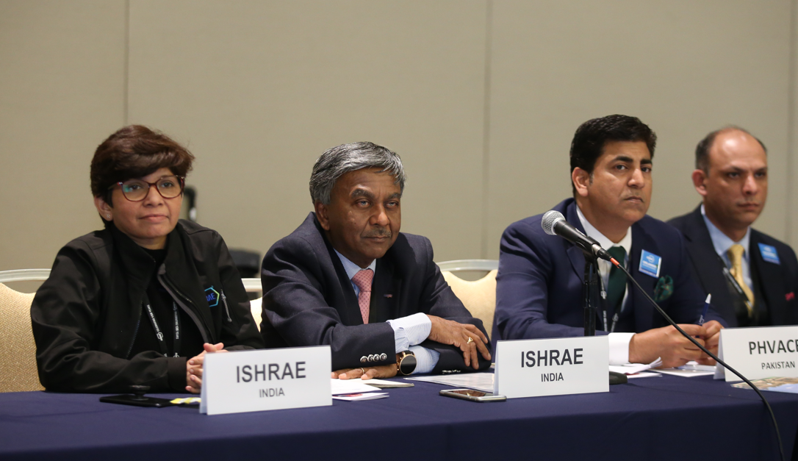
Panel Forum
Contractor
Engineer
Architect
Owner
Code Official
Developer
Notes:
Example of Panel Discussion members; I suggest limiting to about 4 people. If promoted properly, these can quadruple attendance.
Panel forums must have a strong moderator to keep the discussion on task.

Slide 5
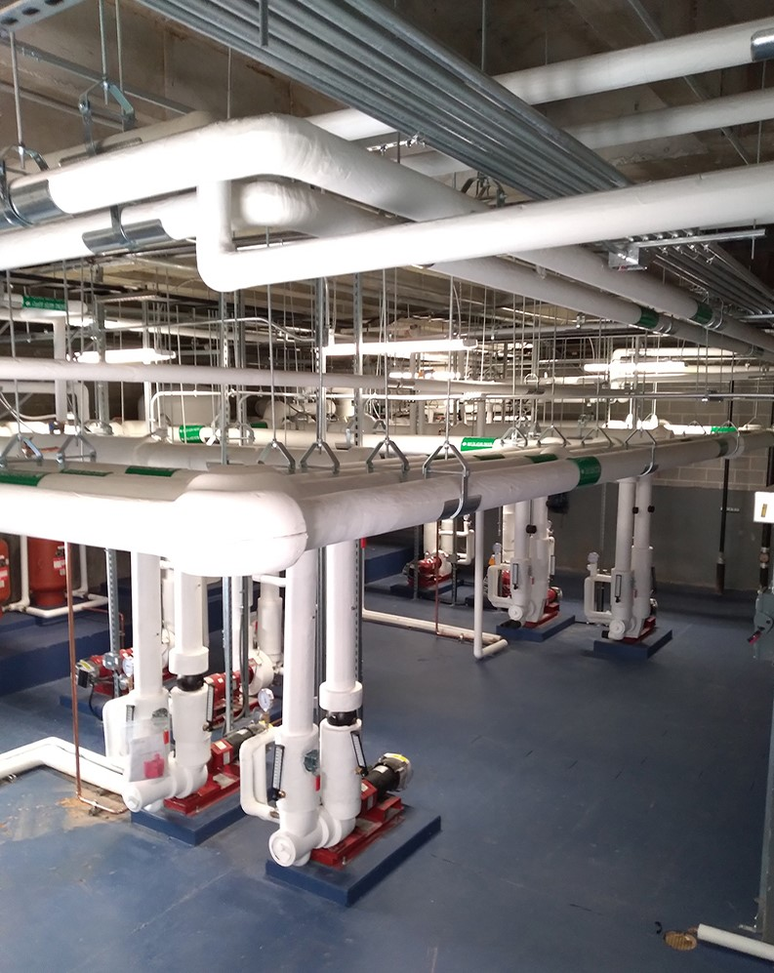
Field Trips
University research labs
Industrial food or beverage processing plant
Application installations
Laboratories
Plant tour
Breweries
Clean rooms
Low temperature manufacturing facility
Cold storage warehouse
Modern supermarket
Notes:
Examples of field trips. Let others tell their success stories.

Slide 6
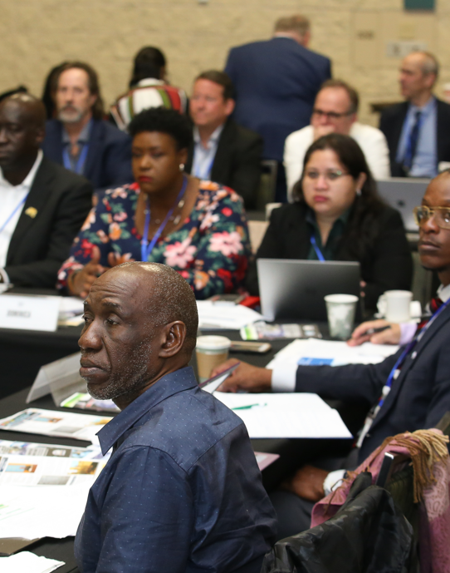
Research Talks
ASHRAE Research (Research Administration Committee Members)
University research
Trade association research
Private research
Notes:
Examples of research talks. Having a research firm or University research team report on the results of an ASHRAE research project can be quite informing. Research by others on items of interest to ASHRAE works as well. Do not let a Research Promotion Chair just present a long list of ASHRAE project topics for a program or use the entire meeting to solicit donations.

Slide 7
Joint Meetings
Other nearby Chapters
Other societies
Engineering
Technical
Architects
Construction
Contracting
Trade
CSMPS/SMPS
Notes:
Your imagination can go to work here. Think of a joint engineer and Architectural Society meeting, other Engineering Societies, Contractor Organizations, Building Owners, etc. Again, without good promotion, none of these will be successful.

Slide 8
Non-Technical Talks
Diversity, Equity, and Inclusion (DEI)
Leadership skills
Legal issues (owner, architect, engineer, contractor, manufacturer, sales agent)
Check with local Bar Association/Professional Liability Insurance firms for speakers
Research and Membership Promotion nights
Building manager/owner problems
Business management, developing economies, legal education
Notes:
Examples of non-technical programs. For Research Promotion nights I suggest you have your RP Chair highlight a few funded Research project descriptions (just a few or it will get boring) and to make a ceremony out of recognizing your honor roll and higher RP contributors, especially the major contributors.
Sometimes local facilities personnel can provide their perspective on dealing with construction issues, engineers, architects and contractors.
An occasional meeting to help teach people skills or other managerial/leadership skills is a good change of pace. Carefully select speakers for these topics.

Slide 9
Tech Hour
ASHRAE Tech Hour replaced the previous annual web broadcast
Tech Hour videos are one-hour in length and worth 1 PDH
2-4 Tech Hours are published each year
Videos are first available on the ASHRAE 365 app for the first 30 days, then they are posted to the ASHRAE website
Visit www.ashrae.org/techhour for more information

Slide 10
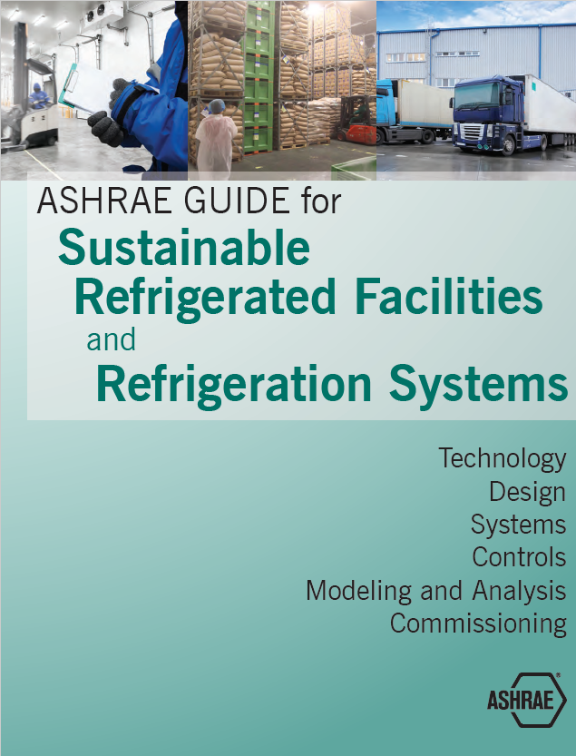
Don’t Forget the “R” in ASHRAE Refrigeration
Plan technical tours of ice rinks, breweries, food processing plants
Use Technical Committees (TC 10 – Refrigeration Systems) for programs topics and news
Partner with other organizations related to refrigeration
Visit Refrigeration (ashrae.org) for more information

Slide 11
ASHRAE Learning Institute (ALI) Chapter Professional Development
Instructor-led seminars
Self-paced courses
Developed and presented by subject matter experts at discounted rates to Chapters
Each seminar uses ASHRAE peer-reviewed materials that provide practical information that can be put to immediate practice
Visit www.ashrae.org/education for more information
Notes:
These are resources to supplement the normal Chapter meeting programs and do provide a value to ASHRAE members.

Slide 12
Distinguished Lecturer (DL) Program
www.ashrae.org/distinguishedlecturers
Chapter receives excellent lecturer to speak on relevant subjects of interest
Opportunity for AIA and GBCI continuing education credits for approved presentations
Society pays lecturer’s transportation to city of event
Opportunity to work with other Chapters to combine DL visits
Notes:
The Presidential Initiatives Master list is updated annually and can be found in the PAOE Newsletter. Try to schedule topics that relate to this list, and some of the initiative topics may earn specific PAOE points for your chapter.

Slide 13
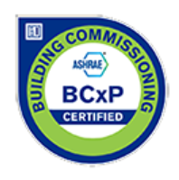
ASHRAE Certification
ASHRAE offers seven certification programs:
Building Commissioning Professional Certification - BCxP
Building Decarbonization Certification – CDP
Building Energy Assessment Professional Certification - BEAP
Building Energy Modeling Professional Certification - BEMP
Certified HVAC Designer - CHD
High-Performance Building Design Professional Certification - HBDP
Healthcare Facility Design Professional Certification - HFDP
Operations & Performance Management Professional Certification - OPMP
Visit www.ashrae.org/certification for more information
Notes:
Hold a presentation giving your members an overview of the available certifications, or dive deeply into a specific certification.

